Slide 1
My Accounts
Randy Rau – Chief Financial Officer
Alex Salazar – Budget Director

Slide 2
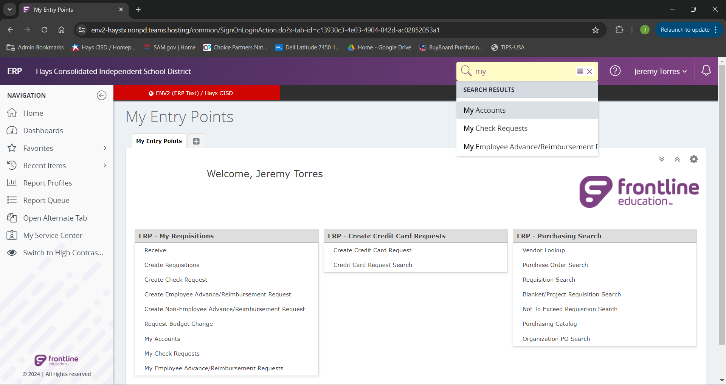
We will being by searching for “My Accounts” and selecting that link.

Slide 3
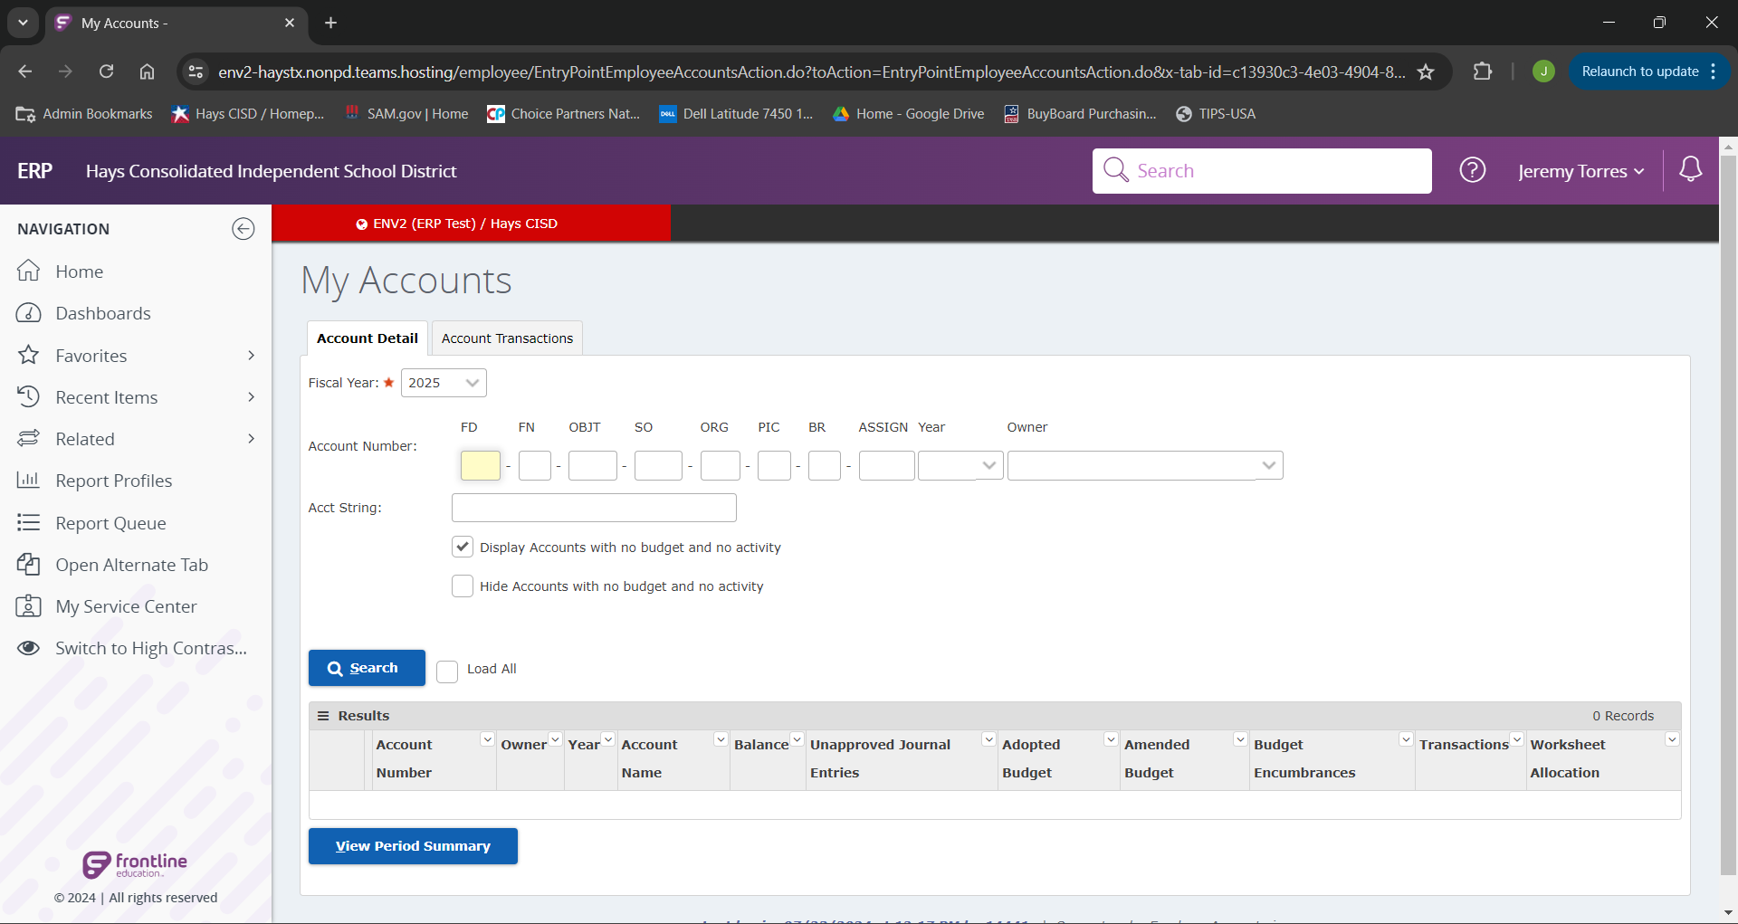
When we arrive on this landing page, we will first verify that out Fiscal Year is correct.
From here we can begin typing the portions of the budgets that we would like to search and click the “Search” button. If you know you only have a smaller amount of budgets, we can just click “Search and it will display all budgets linked to your profile.
Note: We do have the option to either show or hide accounts with no budget or activity. This will be useful if you are only wanting to display useable accounts.

Slide 4
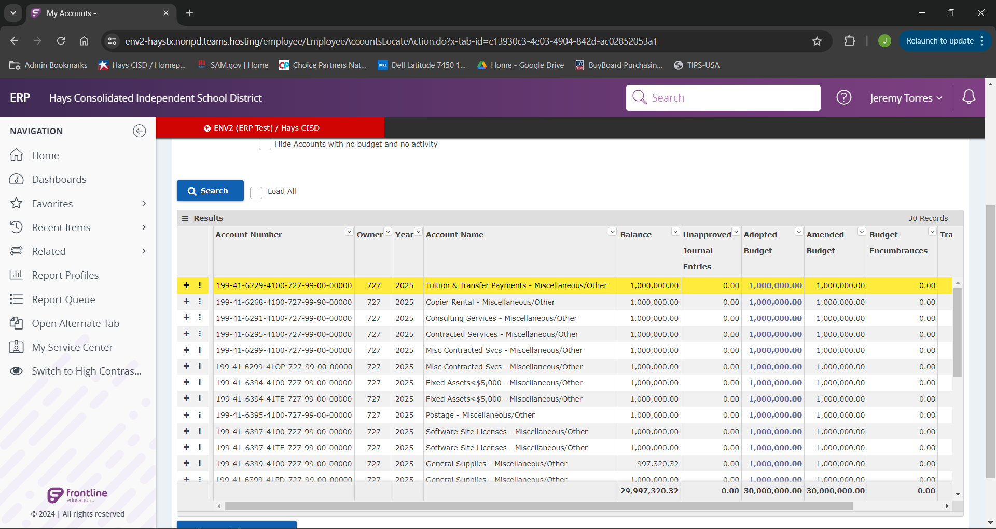
Once we have initiated our search, we will be able to see all available budget codes to us. We can now see our balance, Adopted Budget, and Amended Budget for each of our account codes.

Slide 5
FD – Fund Code
FN – Function Code
OBJT – Object Code
SO – Sub-Object Code (Note: The Sub-object code now is a four digit combination of both the function code, and the original two digits of the Sub-object Code.
ORG – Organization Code
PIC – Program Intent Code
BR – Responsibility Code (Note: the responsibility code now has a zero on the end)
ASSIGN – Assignment Code

