Slide 1
Creating a Project Requisition
Formally Blanket
Nicole Turner, Director of Purchasing
Anston Shockley, Buyer
Wendy Cordero, Buyer
Jeremy Torres, Buyer
Carlos Gavidia, P-Card Administrator

Slide 2
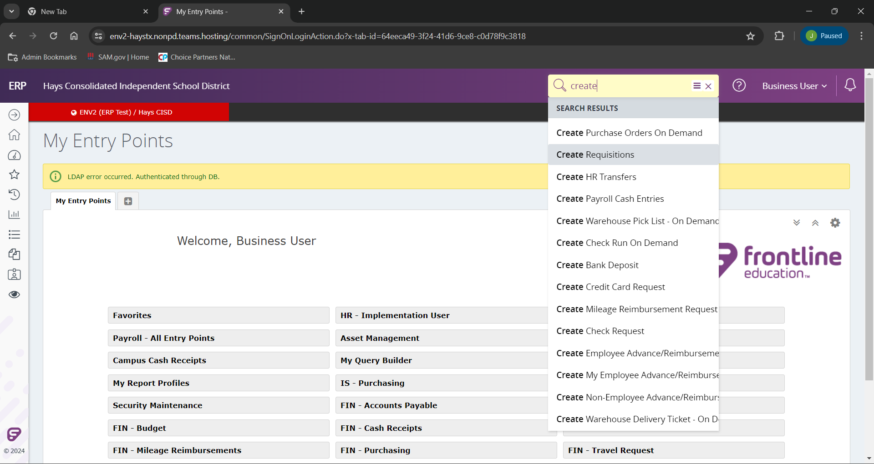
After you have logged into Frontline, to create your requisition we will begin typing the “Create Requisitions” in the search bar as indicated.
As you type in the search field the related inquiries will appear.
Select the “Create Requisitions”.
In a later training we will show you how to find this selection more quickly.

Slide 3
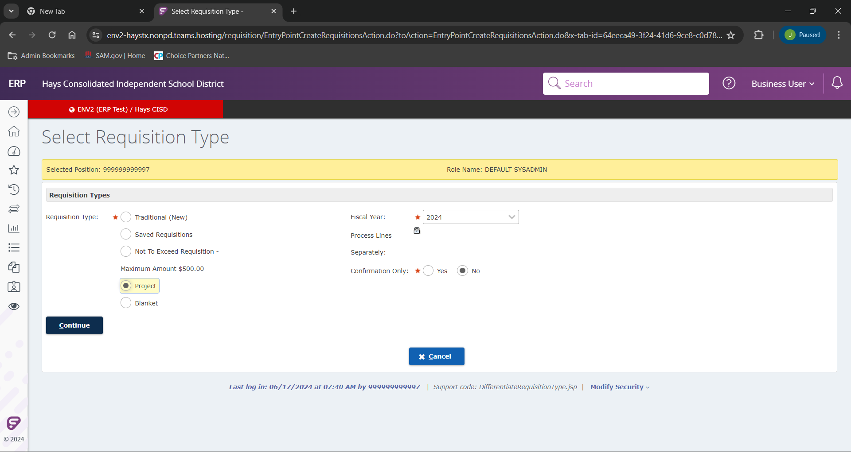
When you land on the “Create Resolution” page you will be prompted to select your type requisition we are going to create. For this example, we are going to select “Project”.
We will need to be sure you have the correct “Fiscal Year” selected as well.
Note: Project Requisitions will not have a cart name as the traditional one do.

Slide 4
Click Continue to the requisition creation.

Slide 5
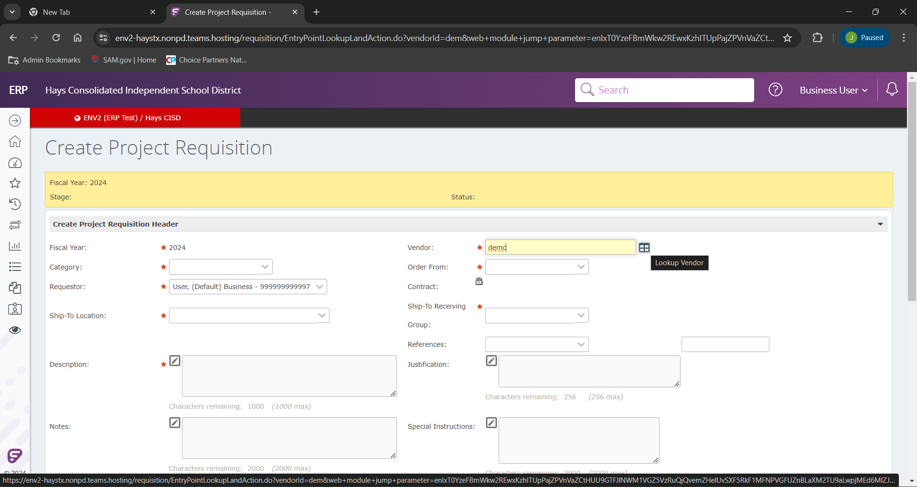
Once on the “Create Traditional Requisition” screen. Our first prompt we will use is the “Vendor”. If you know your vendor name you can begin to typing their name.
If you type in their exact name, it will populate as you click out of that field. If you only know a portion, you can type that portion and either click out of that field, of click the “Lookup Vendor” icon.

Slide 6
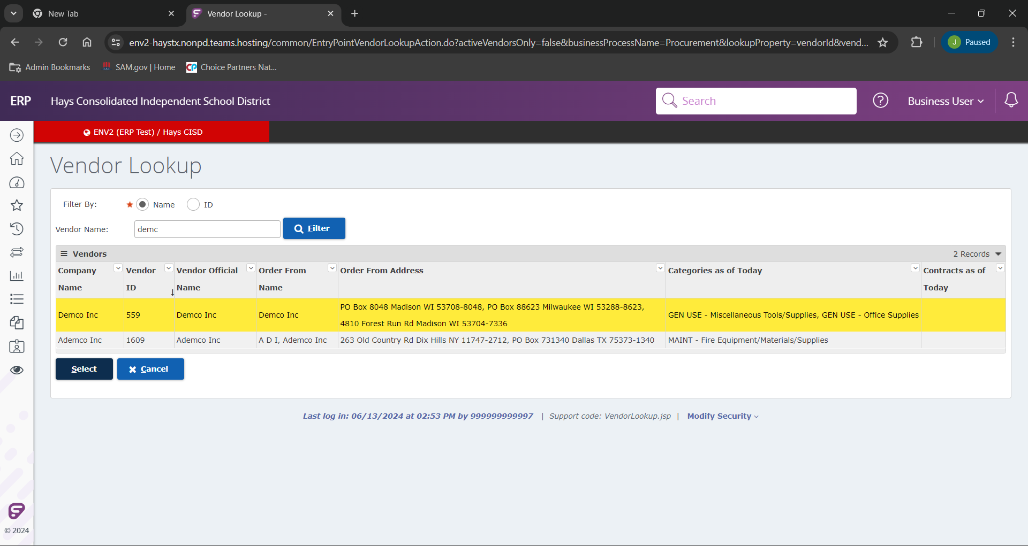
If you clicked out of the “Vendor” field or clicked the “Lookup Vendor” option. We will land on this “Vendor Lookup” page. From here we will select our correct vendor from the search list (In this example we will be using Demco), click the vendor to highlight/ select them.
After we select our vendor, we will click “Select”.

Slide 7
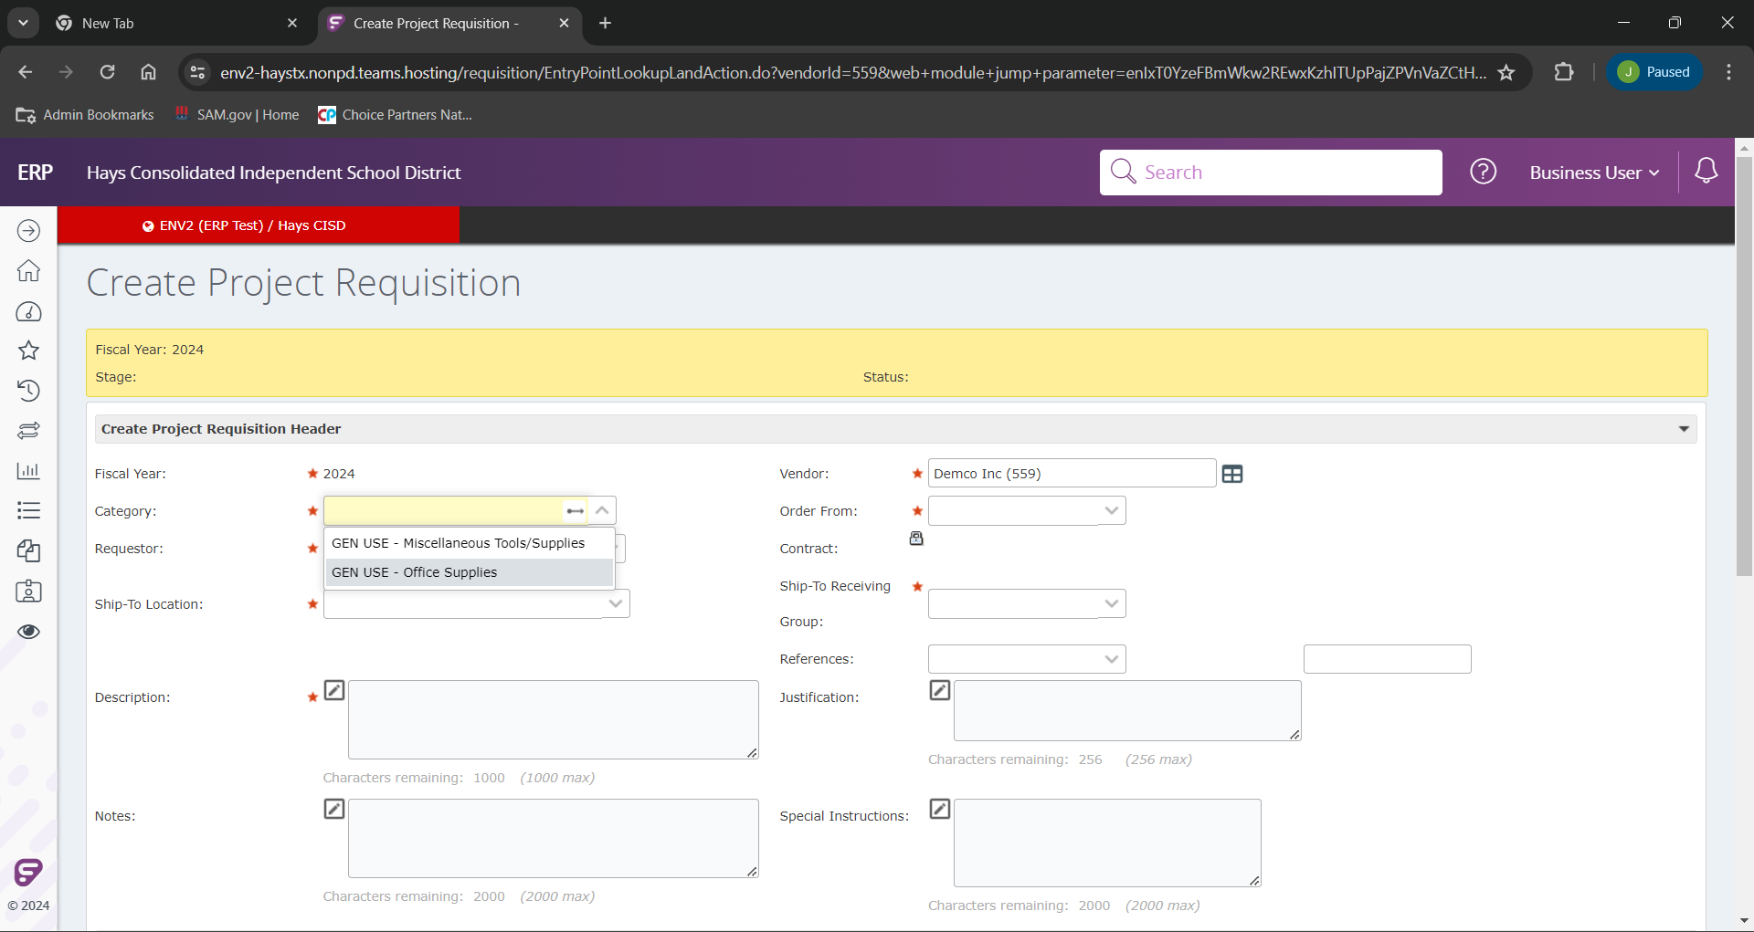
After the vendor is selected, we will chose the correct category in our “Category” field. For this example we are selecting “GEN USE – Office Supplies”.
Please note. As we work through this new ERP together, if there is a vendor that is being used in a different category reach out to Purchasing.Dept@hayscisd.net and we will work to make the appropriate corrections.

Slide 8
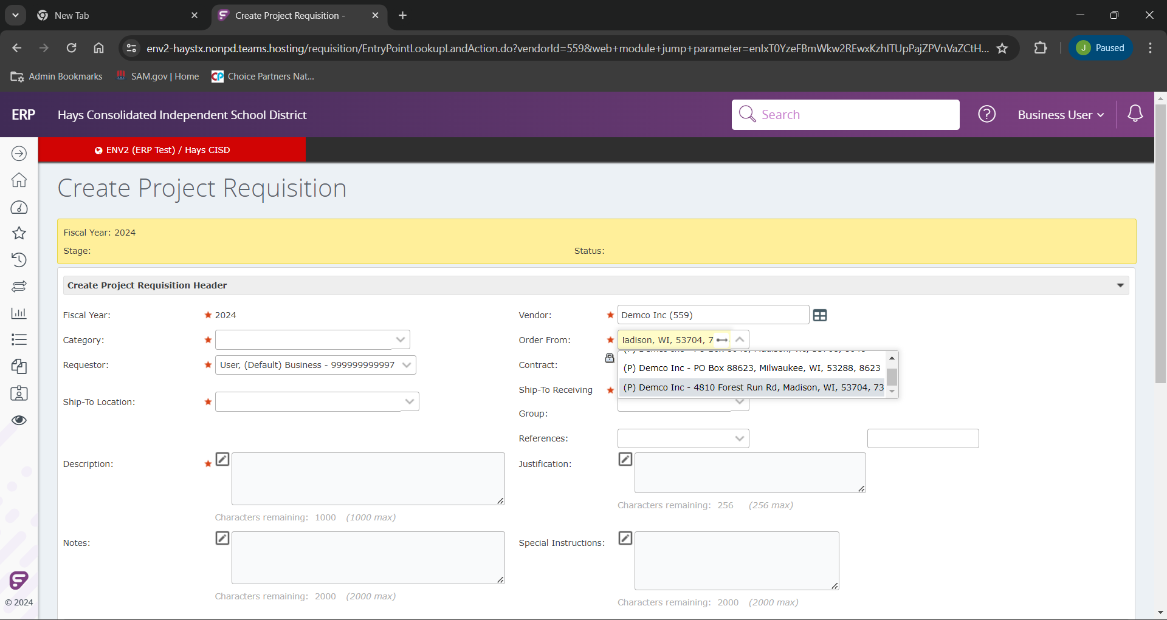
Several vendors will have multiple “Order From” locations. Please be sure to select the one published on your provided quote. In this example we will be using “(P) Demco Inc – 4810 Forest Run Rd, Madison, WI, 53704, 7736”

Slide 9
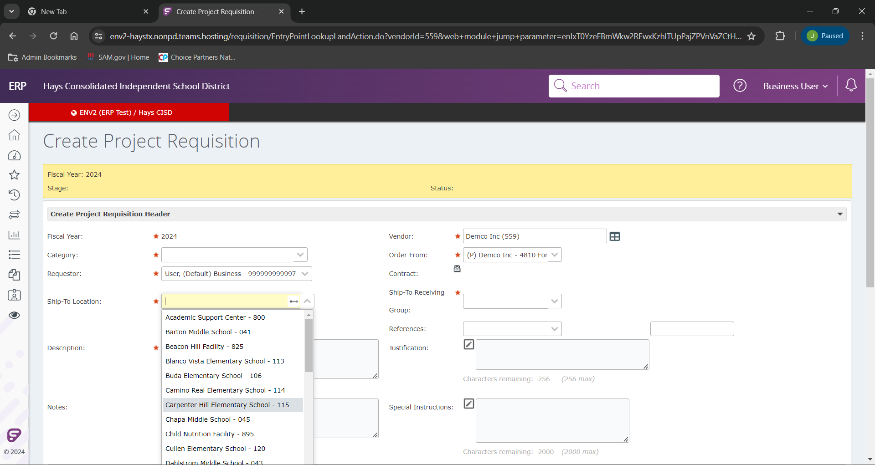
We will next select our “Ship-To Location”. A drop down will show all available options, but you can also begin typing in your location if you choose. In our example here, we will choose Carpenter Hill Elementary.

Slide 10
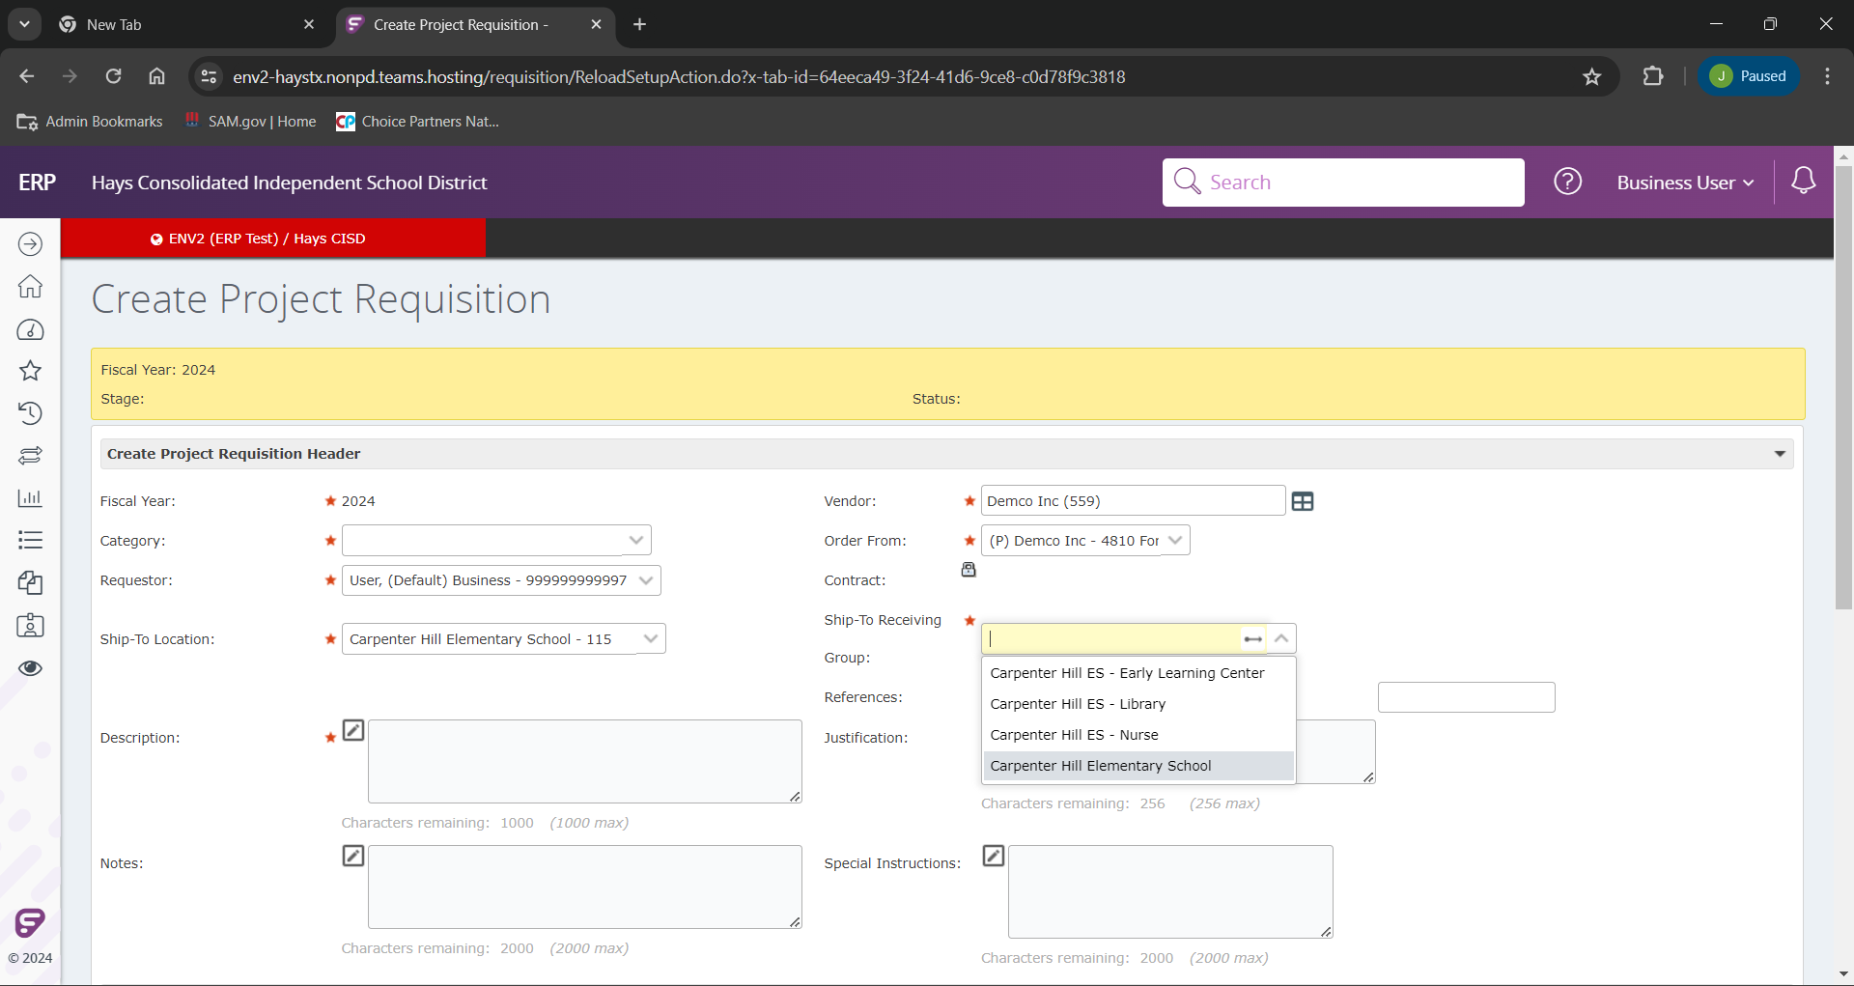
If your location has multiple ship points, you will next the appropriate “Ship-To Receiving Group”. Our example will use “Carpenter Hill Elementary School”.

Slide 11
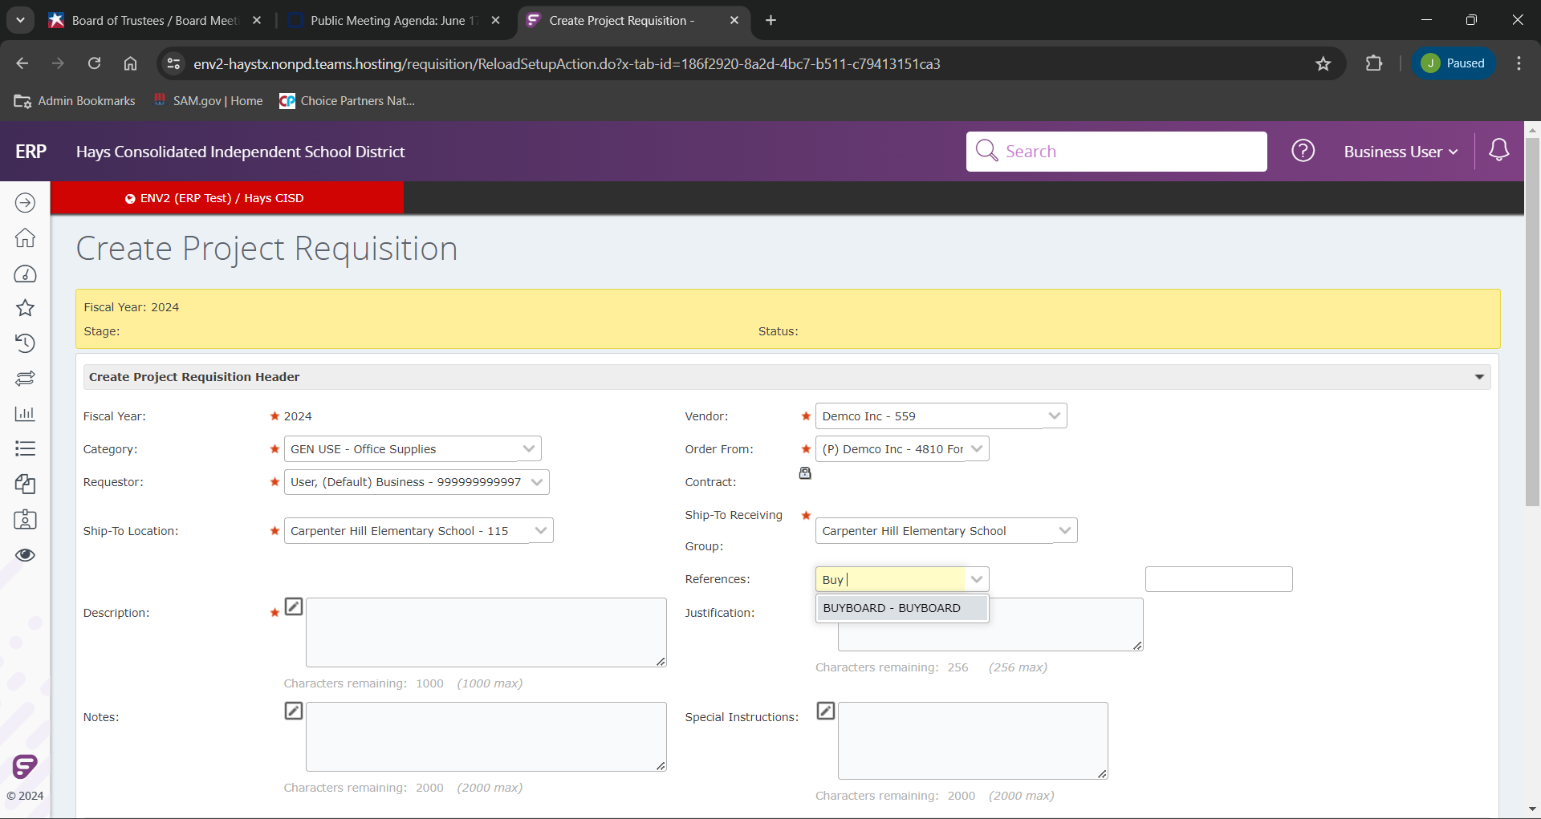
If your requisition will be using a contact number for procurement, you can click into that field and a drop down will populate with our current contacts. (If you don’t see your contract please inquire with the purchasing team).
Your second field will be the actual contract number.
Our example we will use “BUYBOARD” and number 723-22

Slide 12
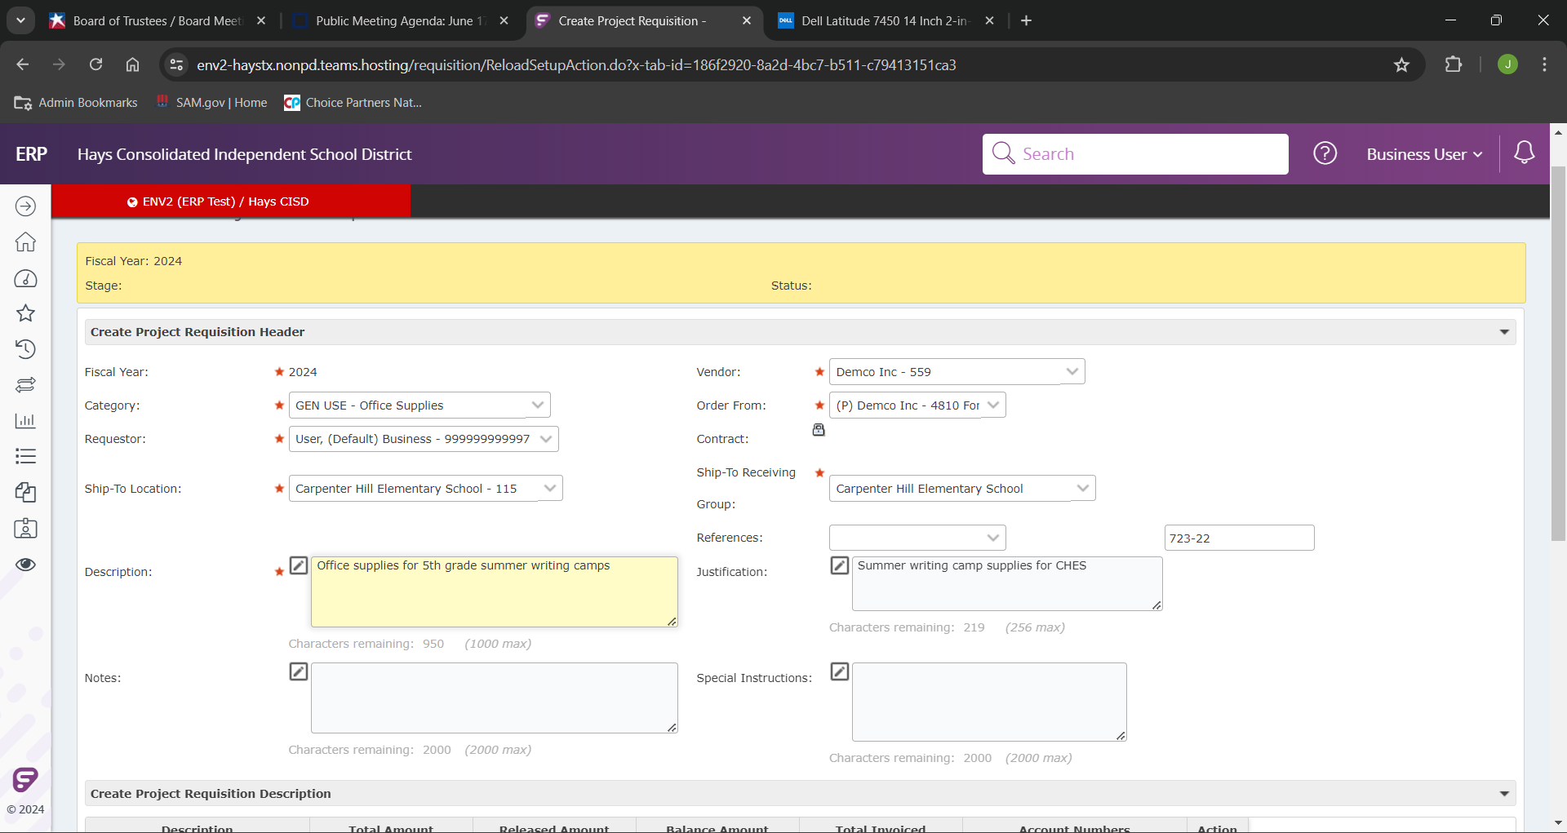
We will then fill out our “Description” field, which will be a detailed description of the product that is being ordered.
Then will add our “Justification” field, on our reasoning for entering our requisition.

Slide 13
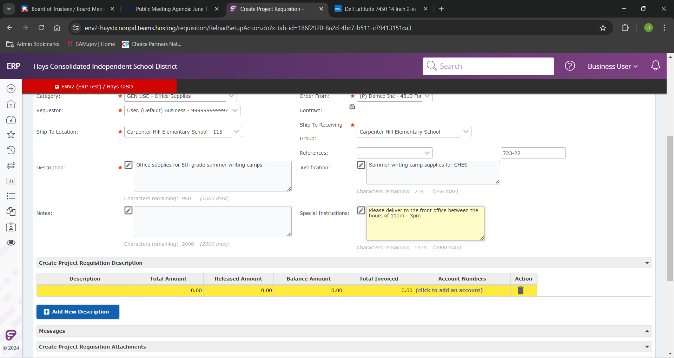
In the “Special Instructions” field we can enter any notes regarding any specific order or delivery notes.

Slide 14
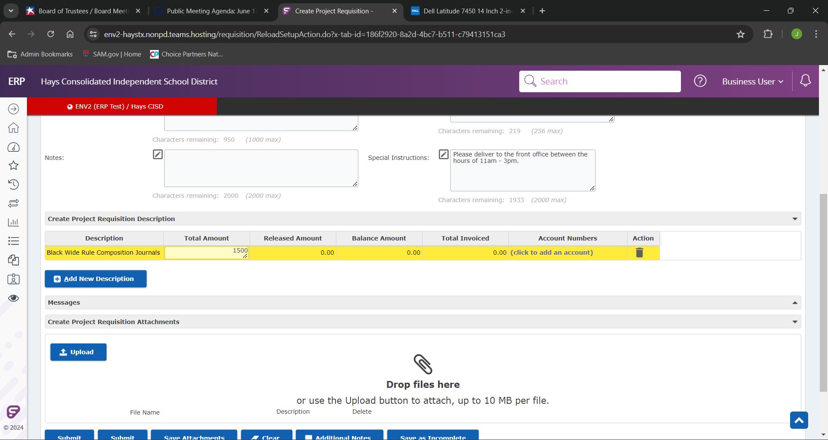
We will enter the most accurate description we can into the “Description” field for the line we are ordering. This can generally be found on the quote or invoice.
This will then be followed by the estimated cost for the materials being ordered in the “Total Amount” field.

Slide 15
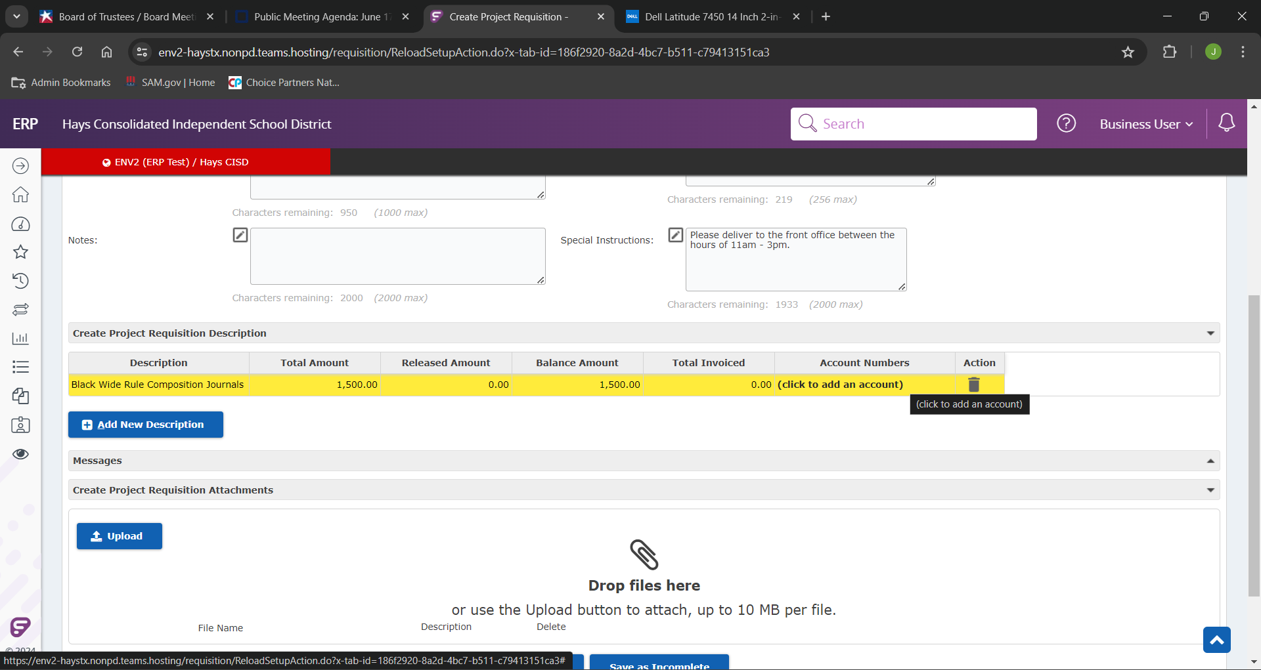
We can next add our budget code by clicking “(click to add an account)” in the “Account Numbers” field.

Slide 16
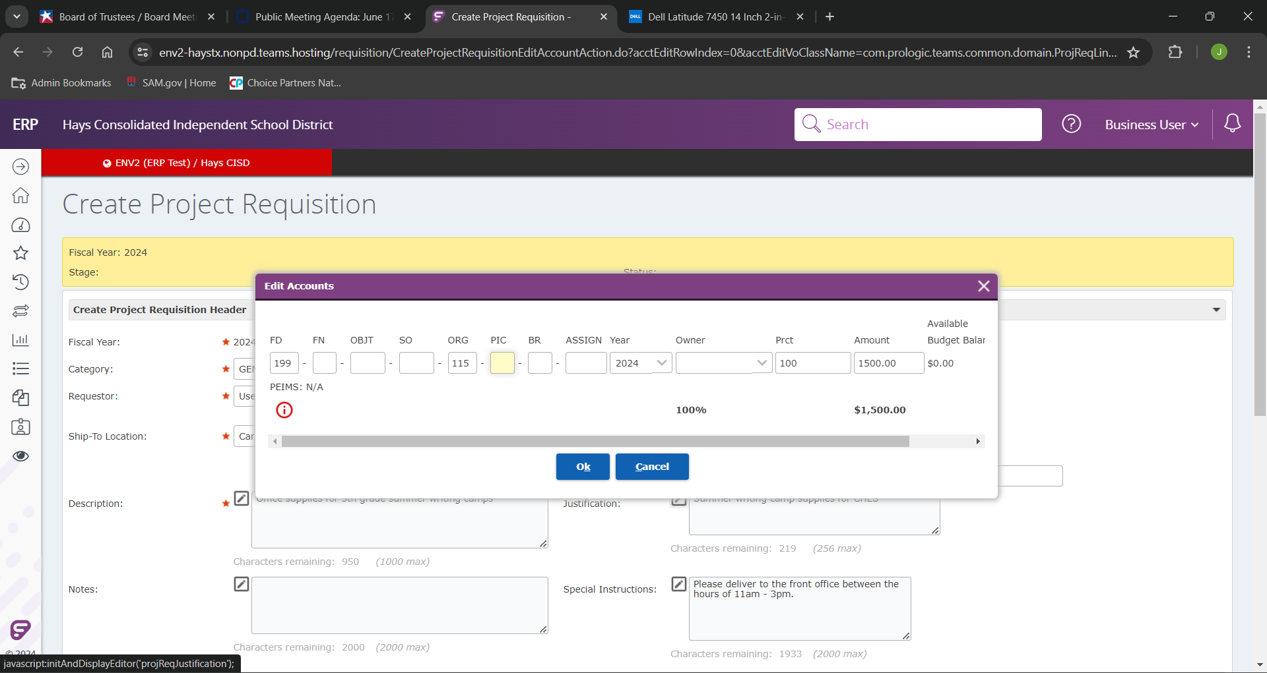
If you know you budget code you can type in manually.
If you would prefer to search it and see the available funds on the budget code, you can begin typing parts you know.

Slide 17
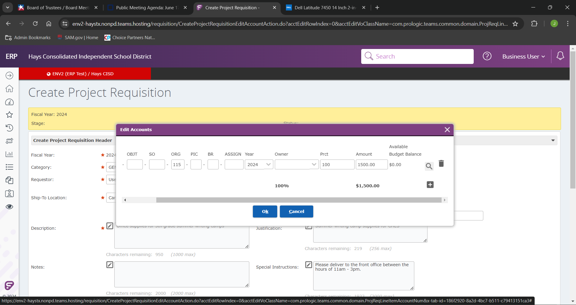
Click the magnifying class to initiate the search.

Slide 18
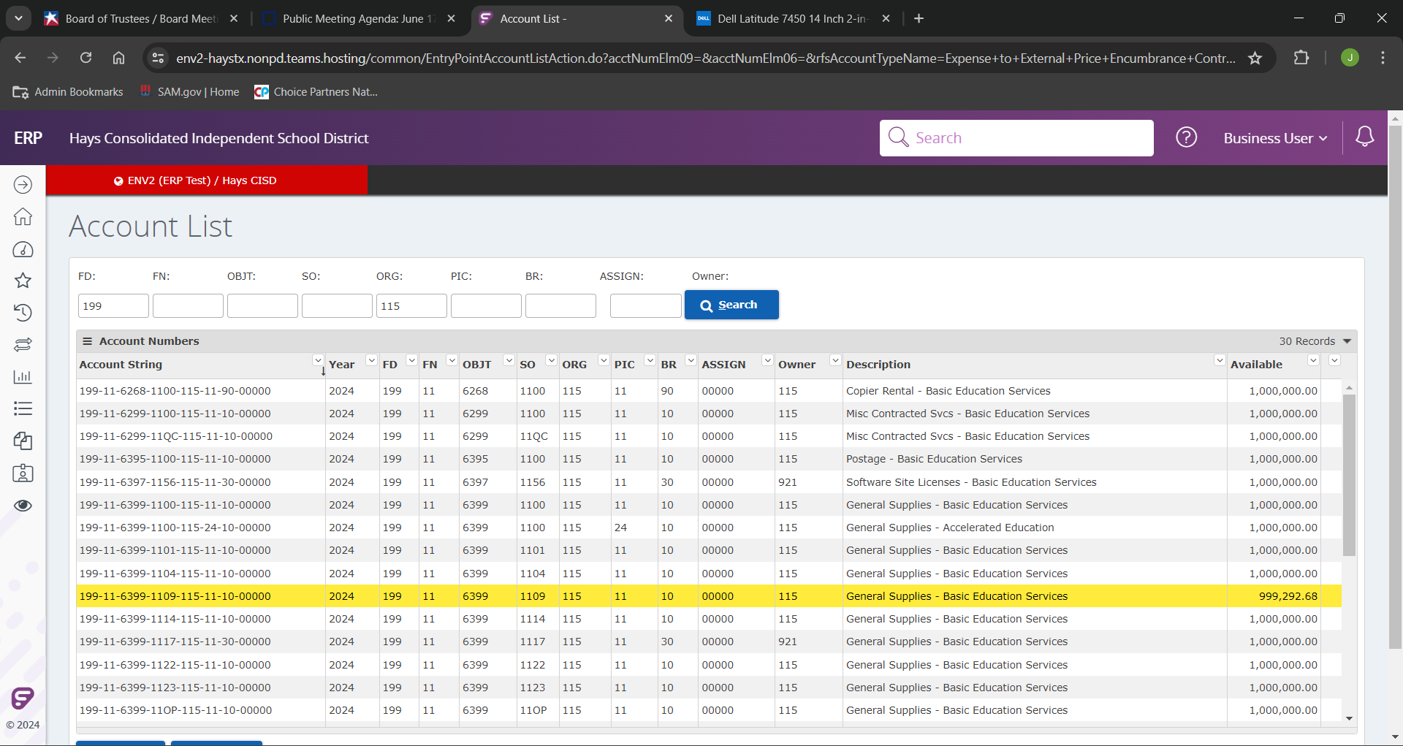
Select the desired budget line (See the last column, "Available”, to see the account balance)

Slide 19
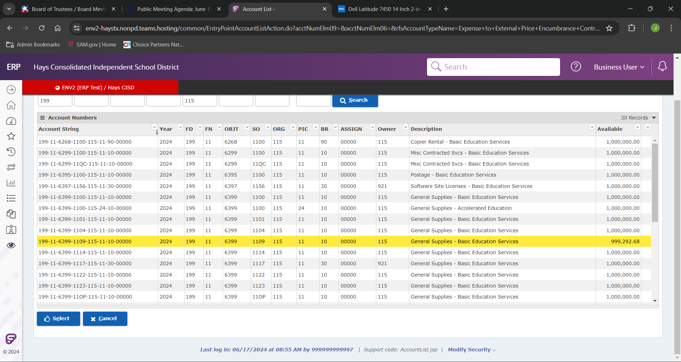
As we have our desired budget selected, we can finalize our selection by clicking “Select”.

Slide 20
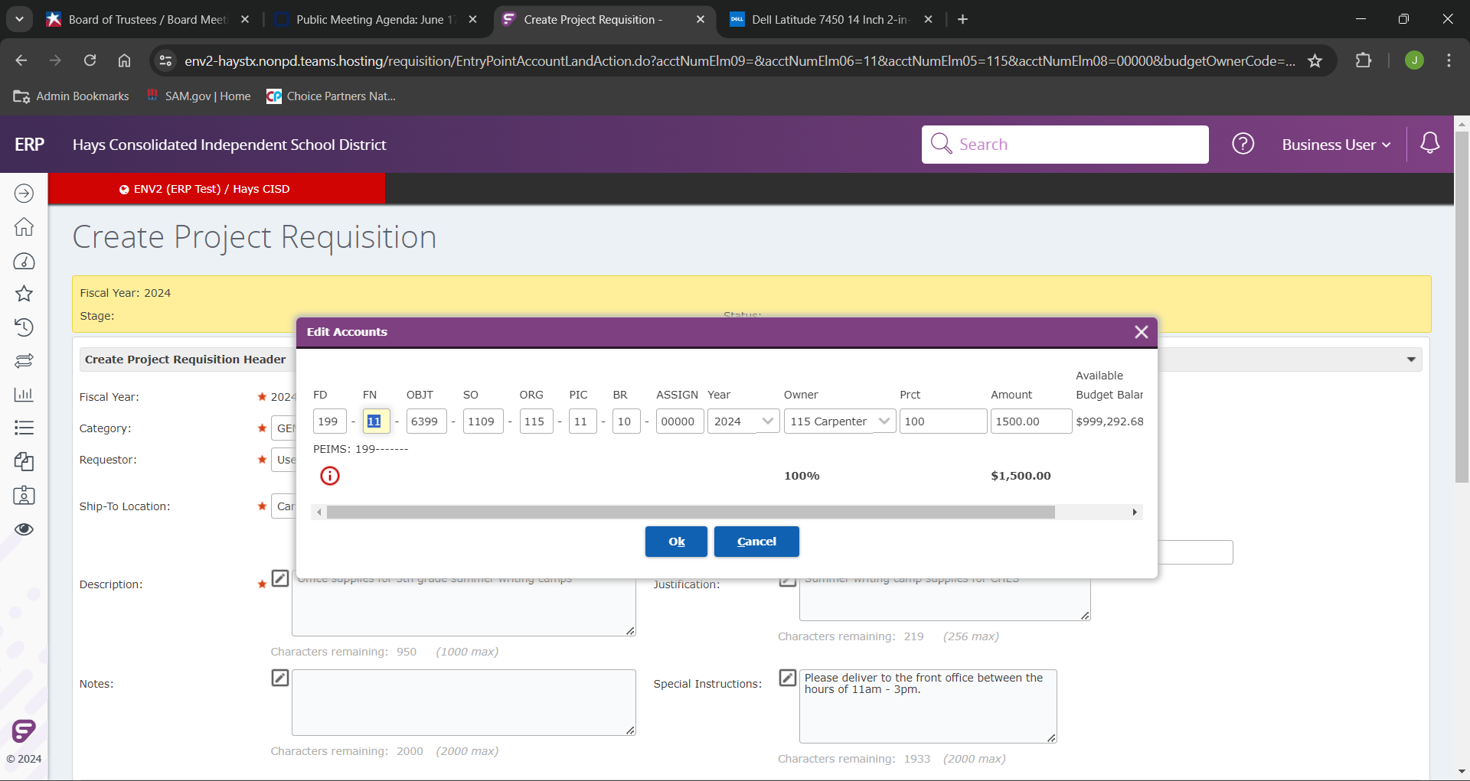
We can now see the budget line has been completed.
As we verify the budget line is correct, click “Ok (save current line)” to add the budget code to the line we are creating.

Slide 21
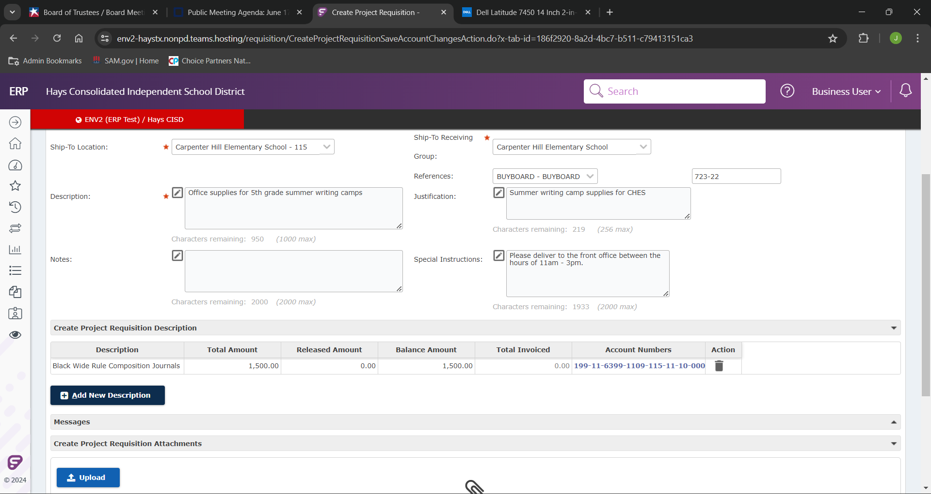
If we would like to add a second line on our project requisition, we can click “Add New Description”.

Slide 22
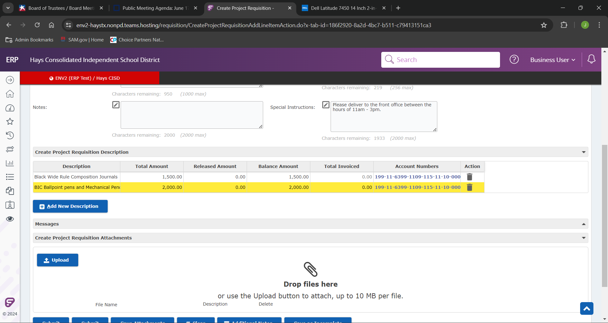
We then will enter the next description and blanket amount for the new line.
Note: If adding a new line the account number will auto-populate from the previous line.

Slide 23
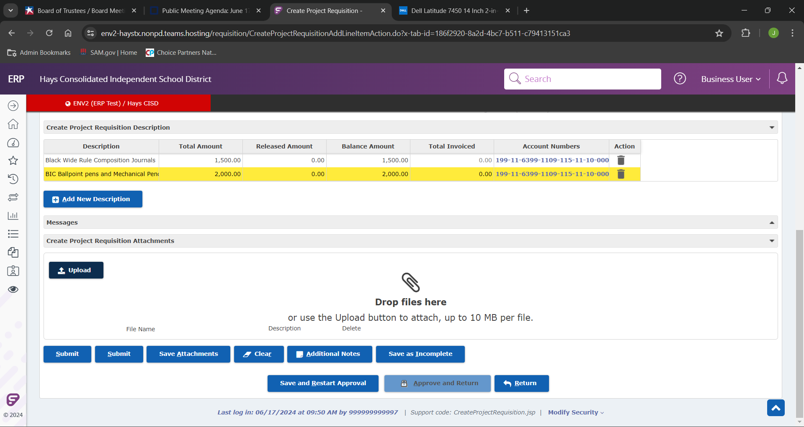
If we have any supporting documentation we can upload any emails, quotes, or invoices by selecting “Upload”.

Slide 24
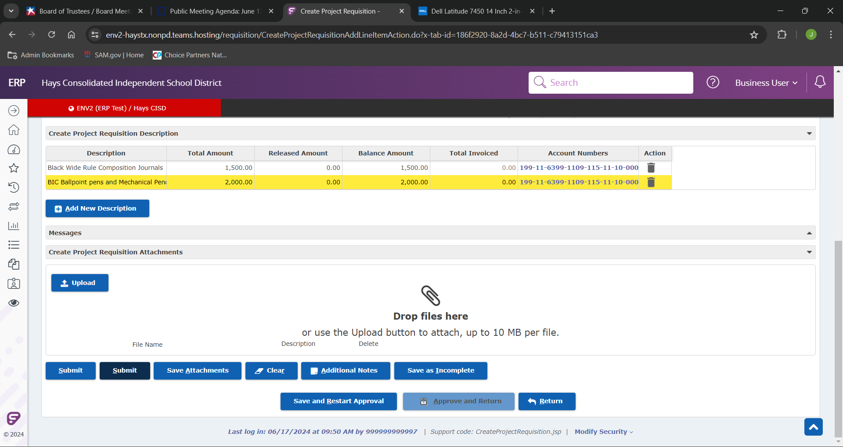
To finalize our project requisition we will click “submit”.

Slide 25
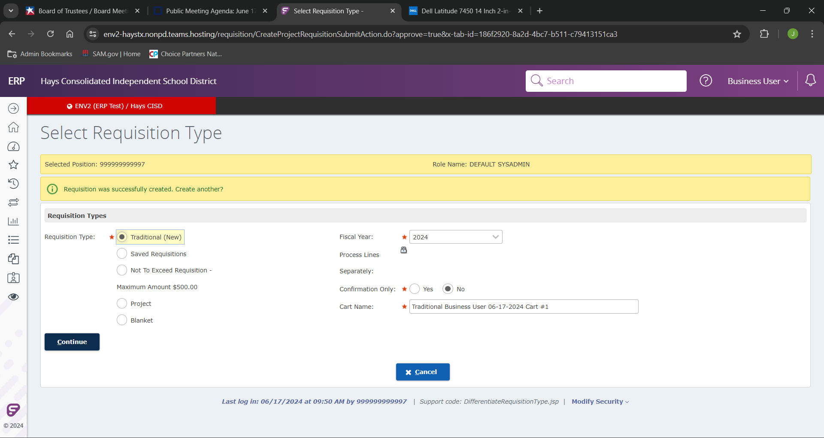
If we did everything correctly, we will see the above message.

Slide 26
If you have any further questions please reach out to any of the purchasing team listed on the cover, or email the entire team at purchasing@hayscisd.net

