Slide 1
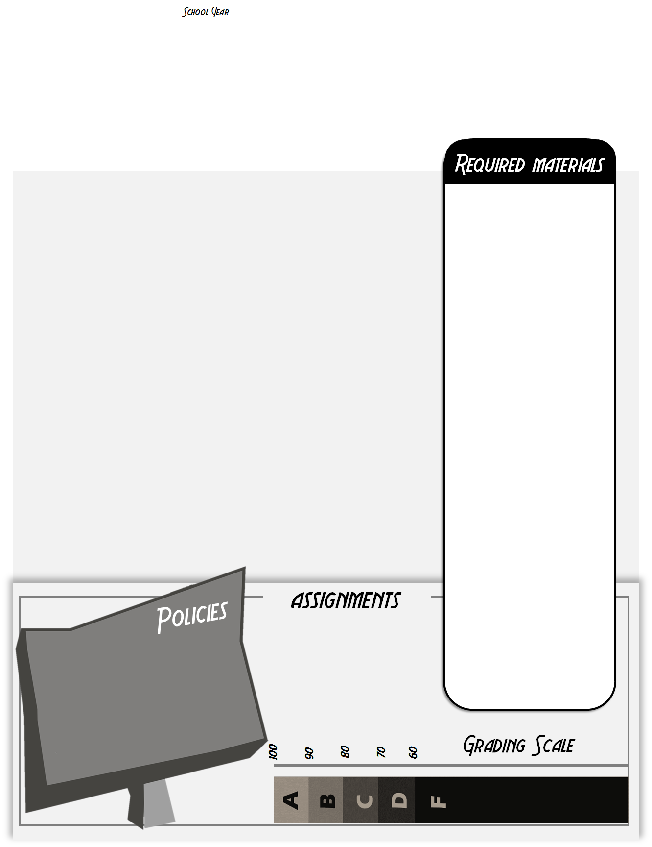
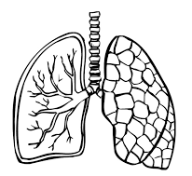
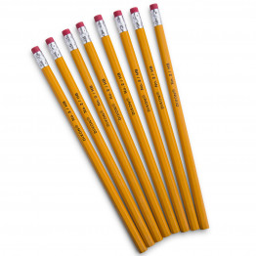
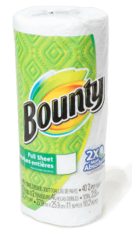
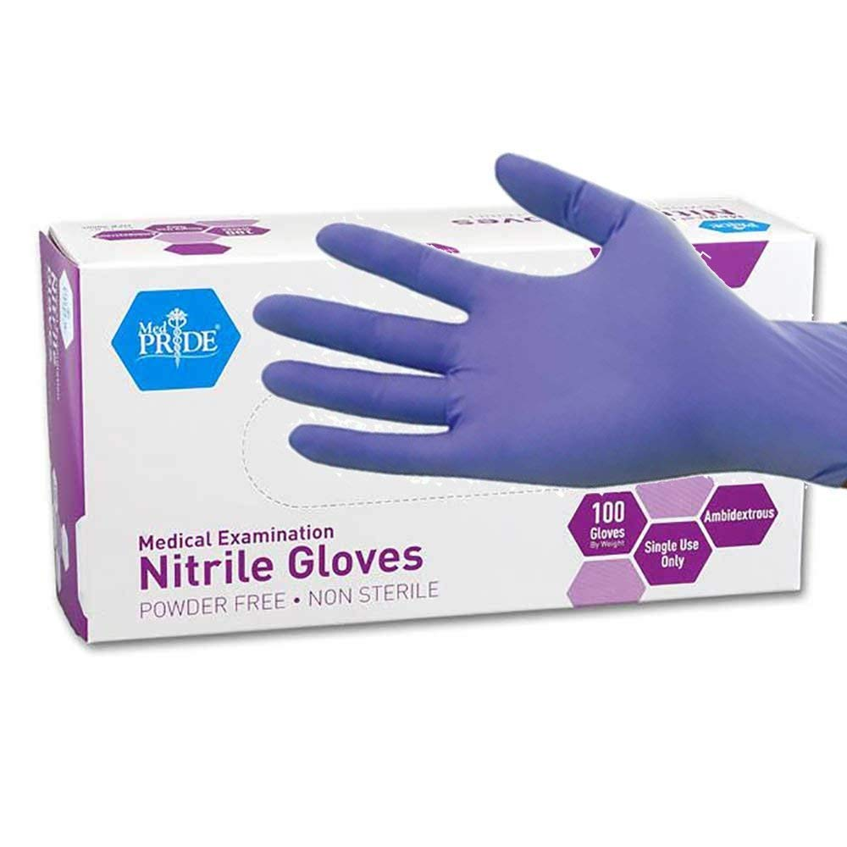
2019-2020
Medical Interventions
Ms. Robertson
Classroom Google Code: leah.robertson@hayscisd.net Lehman High School C100 512-268-8454
We will investigate the variety of interventions involved in the prevention, diagnosis, and treatment of disease as they follow the lives of a fictitious family. A “How-To” manual for maintaining overall health and homeostasis in the body, the course will explore how to prevent and fight infection, how to screen and evaluate the code in our DNA, how to prevent, diagnose, and treat cancer, and how to prevail when the organs of the body begin to fail. We will learn about a wide range of interventions related to immunology, surgery, genetics, pharmacology, medical devices, and diagnostics. Each family case scenario will introduce multiple types of interventions, reinforce concepts learned in the previous two courses, and present new content. Interventions may range from simple diagnostic tests to treatment of complex diseases and disorders. These interventions will be showcased across the generations of the family and will provide a look at the past, present, and future of biomedical science.
You will need the following materials DAILY
Composition Book
Folder
Pencils
Colored pens
(I will provide for you!)
If you are absent, it is YOUR responsibility to check Google Classroom and the gradebook for the work you missed.
Check with another student about what you missed.
Check with Ms. Robertson once you have an idea of the work that was missed. Ask for any handouts and clarify directions/due dates.
If you have questions, need to make up a lab or need help, arrange a time to come in outside of school.
Please bring the following materials by the end of the first week
Internet & Classroom Google
Kleenex
or
a roll of paper towels
or
Nitrile gloves
(your size)
There is not a textbook for this class. Instead, all curriculum is online. We use web resources and lab work to learn. You can access the curriculum through myPLTW.org, Inkling Axis app and on our Google classroom.
The best way to stay connected is by logging onto Classroom Google and the gradebook. Students and parents can sign up for Google Classroom and gradebook notifications. If you need help, feel free to ask me.
Major grades = 60%
Daily grades = 40%
Late work: maximum grade = 70%
Missing work = 0 (MSG in gradebook)
NO CHEATING: no copying work from other students or from the internet. This will result in a 0.
If you have a smartphone please download these free apps— Google Classroom, Google Drive, Gmail, Inkling Axis.

