Slide 1
Logging In

Slide 2
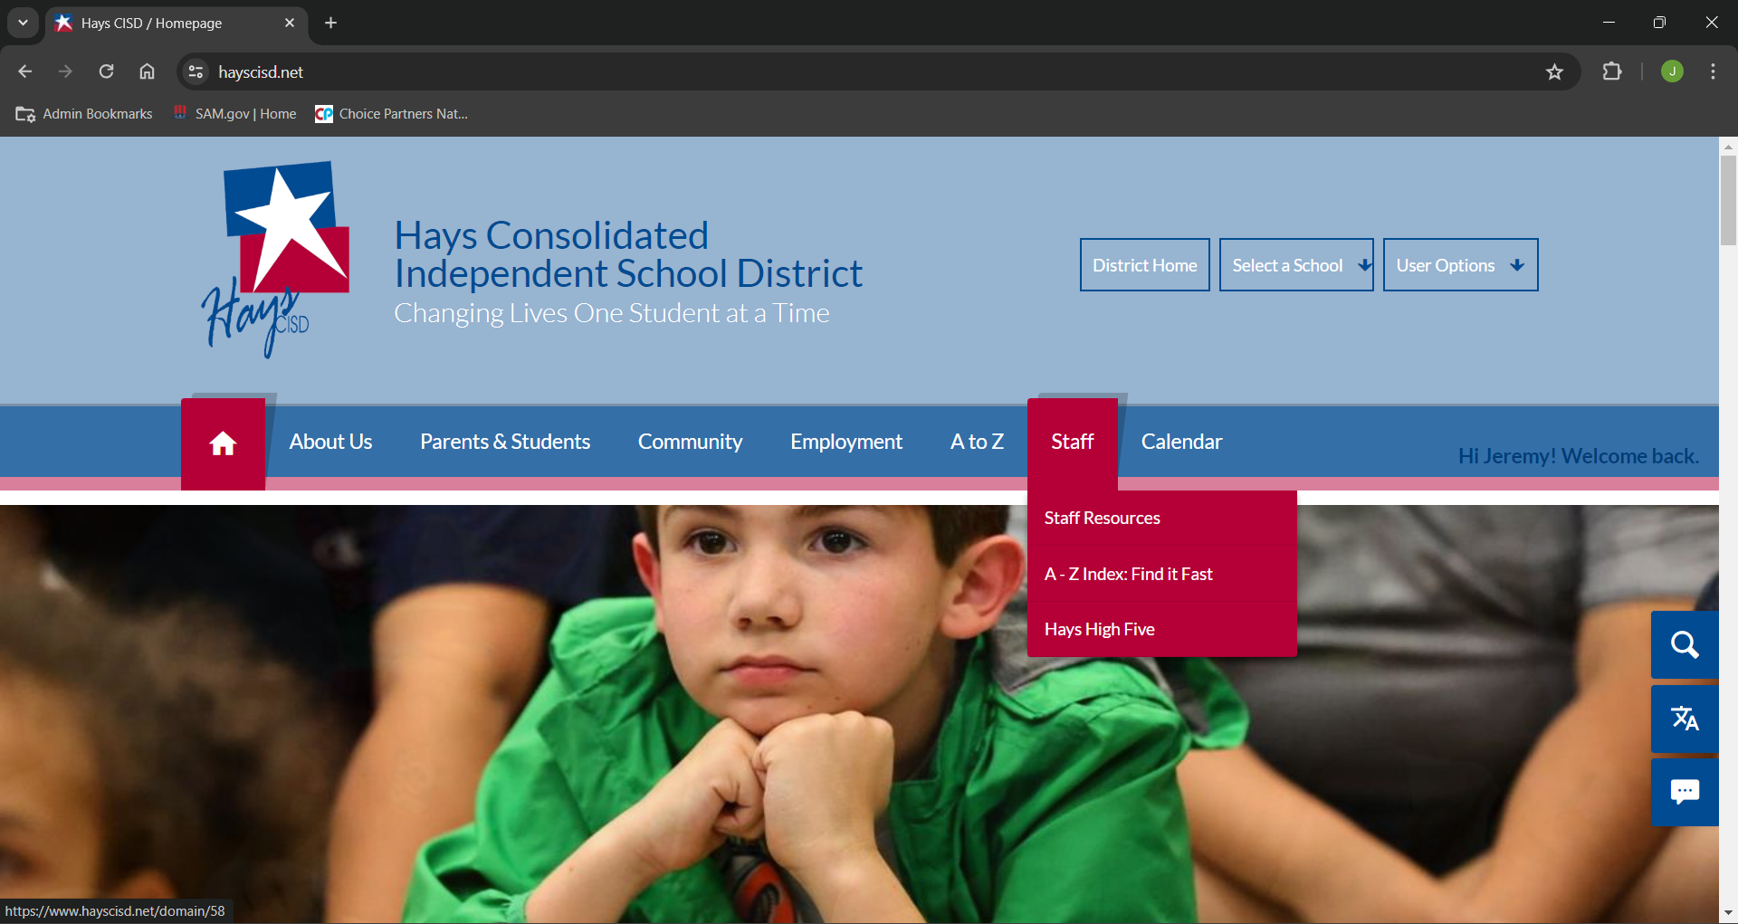
To login to the new frontline ERP select “Staff Resources” under the “Staff” link on the Hays CISD homepage.

Slide 3
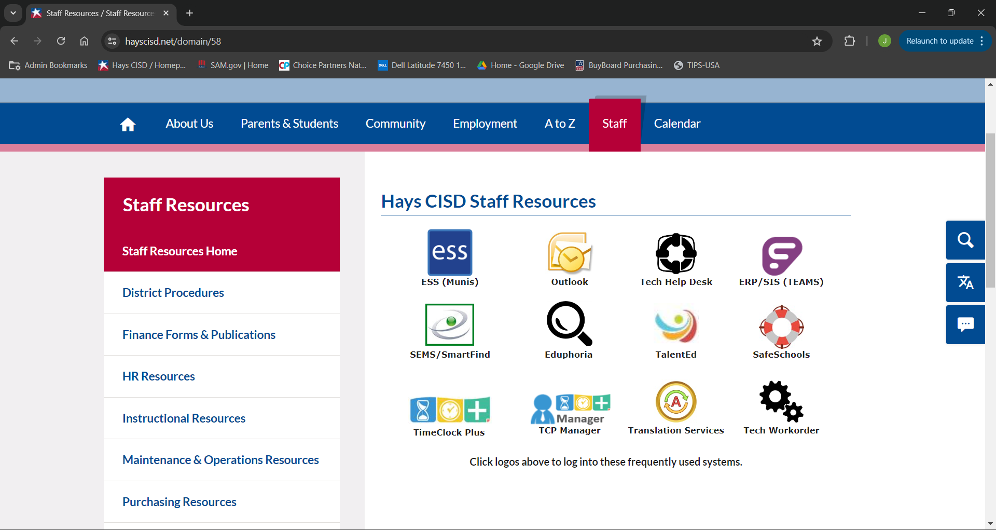
Click the “TEAMS” link to open up the ERP.

Slide 4
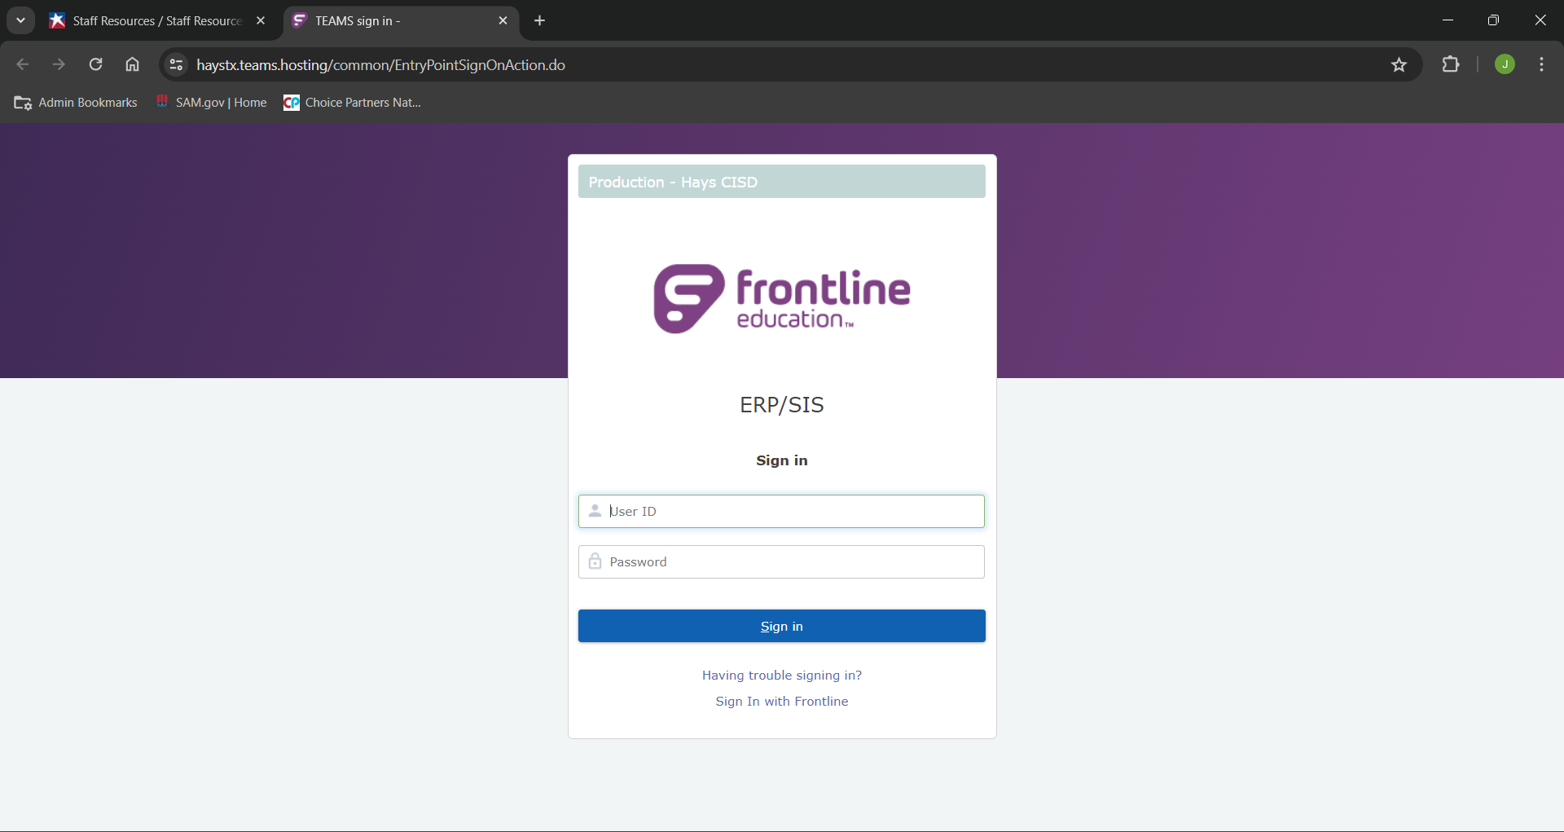
To Login use your Hays CISD credentials.

Slide 5
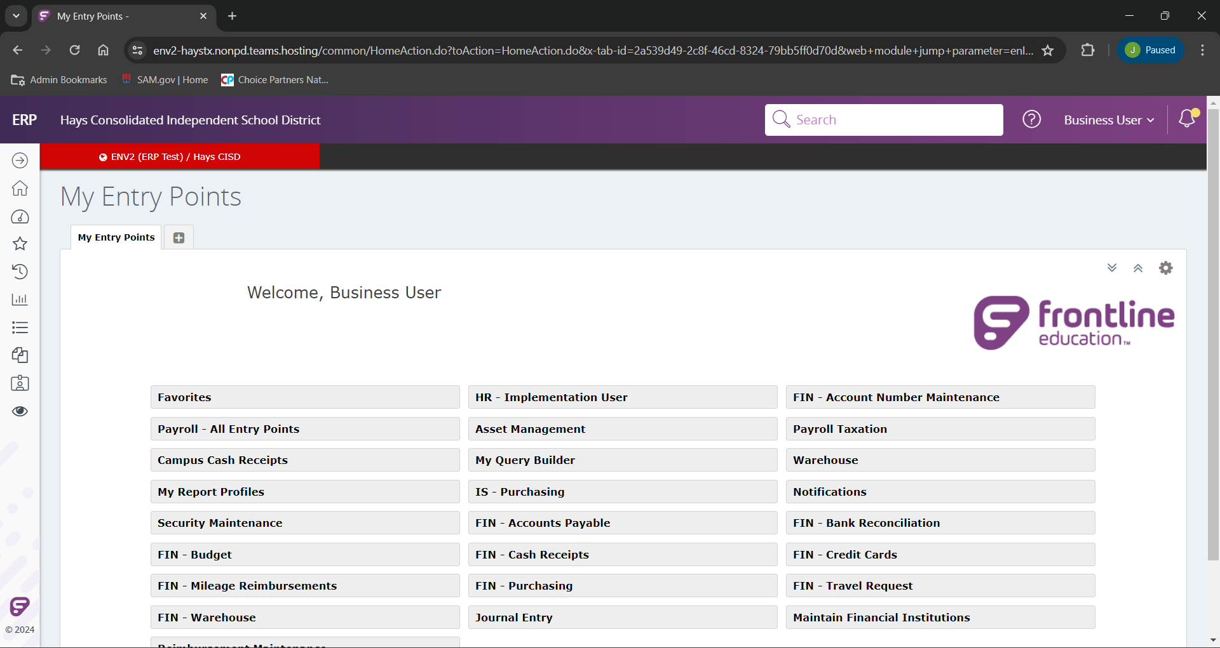
When you login you will land on the “My Entry Points” or homepage for frontline. Here you will have all of the links you are able to access in your respective roles.

Slide 6
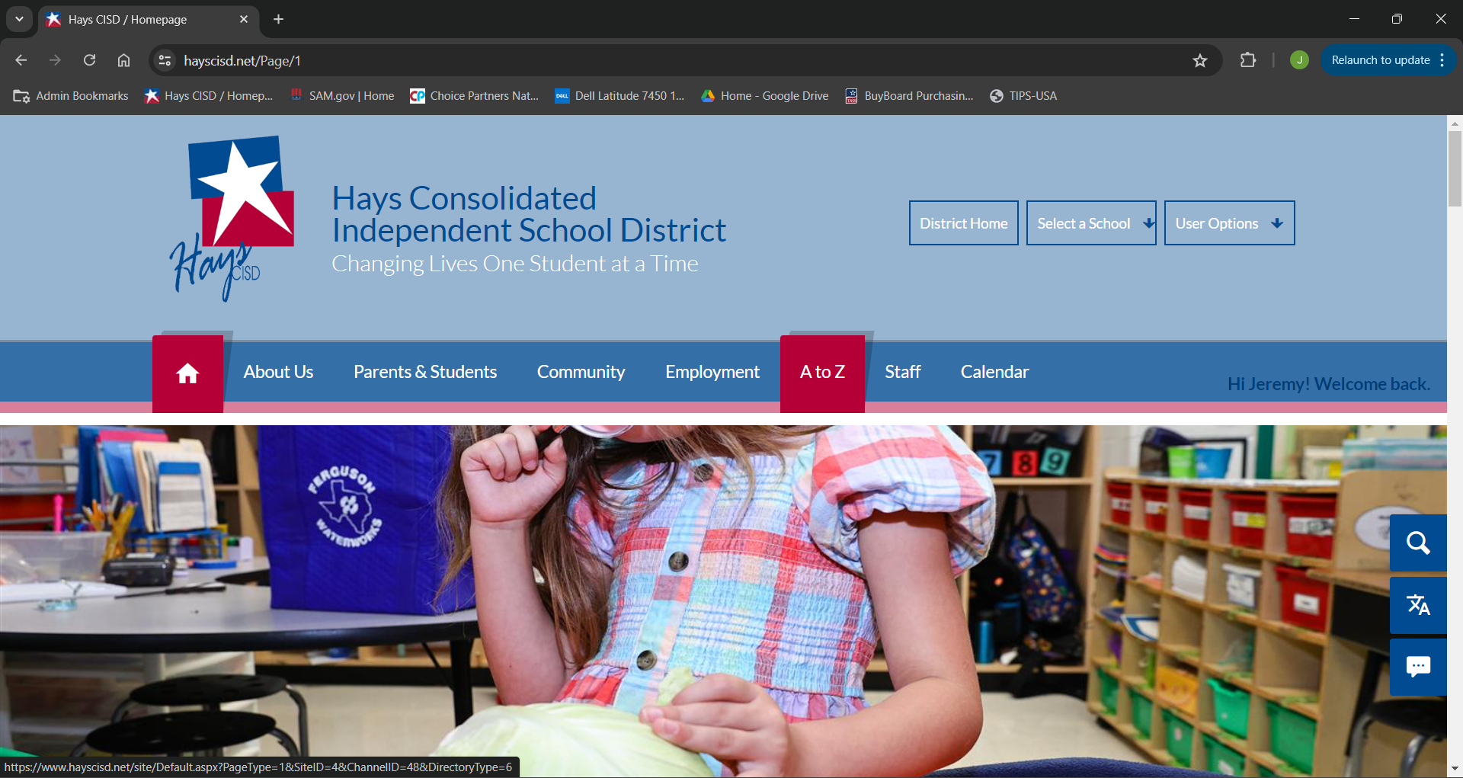
Alternatively, from the homepage, we can click “A to Z”.

Slide 7
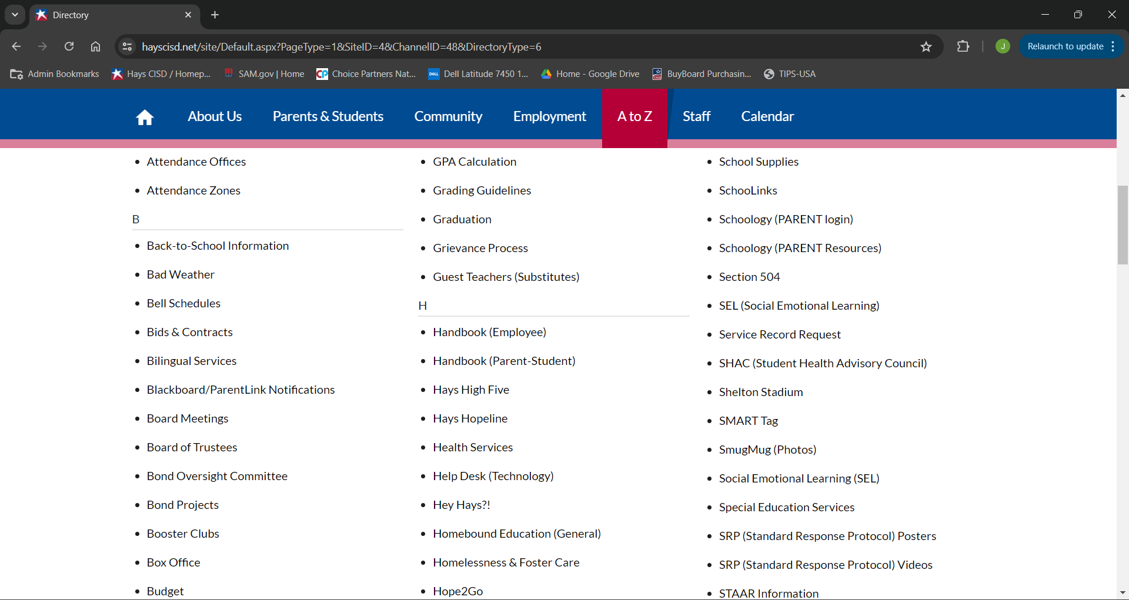
In our A to Z we will scroll down to, and select “Help Desk (Technology)”

Slide 8
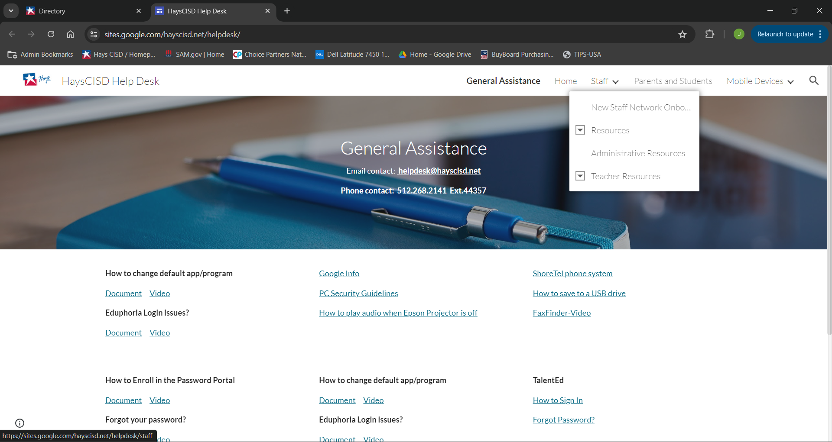
When you login you will land on the “My Entry Points” or homepage for frontline. Here you will have all of the links you are able to access in your respective roles.

Slide 9
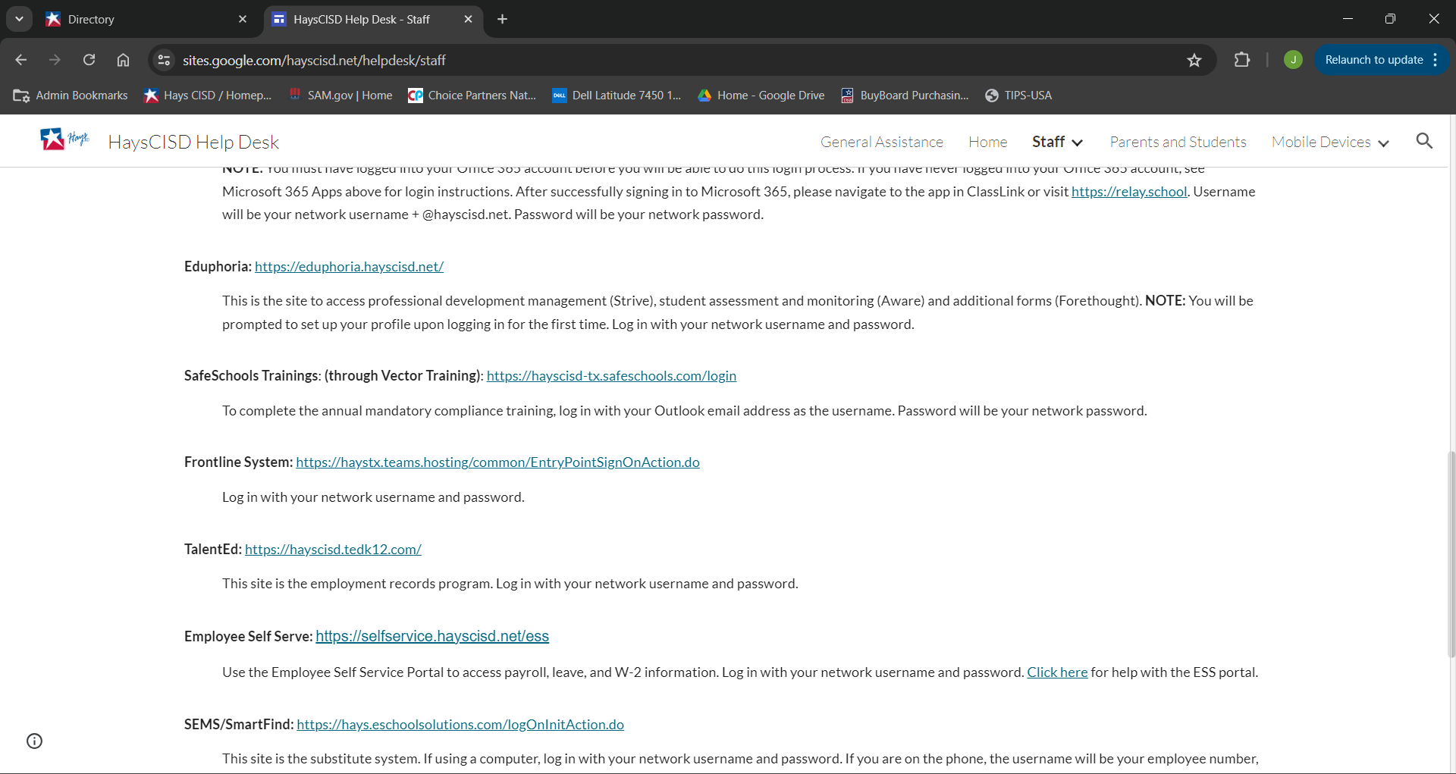
When you login you will land on the “My Entry Points” or homepage for frontline. Here you will have all of the links you are able to access in your respective roles.

