Slide 1
Receive on Credit Card
Nicole Turner, Director of Purchasing
Carlos Gavidia, P-Card Administrator
Anston Shockley, Buyer
Wendy Cordero, Buyer
Jeremy Torres, Buyer

Slide 2
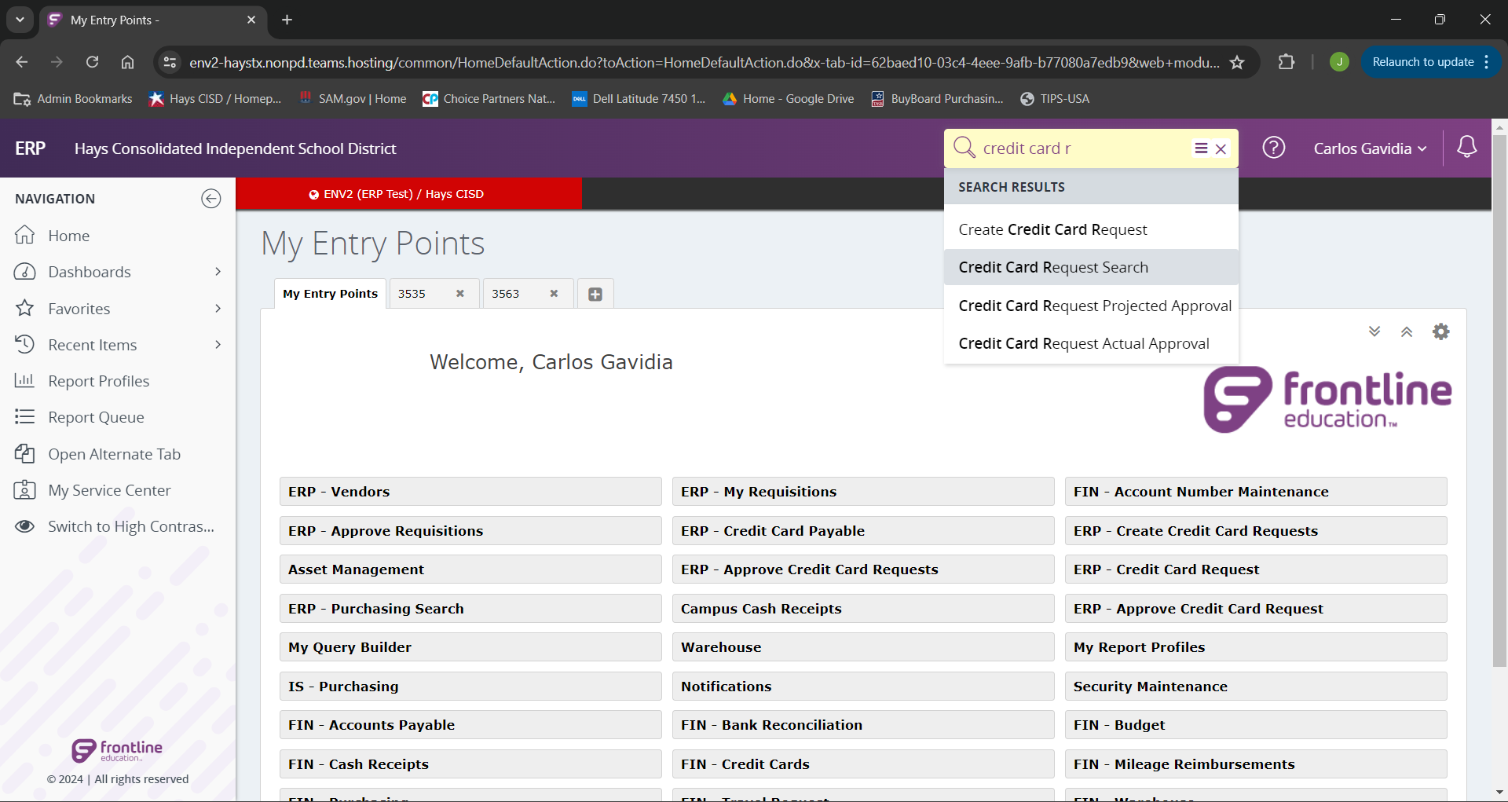
Begin by searching “Credit Card Request Search” from the landing page.

Slide 3
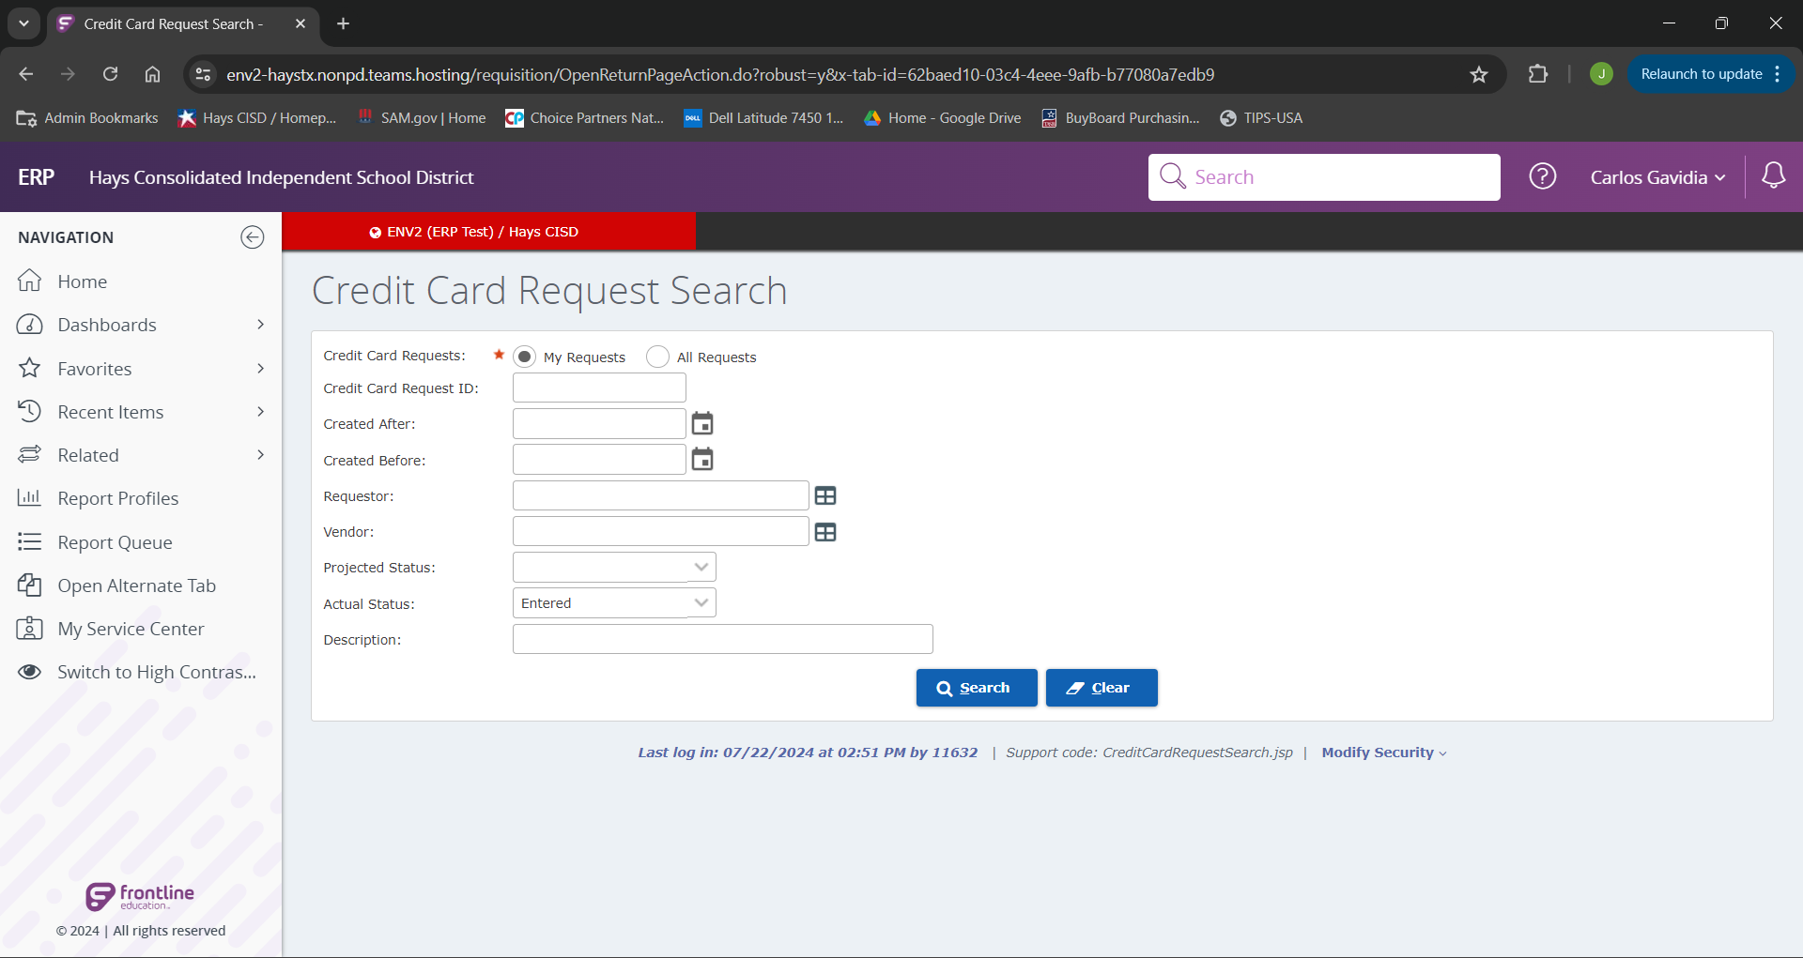
From here we should only be able the select “My Request”.
If we have written down your “Credit Card Request ID” we can search by it now.
If we are unsure of our Credit Card Request ID, we can search for it by any of the above criteria.
Note: If we search “Actual Status” as “Entered” It will only bring up Credit Card request that need to be received on.

Slide 4
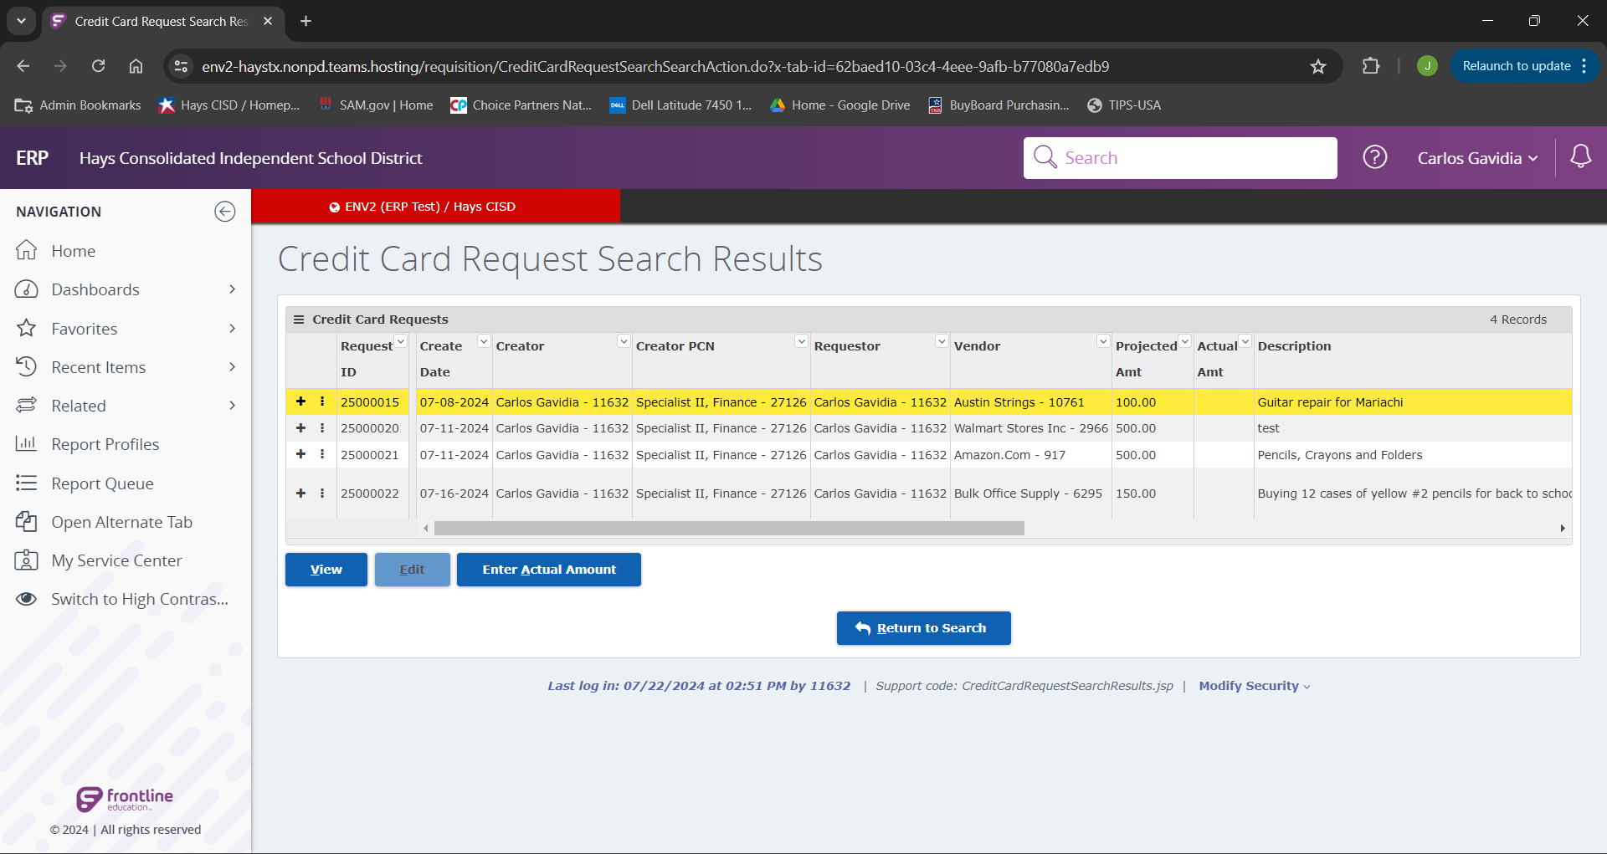
Once we have identified our desired credit card request, we will click to highlight it, the click the “Enter Actual Amount” button.

Slide 5
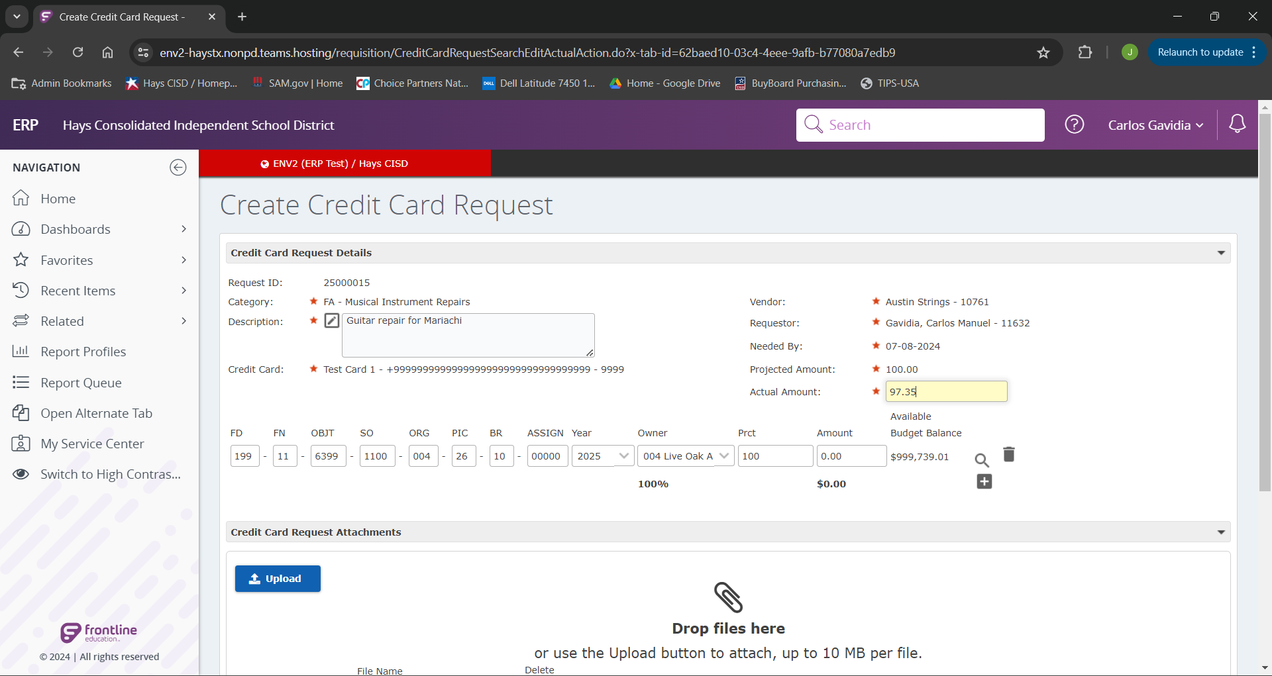
We will then add the actual amount of the purchase into the “Actual Amount” field.

Slide 6
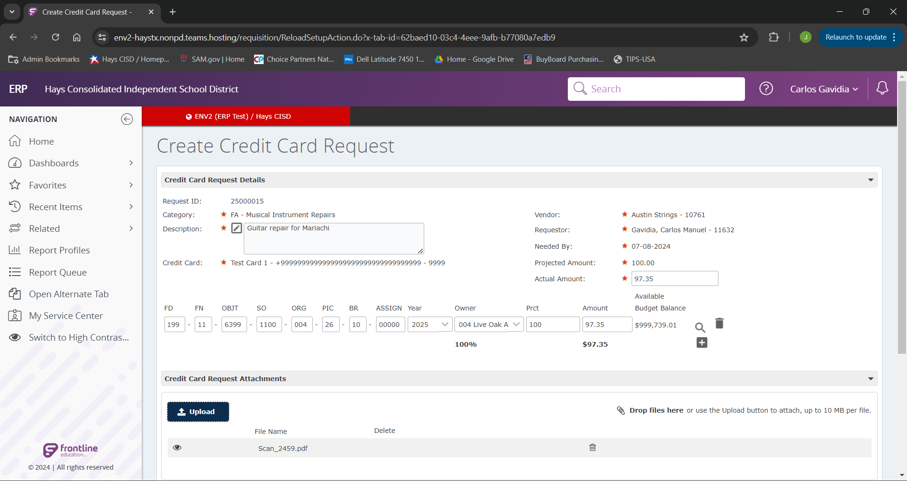
Our next step is to click “Upload” and add all of our receipts for the credit card purchase.

Slide 7
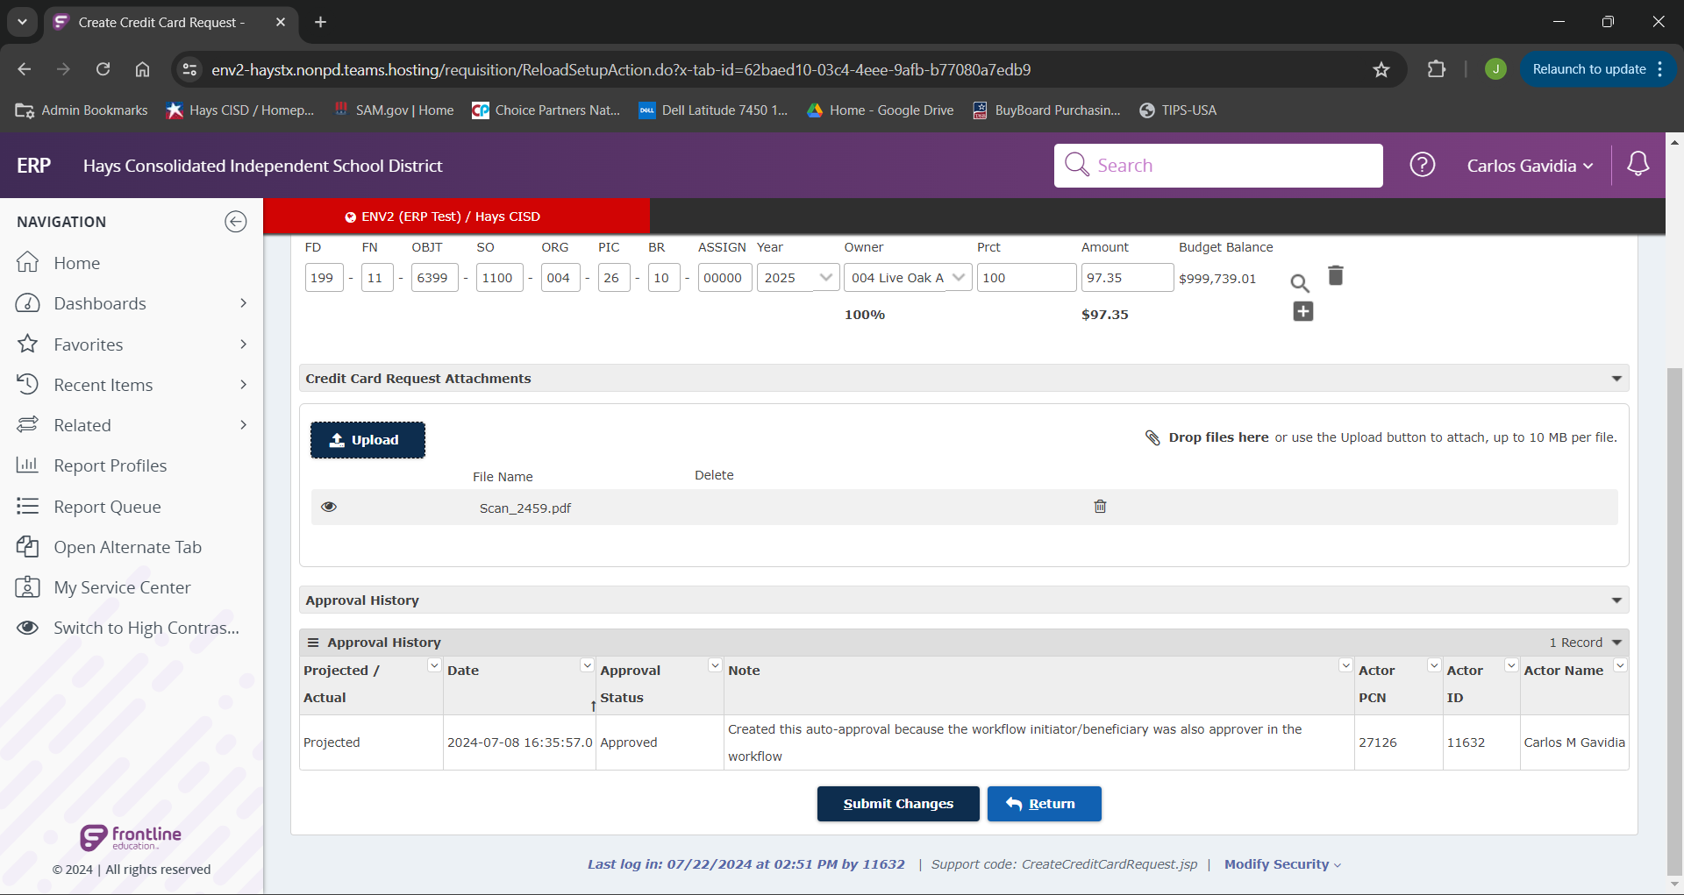
Once we have filled out our required fields and added our receipts we can now click the “Submit Changes” button to submit to AP.

Slide 8
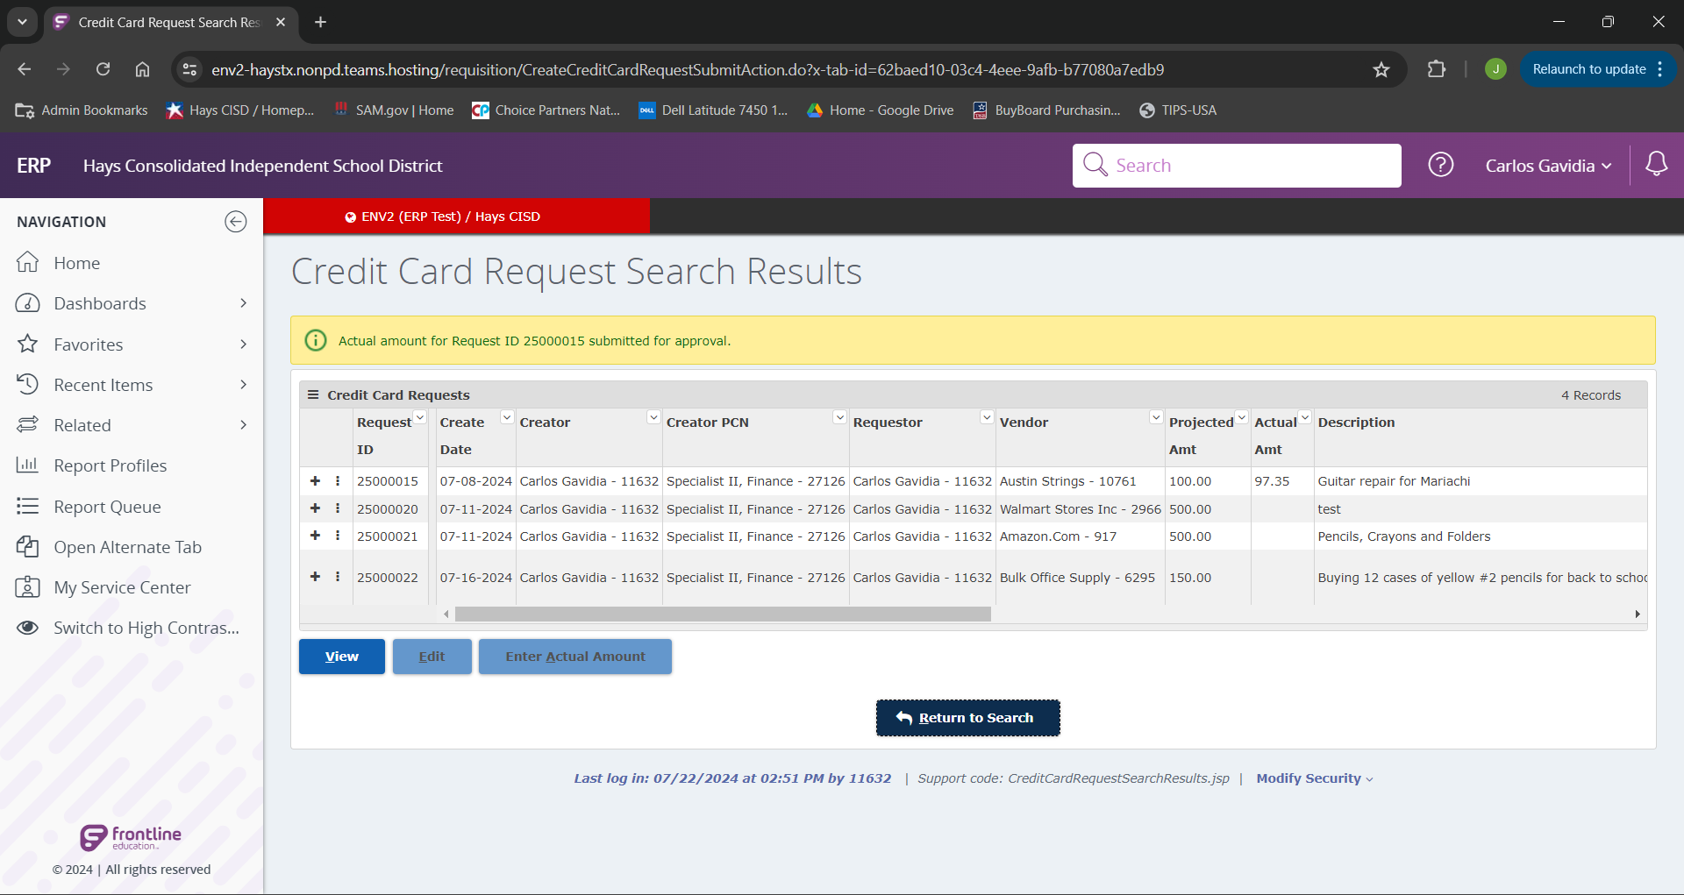
If everything was done correctly we will see the green message indicated. Once AP has processed the approval, and remaining funds will go back to the budget.

Slide 9
You have now learned how to Create a
Credit Card Request in Frontline.
If you have additional questions, please
reach out to the P-Card Administrator.

