Slide 1
Requisition Maintenance
Nicole Turner, Director of Purchasing
Anston Shockley, Buyer
Wendy Cordero, Buyer
Jeremy Torres, Buyer
Carlos Gavidia, P-Card Administrator

Slide 2
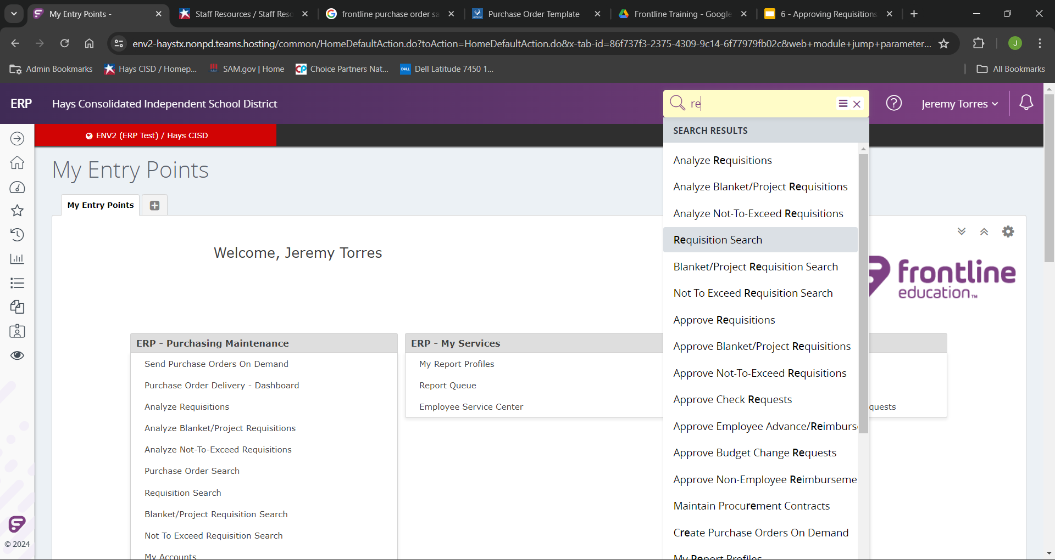
If your first approver has not passed your newly made requisitions, you will still be able to make changes.
To do so, start by searching and selecting “Requisition Search”

Slide 3
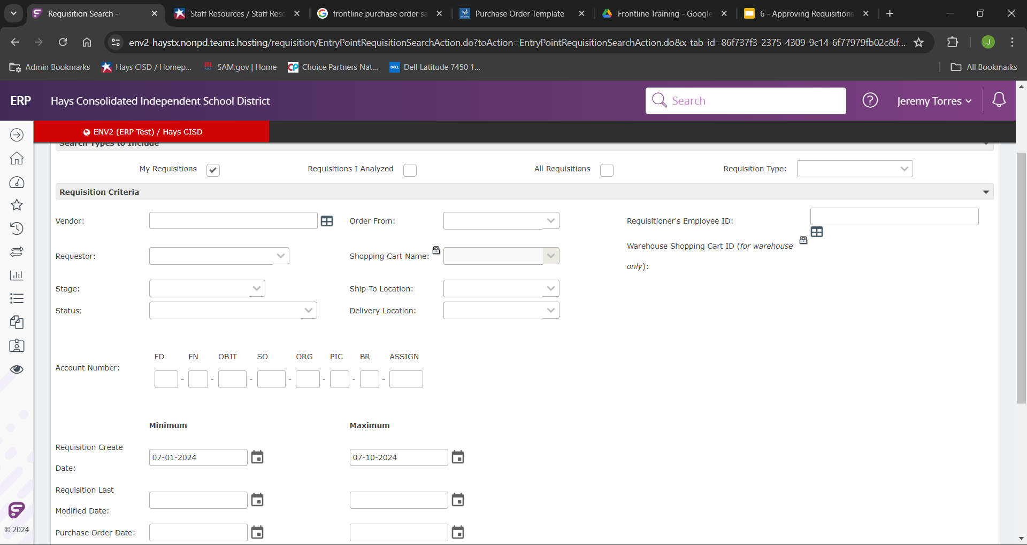
From here you should be locking into the “My Requisition” option.
You my now search for the requisition you are wanting to work on by searching any of the shown here variables, but try to make sure to use the “Requisition Create Date” to help limit the amount of requisitions you will populate.

Slide 4
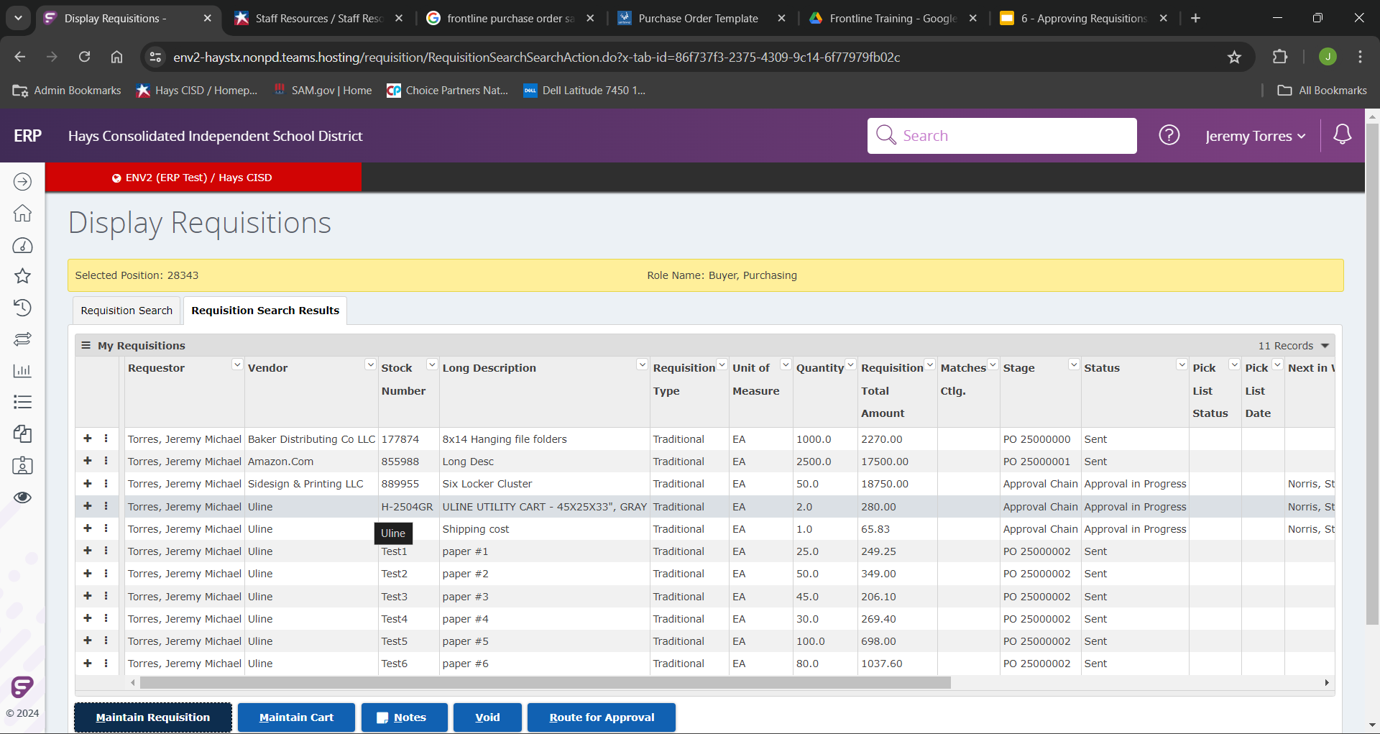
You will now be able to see your search results.
If you just have handful of candidates, and all look good, you can similarly select “Approve All”.

Slide 5
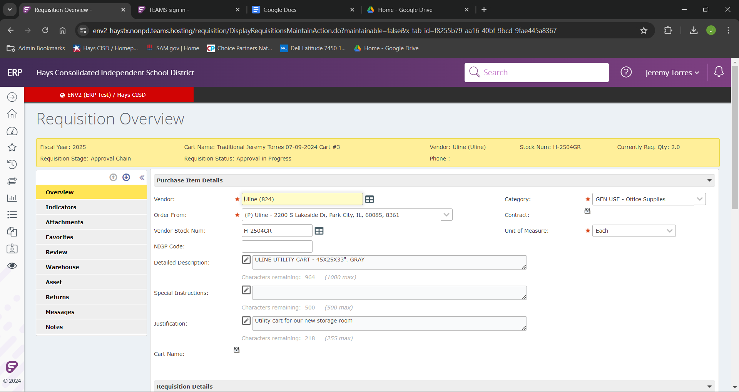
This will land us on the “Requisitions Overview”. From here in the “Overview” tab we can make any changes we needed to.
These could be examples of wrong costing, incorrect order quantity, or incorrect budget.

Slide 6
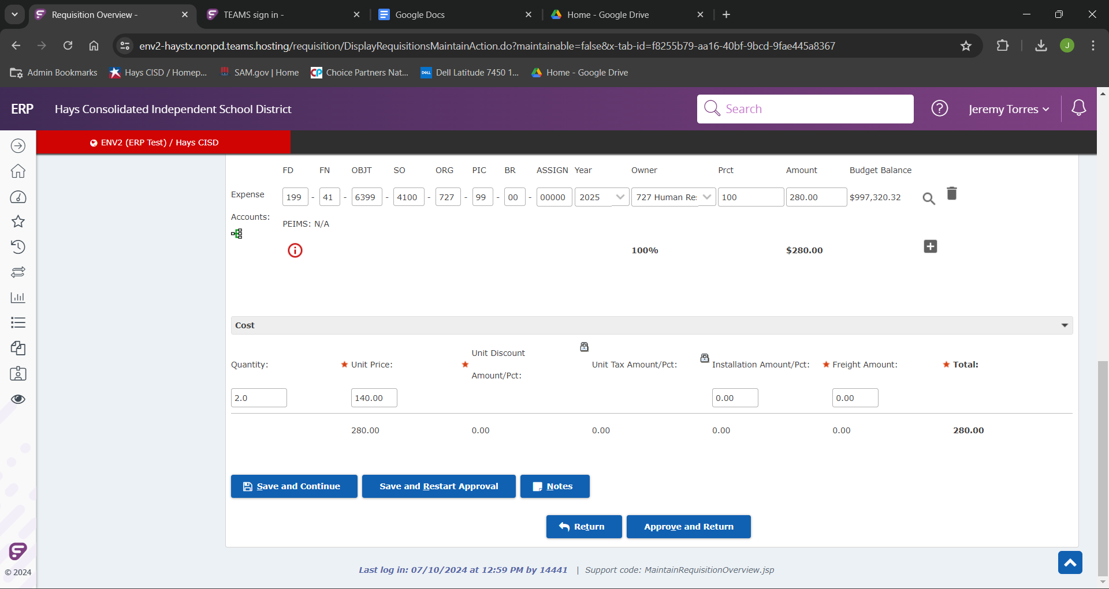
Once we have made all of our changes we can click “Save and Restart Approval” as the requisition creator.

