Slide 1
Credit Card Request
Nicole Turner, Director of Purchasing
Carlos Gavidia, P-Card Administrator
Anston Shockley, Buyer
Wendy Cordero, Buyer
Jeremy Torres, Buyer

Slide 2
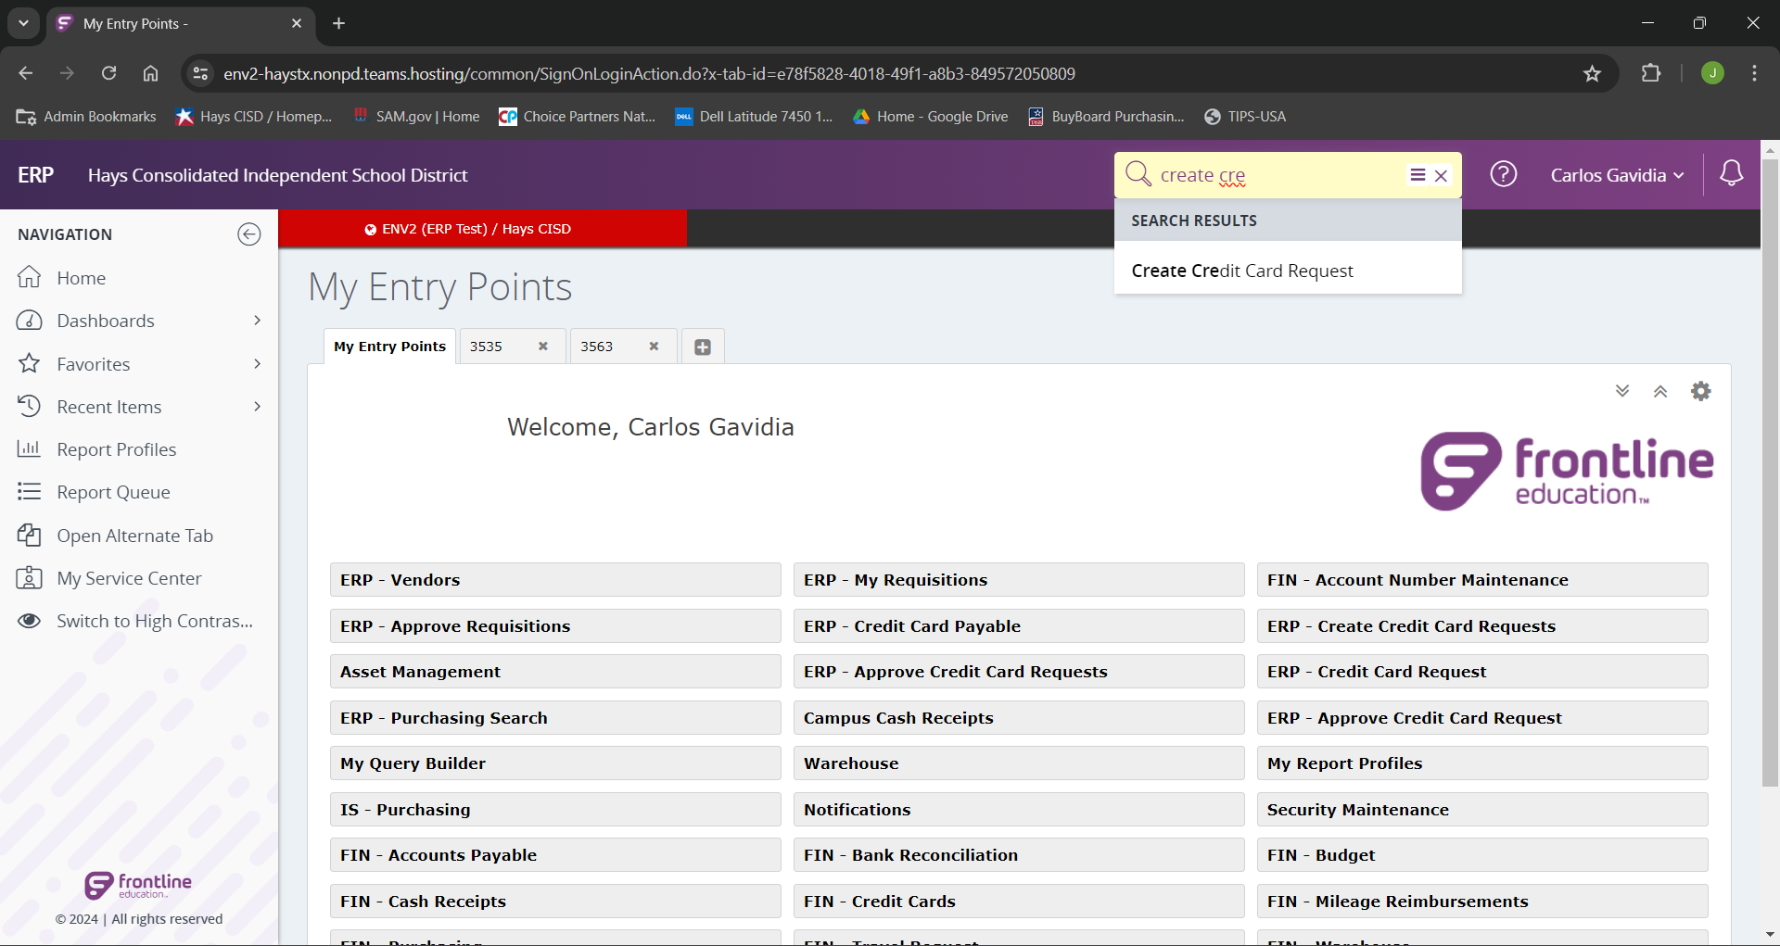
Begin by searching “Create Credit Card Request” from the landing page.

Slide 3
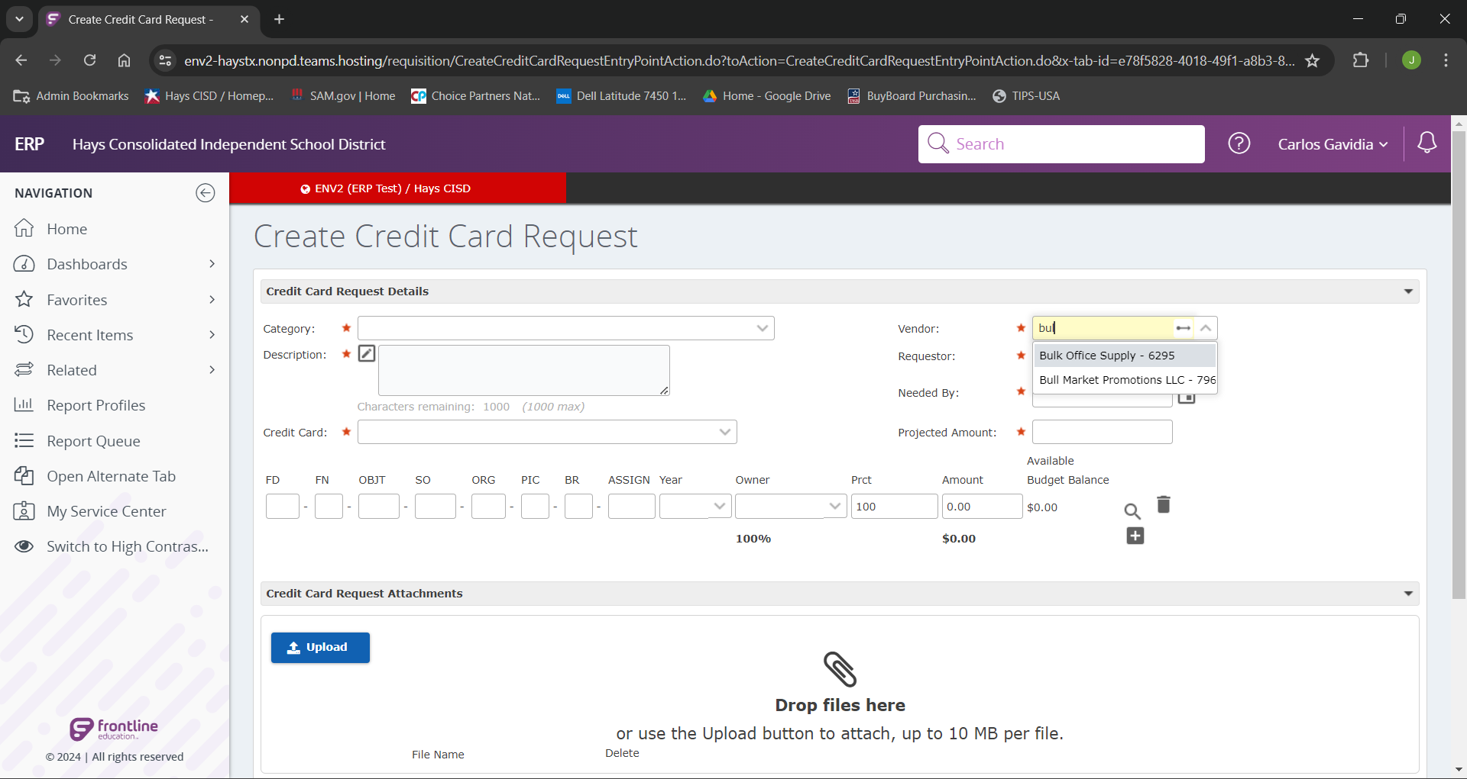
Begin typing in the vendor name. The vendor names will begin to auto-populate upon typing.

Slide 4
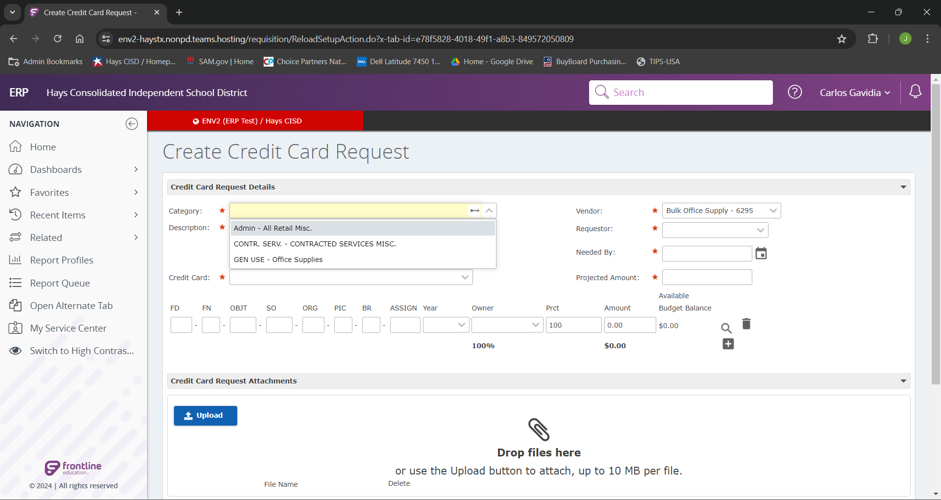
We will next choose the category for our vendor for our purchase.

Slide 5
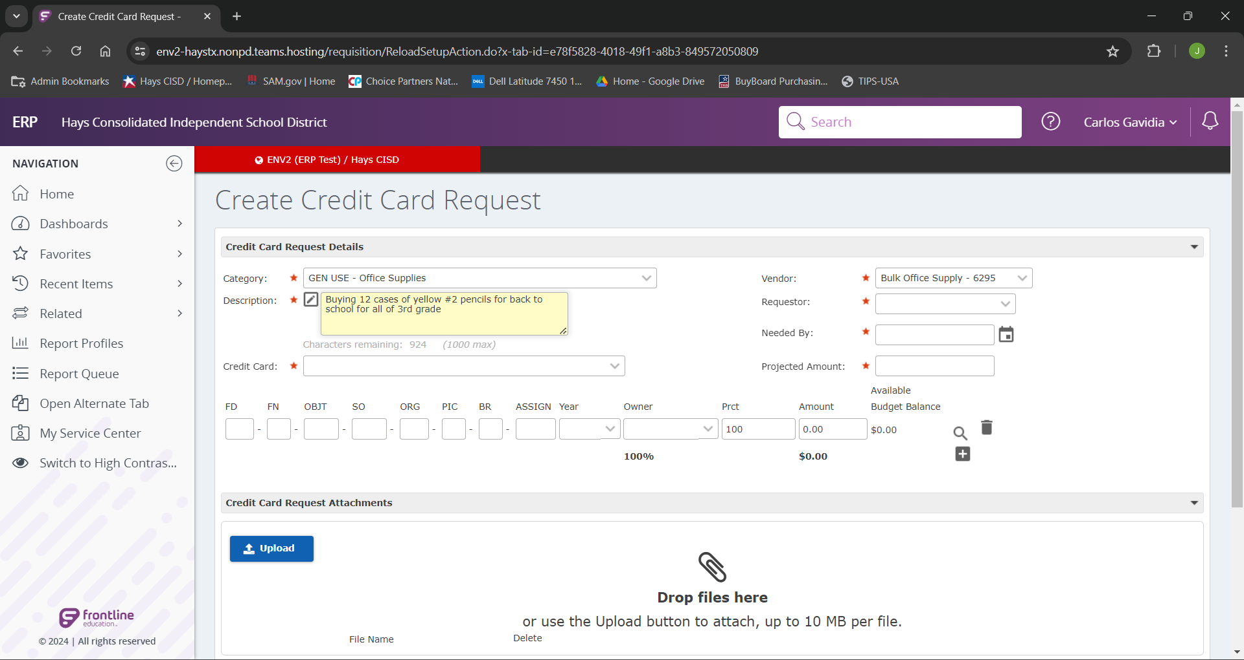
Next we will add in the “Description” field the most descriptive description of our proposed purchase.
Note: The more detail we have in the “Description” field will both assist with approvals and audits.

Slide 6
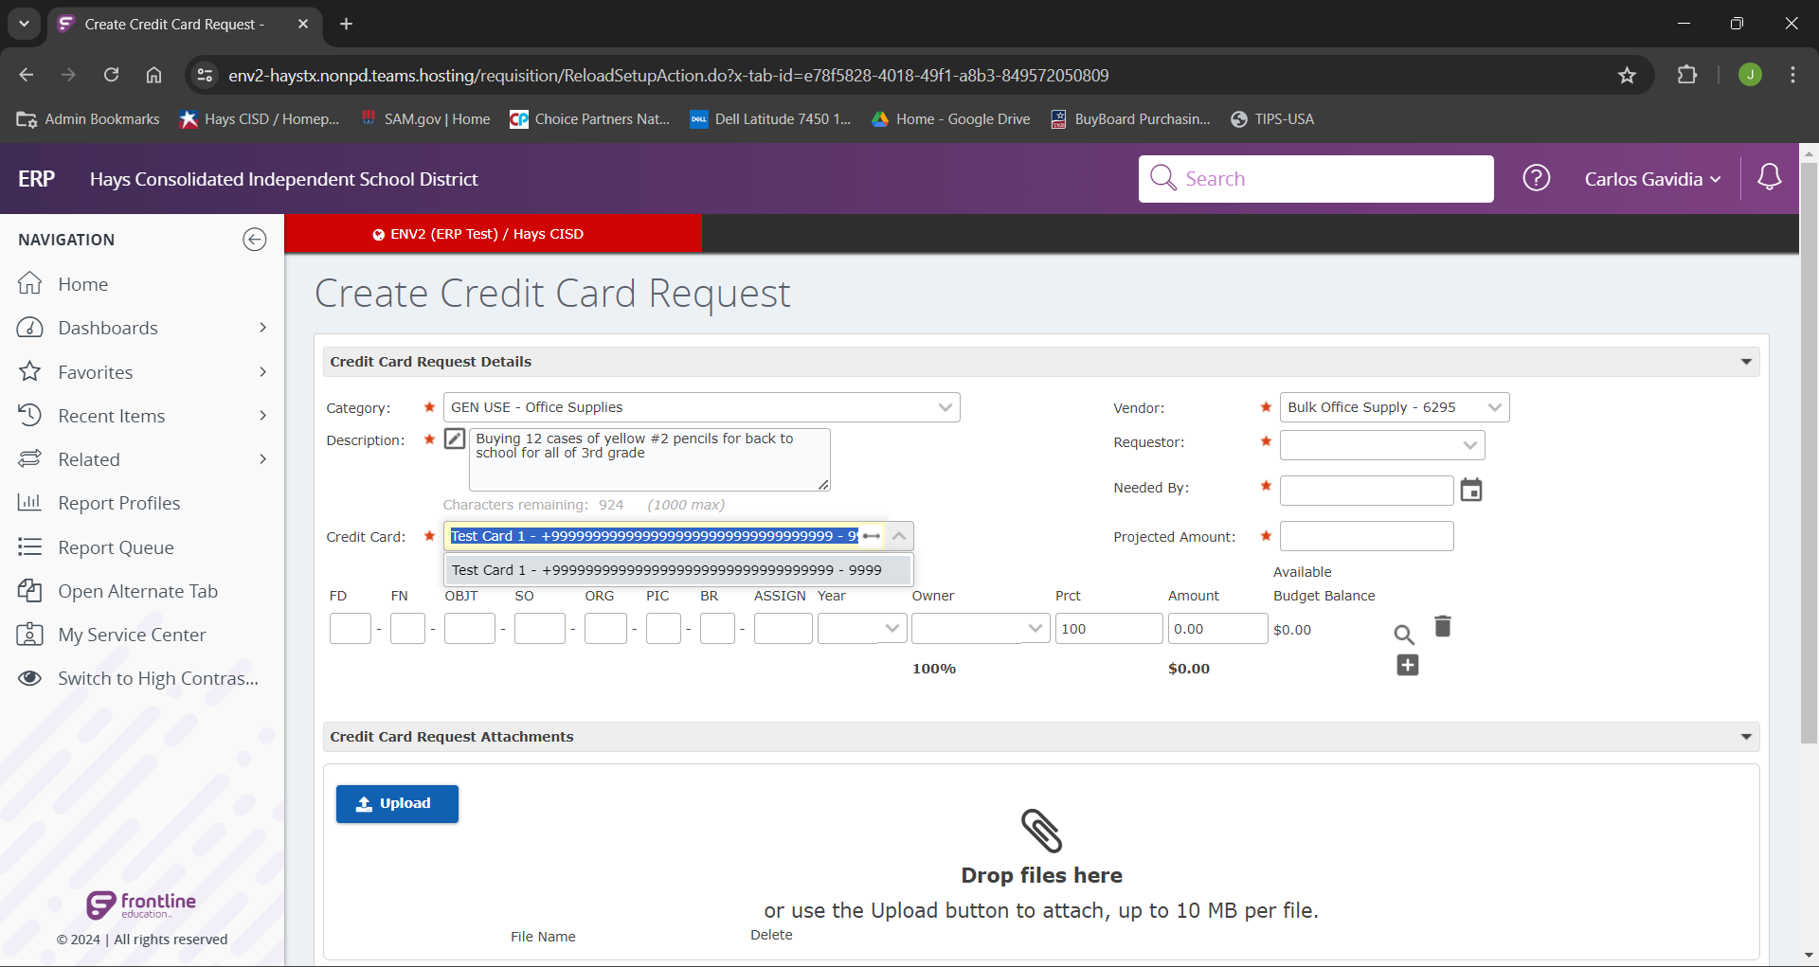
In our next field we will select the desired credit card for the request.

Slide 7
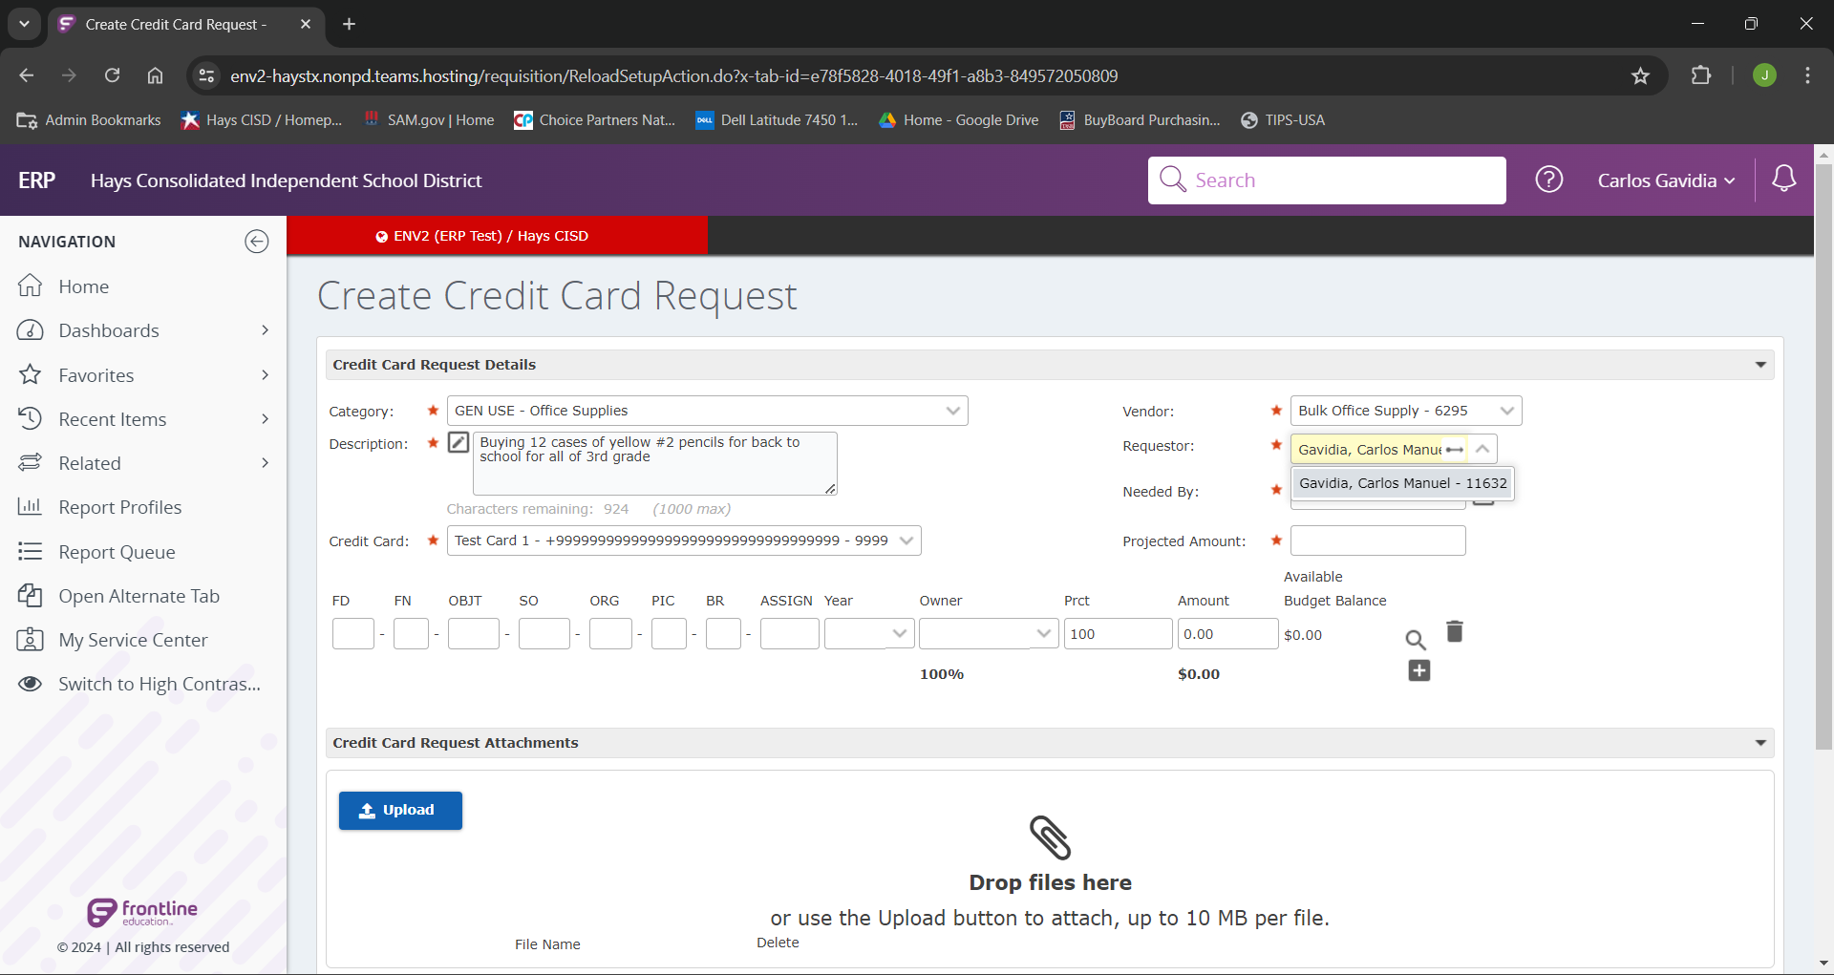
The requestor field should be ourselves.

Slide 8
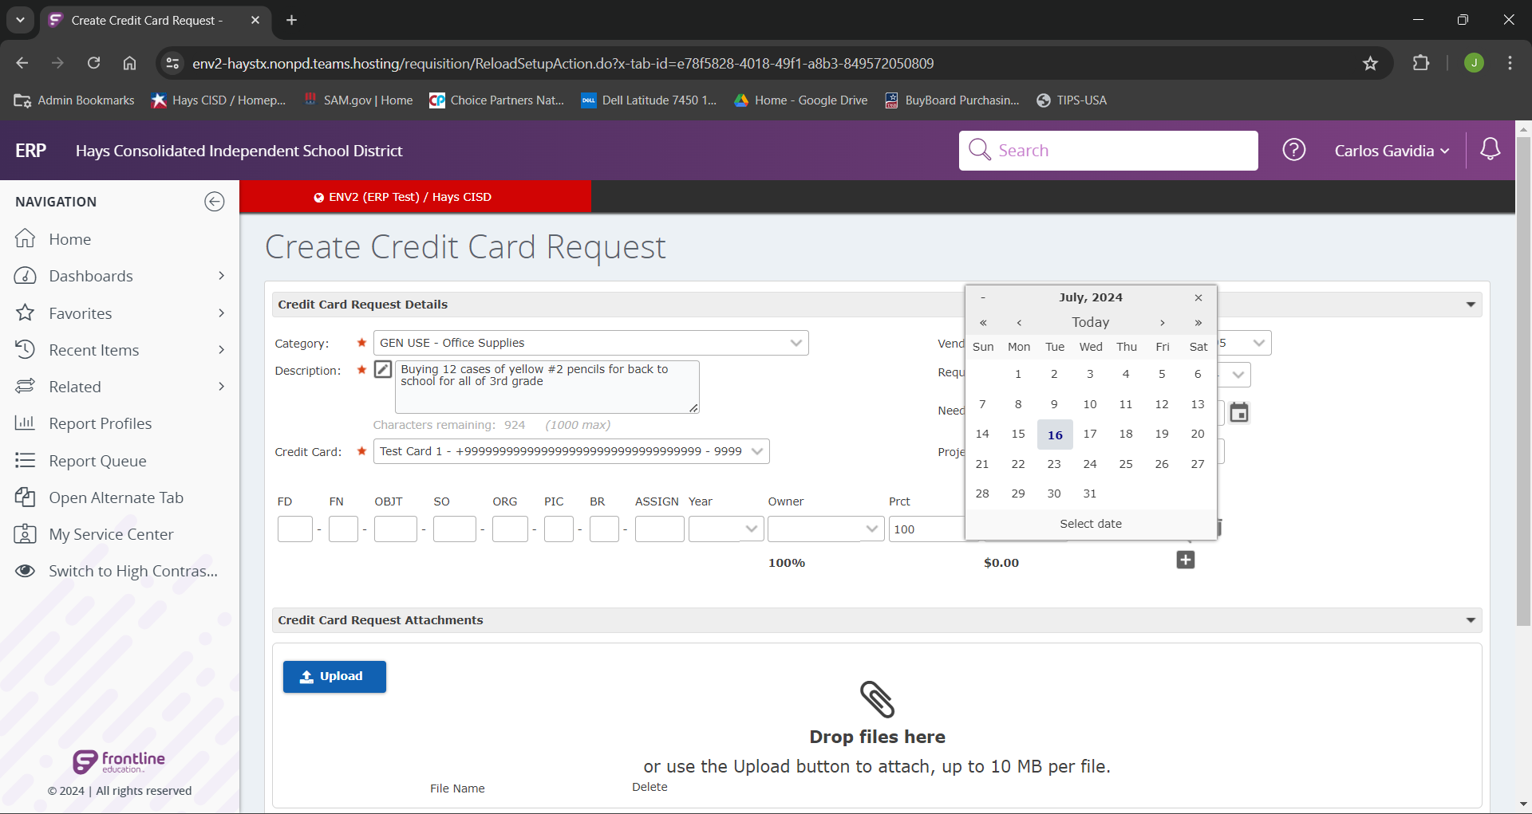
In the “Needed By” field, we can either type the date, or select the date on the calendar icon, that the purchase will be made.

Slide 9
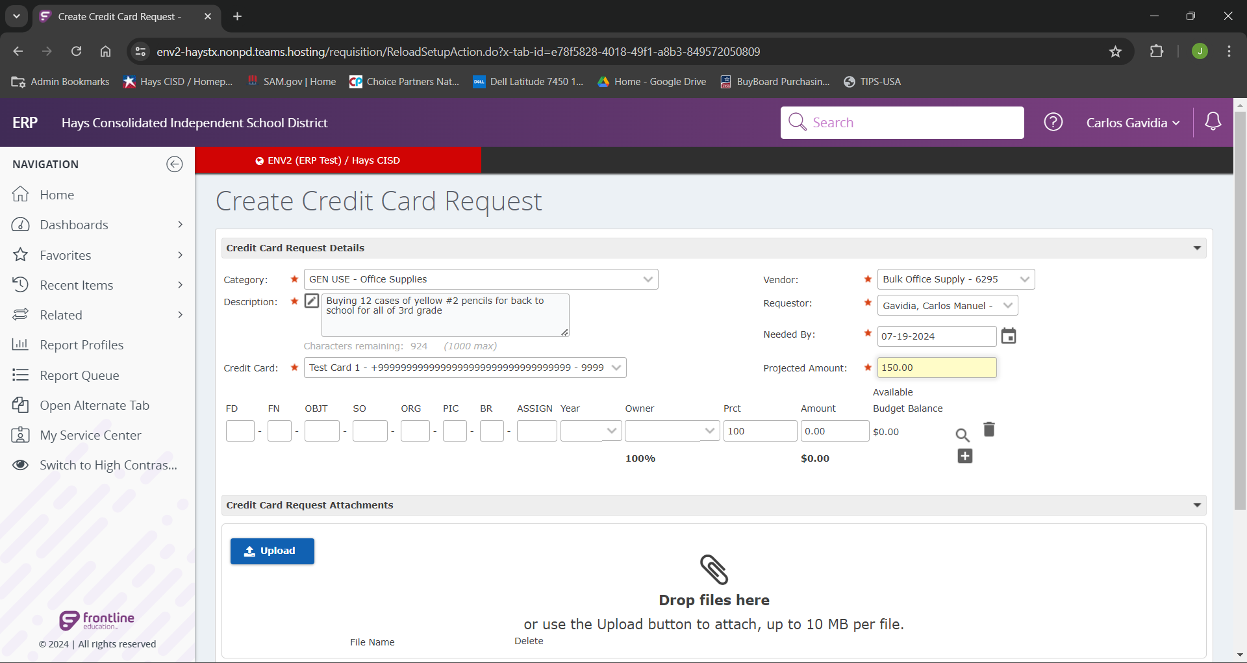
Next, we will enter our estimated purchase amount in the “Projected Amount” field. Please allow a little extra to make sure you don’t surpass the projected amount. (These funds will return the budget as soon the purchase is reconciled)

Slide 10
If we know the budget code we can enter it now, if we don’t know the entire code we can type in the portion we know and click the search icon to search for the correct code.

Slide 11
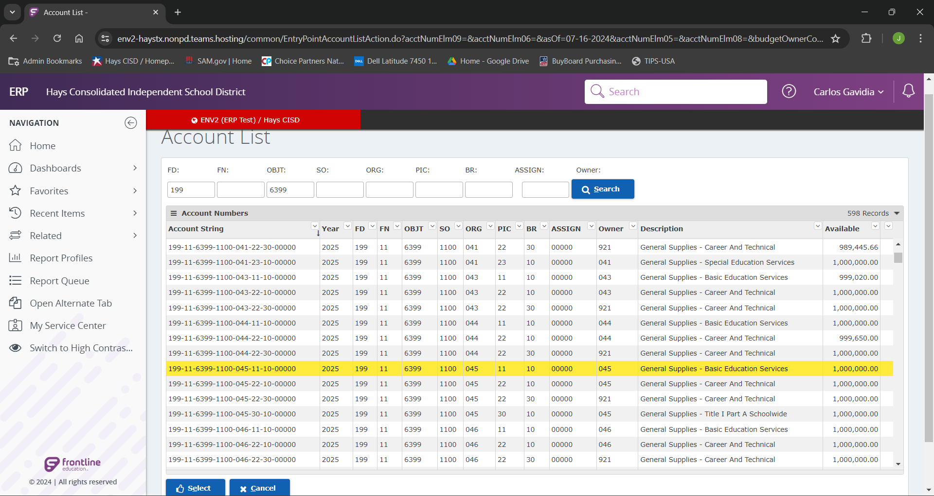
Once we have identified and highlighted our desired budget code, we can select it by either double clicking it or clicking select at the bottom of the page.

Slide 12
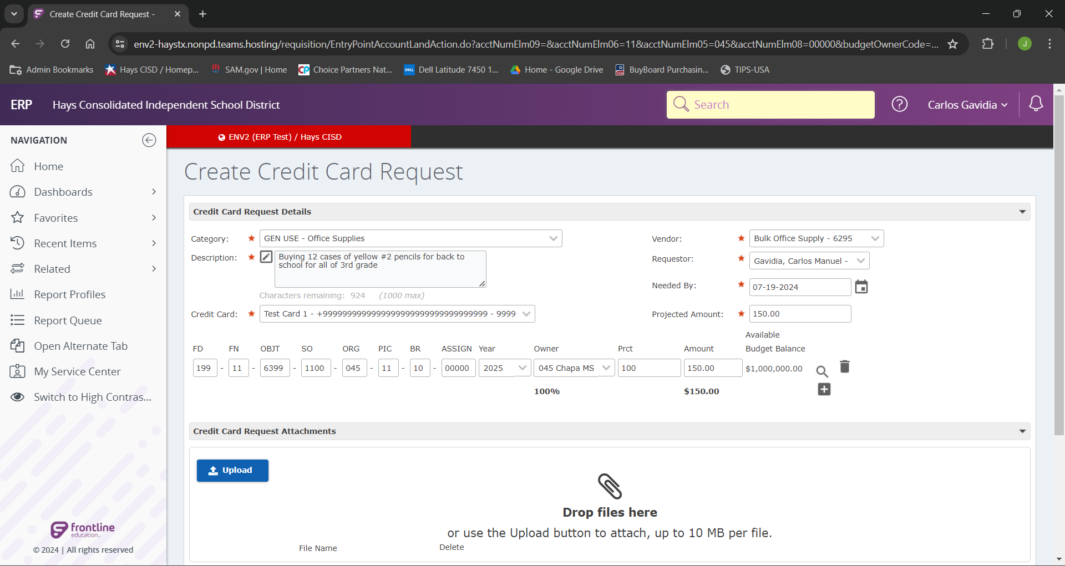
We can now see that the budget code is filled with our selected account.
If we wanted to split the purchase between multiple budgets we can add more account lines by clicking the plus icon and searching as we previously did.

Slide 13
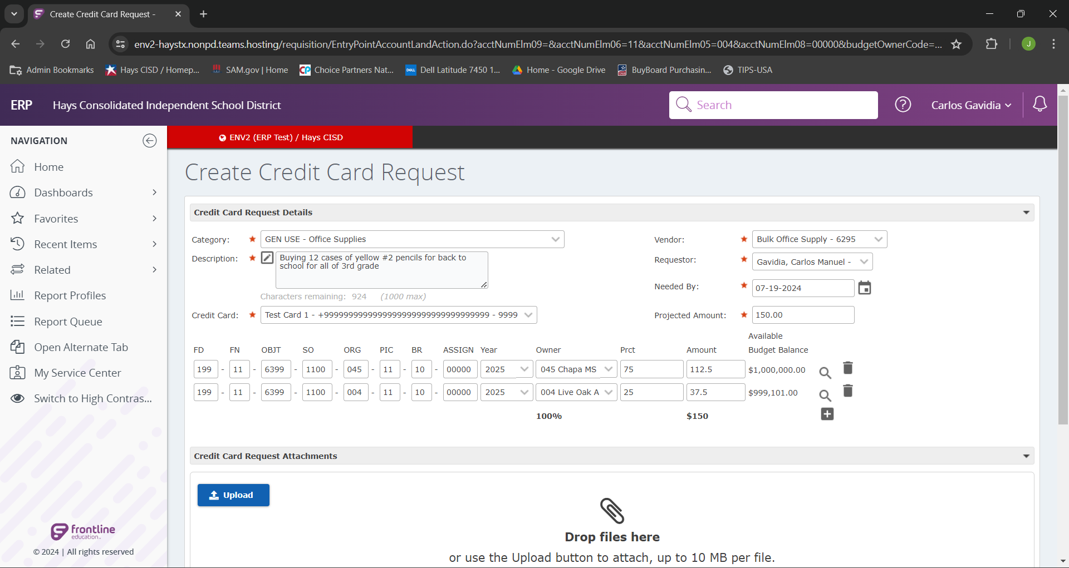
When splitting accounts we can we can split by either percent or dollar amount. These must add up to the total requested or 100%. If not the system will not allow you to progress.

Slide 14
We can then click “Upload” to add any supporting documentation for the purchase. This would be a form of proof for justification of expense on the selected account.

Slide 15
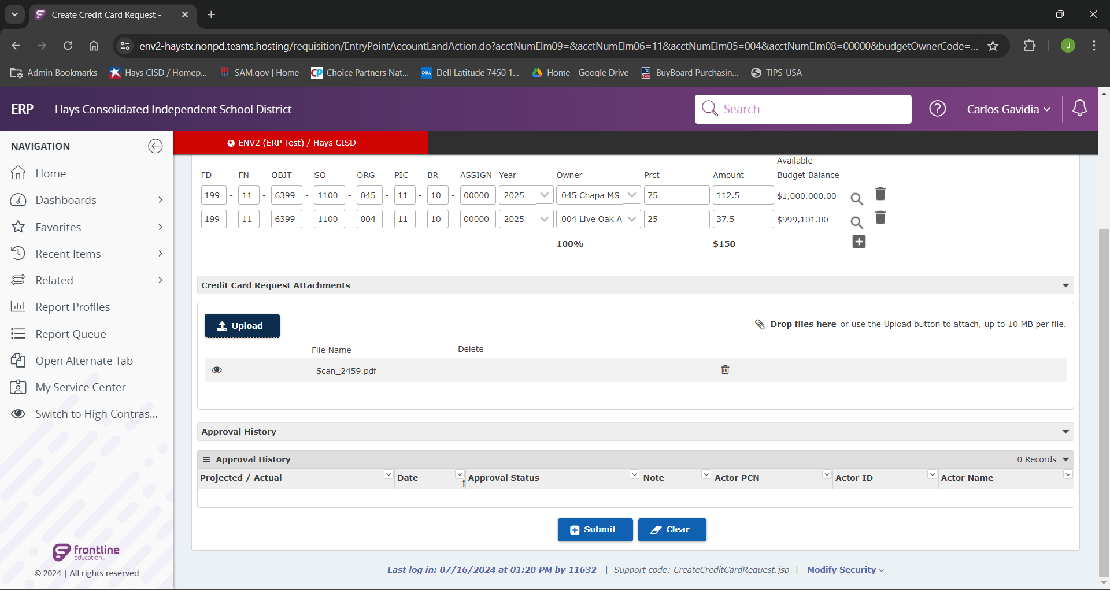
After all these steps have been completed we can now click “Submit”.
Upon submission these fund will be encumbered until the purchase is reconciled.
Once reconciled, any excess funds will return to your budget.

Slide 16
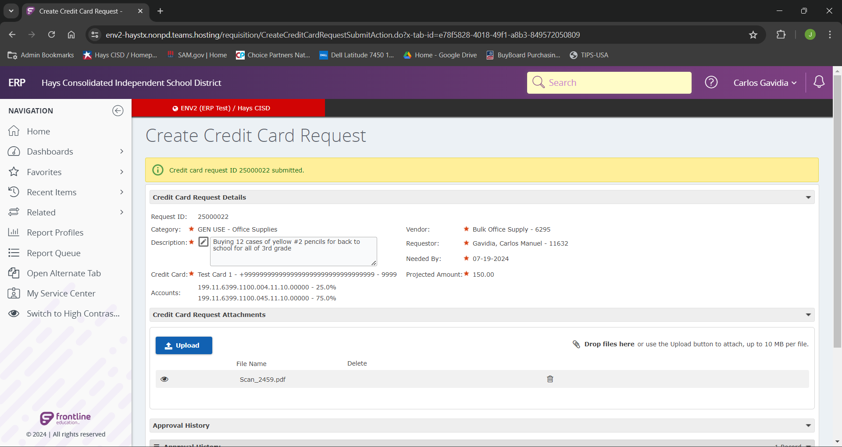
If all steps were followed correctly we should see the green verification message indicated above!

Slide 17
You have now learned how to Create a
Credit Card Request in Frontline.
If you have additional questions, please
reach out to the P-Card Administrator.

