Slide 1
Adding Favorites
Nicole Turner, Director of Purchasing
Anston Shockley, Buyer
Wendy Cordero, Buyer
Jeremy Torres, Buyer
Carlos Gavidia, P-Card Administrator

Slide 2
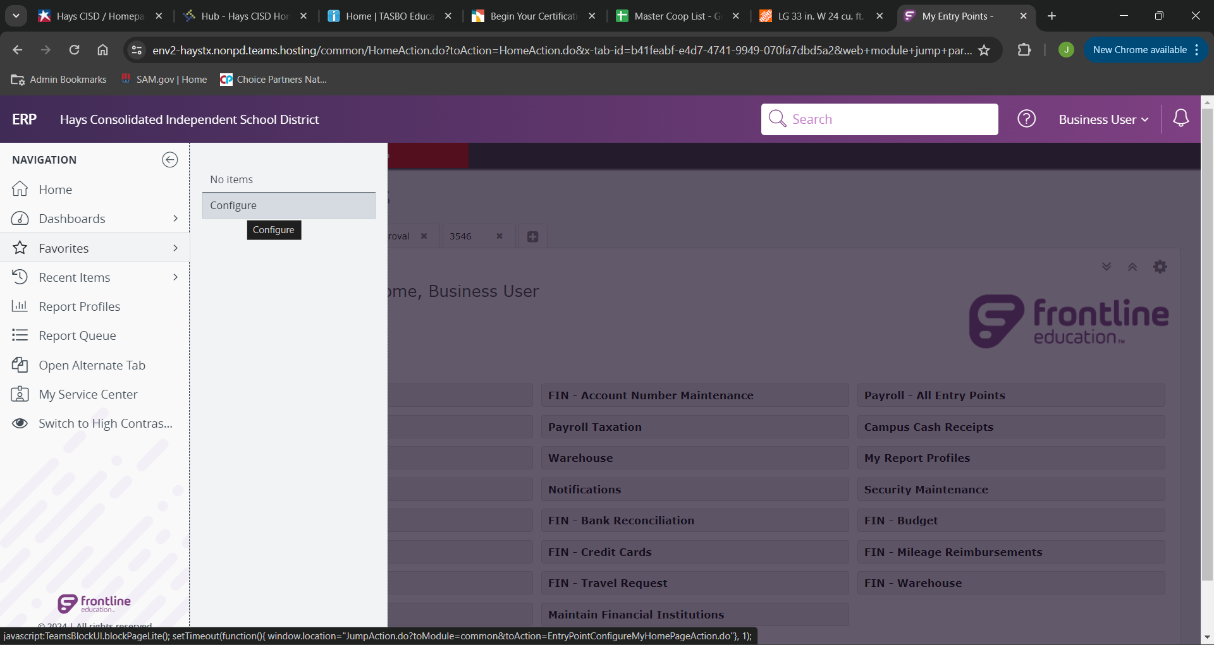
Click on “Favorites” then click “Configure.

Slide 3
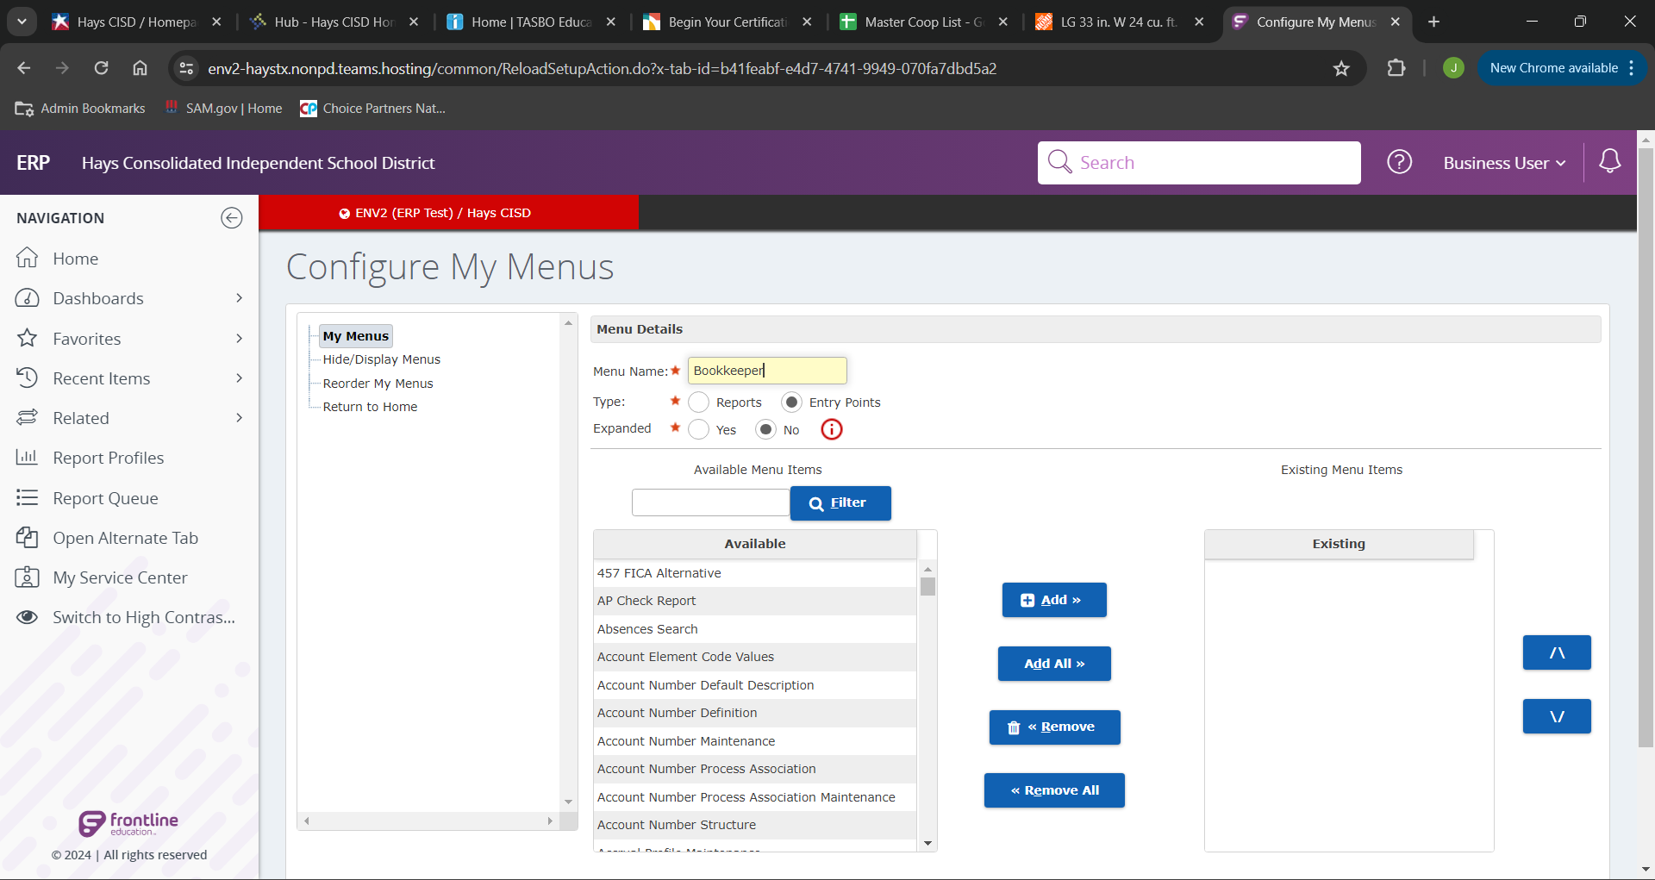
In “menu name” Give your New favorites list a title.
Change “type” to entry points, and “Expanded” to “no”.

Slide 4
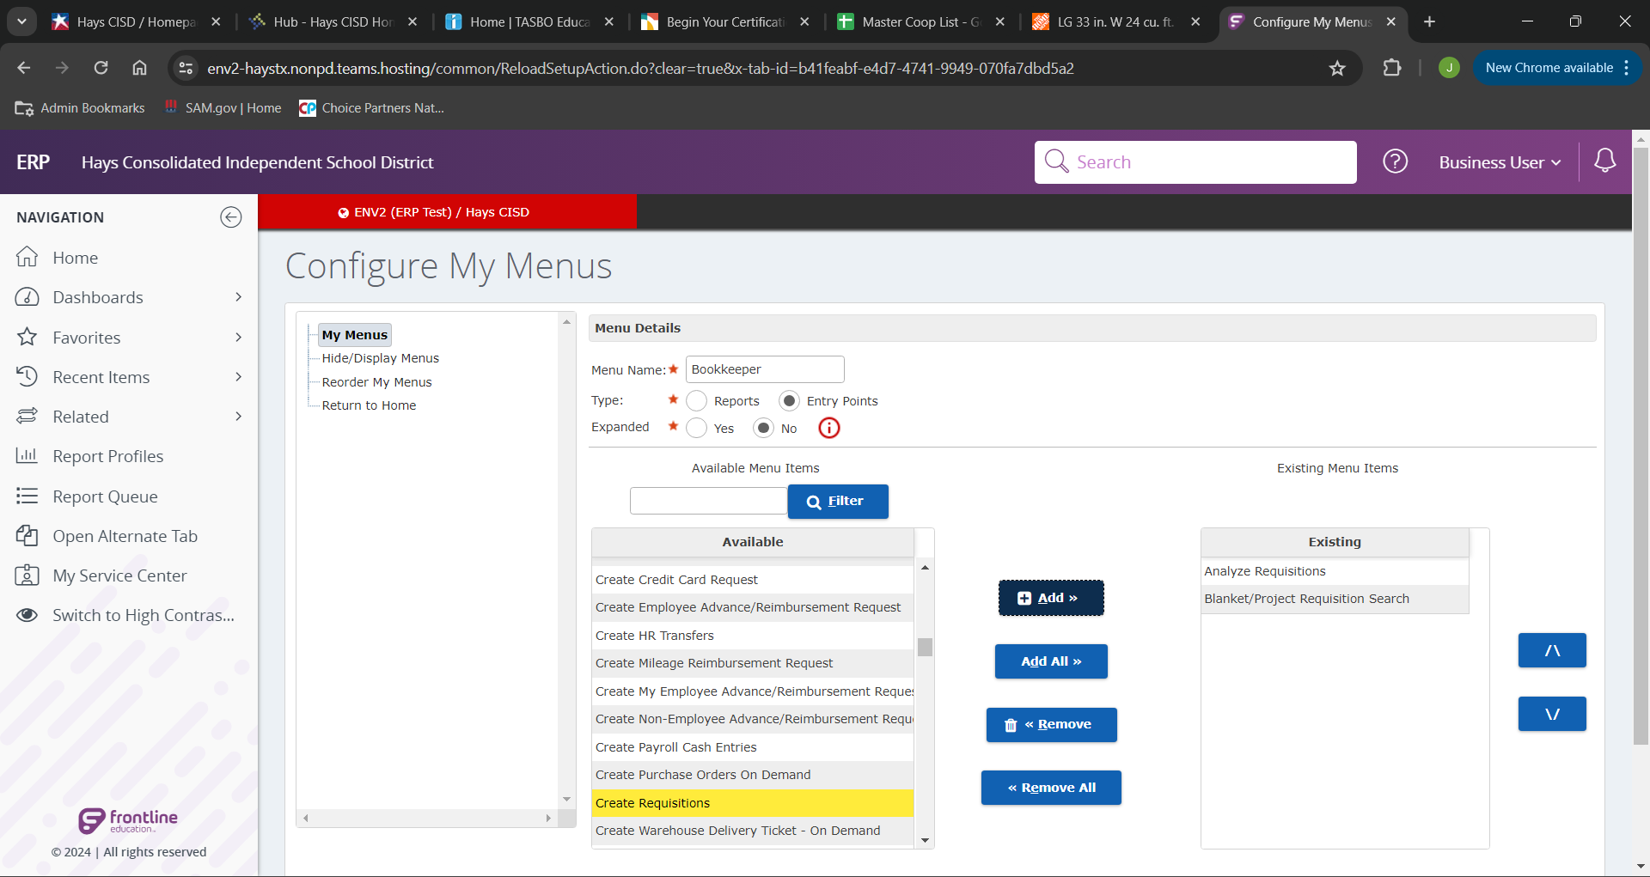
In the “available” list, select your desired entry point and click the “add” button. You can select all of your desired entry point and add them in at this point.

Slide 5
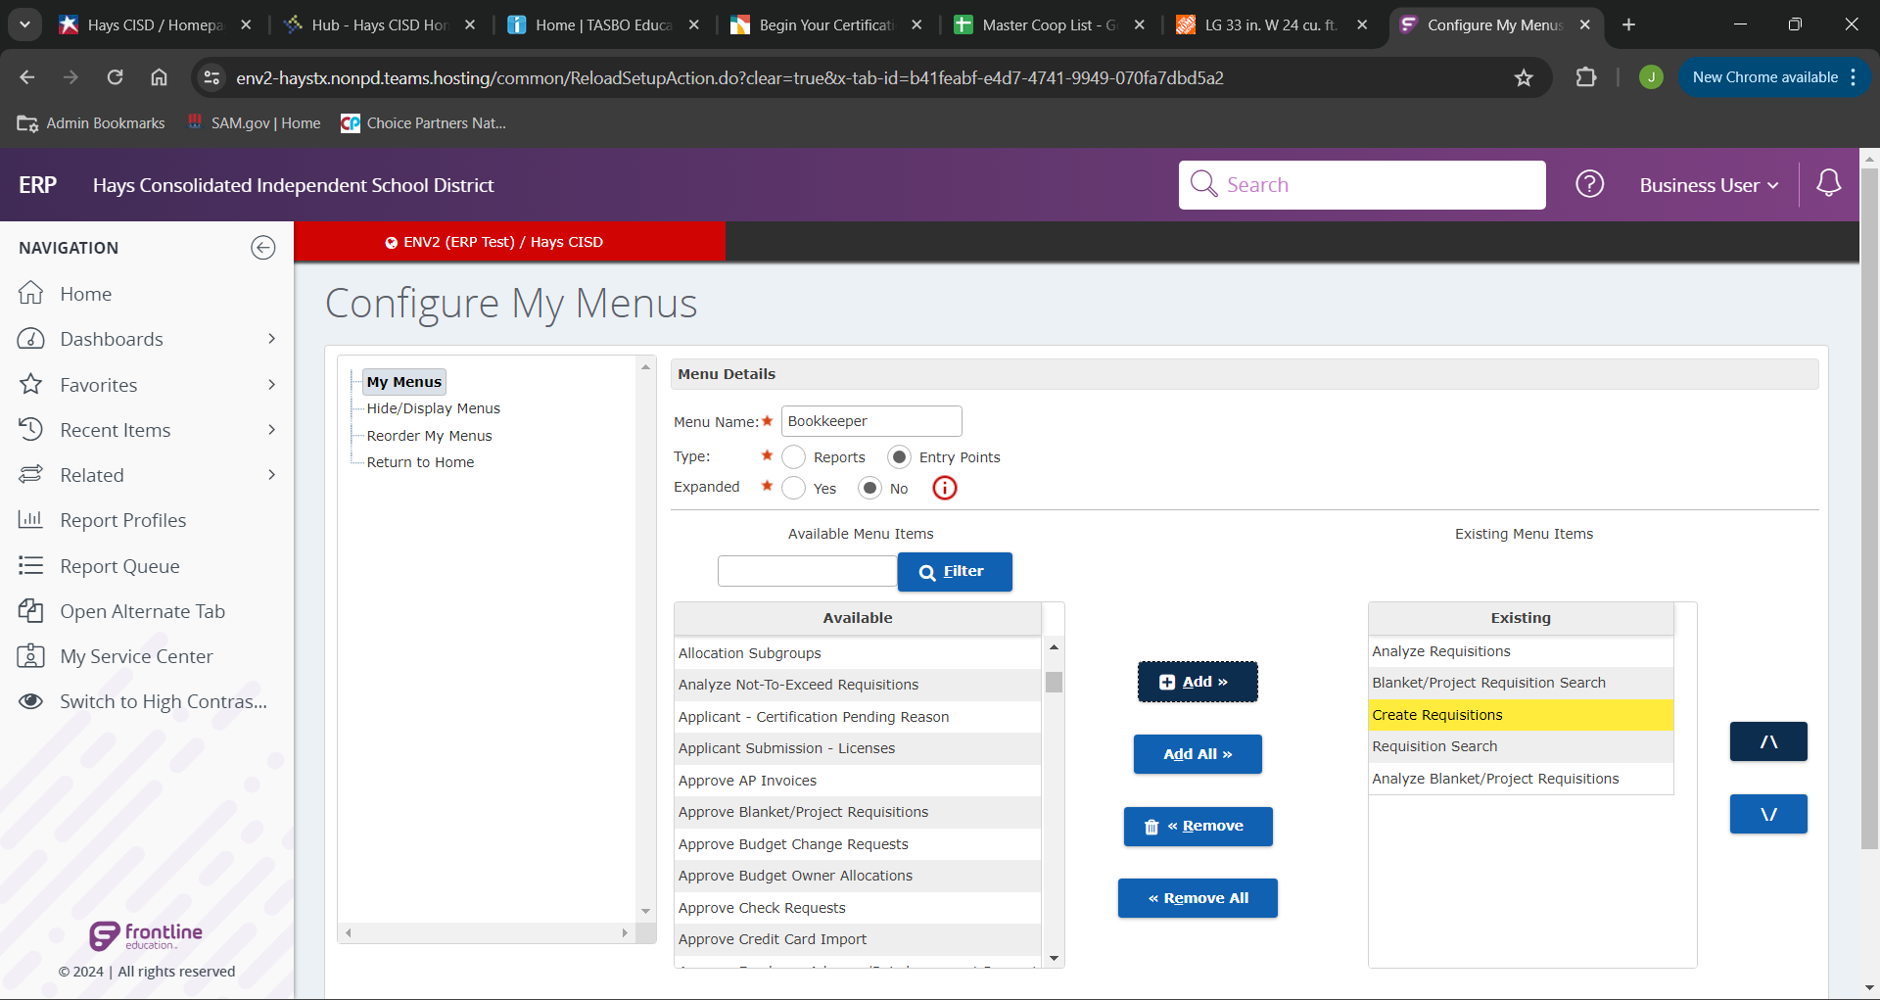
Once you have added your entry points in the “existing” field you can arrange their order by using the arrow buttons on the far right.

Slide 6
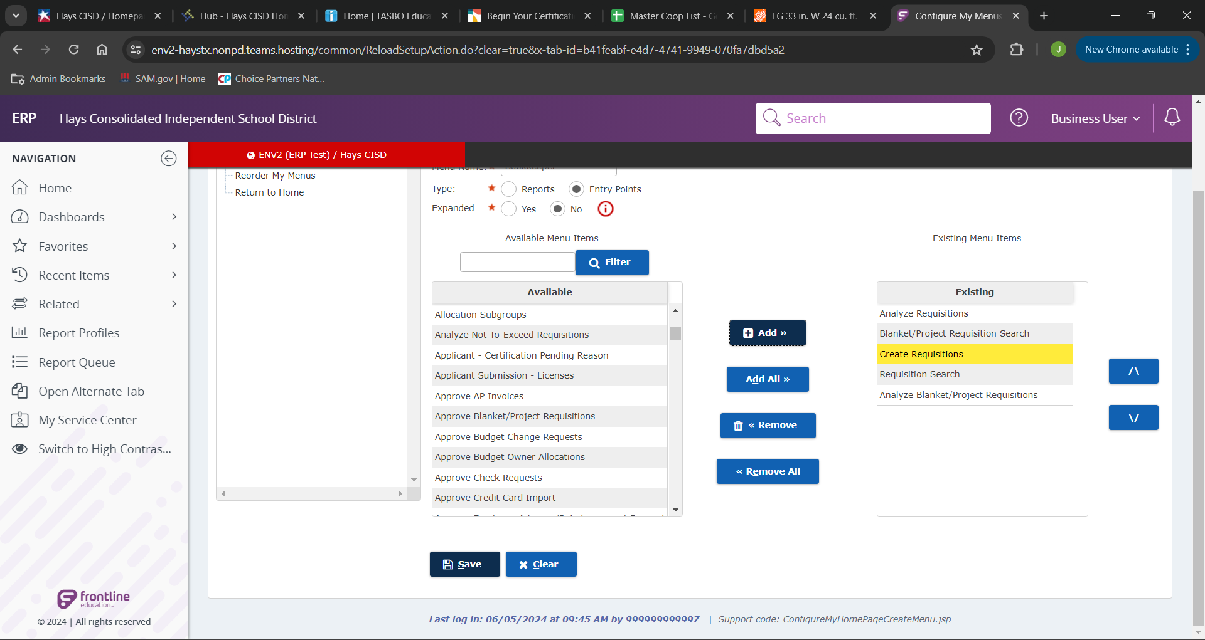
After you have your list the way you like click “save”. To create your short-cuts list in the “Favorites” navigation selection.

Slide 7
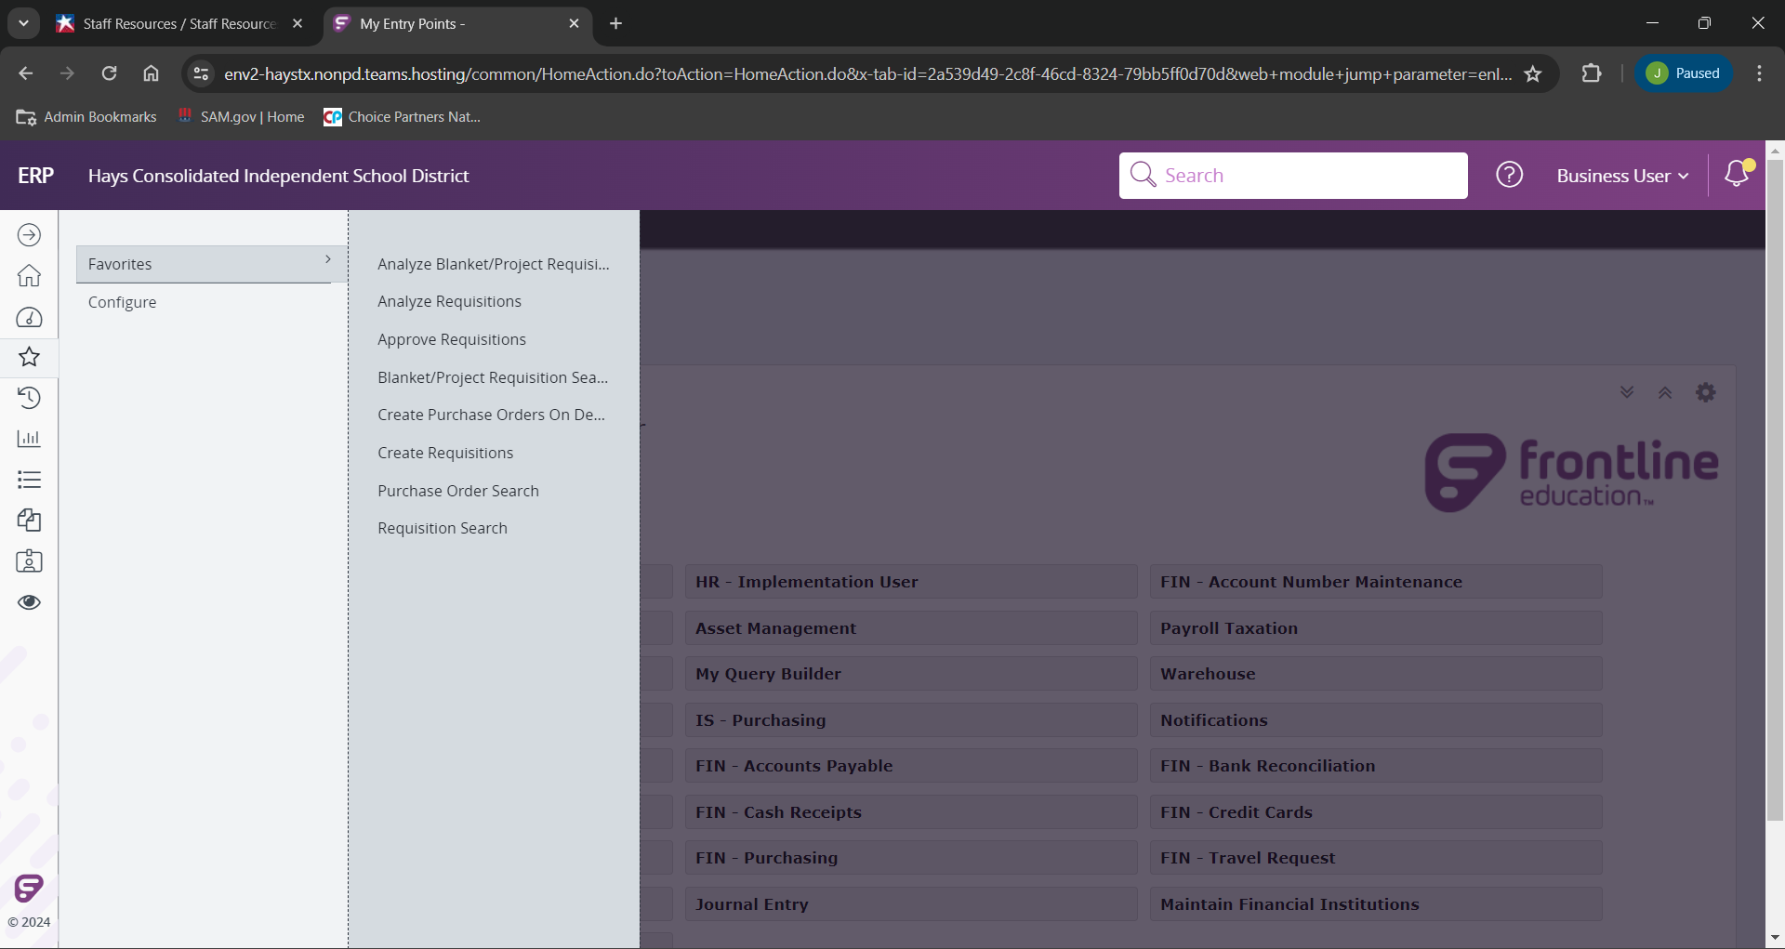
You can now view your custom menu in the navigation bar.

Slide 8
If you have any further questions please reach out to any of the purchasing team listed on the cover, or email the entire team at purchasingdept@hayscisd.net

