Slide 1
Approving Requisitions
Nicole Turner, Director of Purchasing
Anston Shockley, Buyer
Wendy Cordero, Buyer
Jeremy Torres, Buyer
Carlos Gavidia, P-Card Administrator

Slide 2
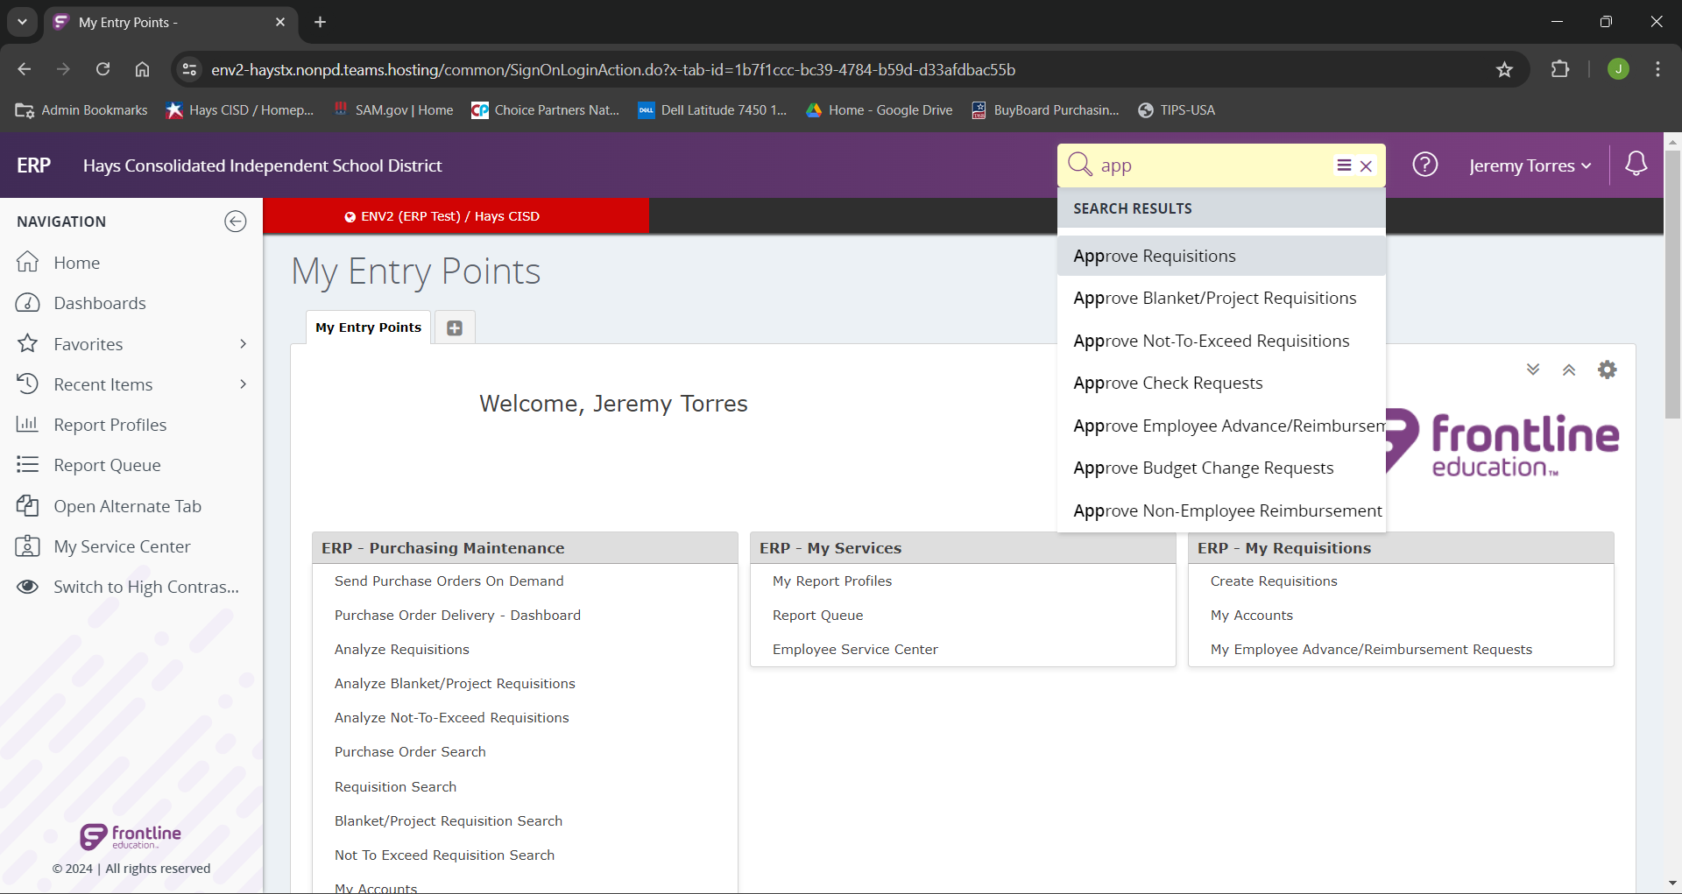
To approve a requisition we will search for the entry point “Approve Requisitions”
Select “Approve Requisions”.

Slide 3
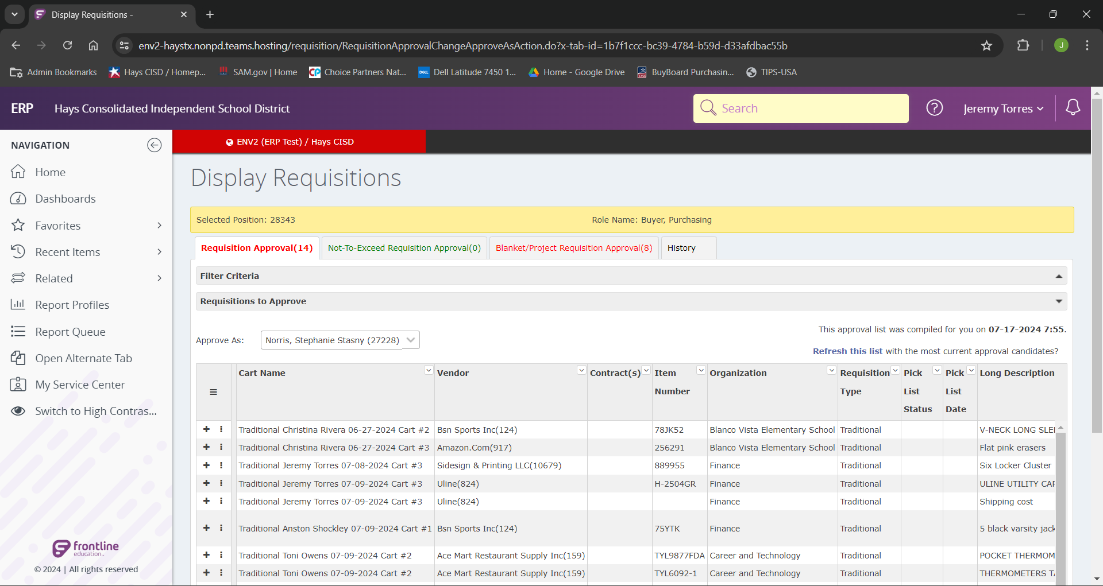
In this screen we will be able to see all requisitions needing approvals.
Note: The indicated tabs at the top. Our requisition types are broken out by type. In this example we have 14 Traditional and 8 Project reqs.
Note: We can see the two purple arrows show the same cart name. This means the two lines are a part of the same “Requisition”. Frontline breaks out the lines of a single requisition individually in the approval screen.

Slide 4
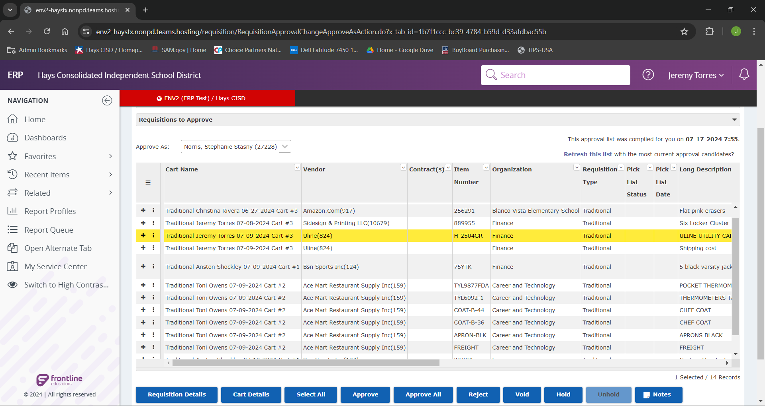
We are going to look at “Traditional Jeremy Torres “07-09-2024 Cart #3” If we scroll to the right we can see several details of that requestion. We see the cart name, vendor, item number, org of the requestor, req type, description of the item. (cont)

Slide 5
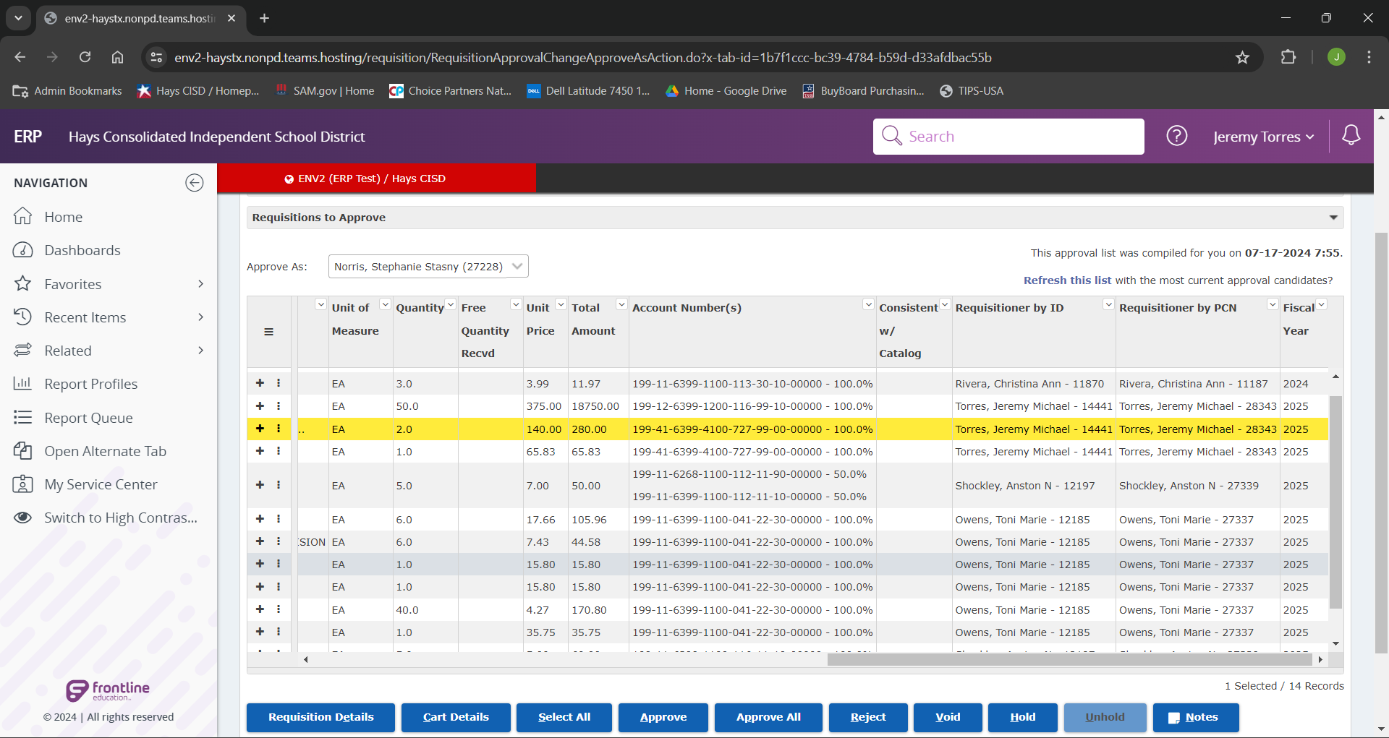
Unit of measure for the item, quantity ordered, unit price, account number being used, requisitionser user number and frontline ID, lastly fiscal year.

Slide 6
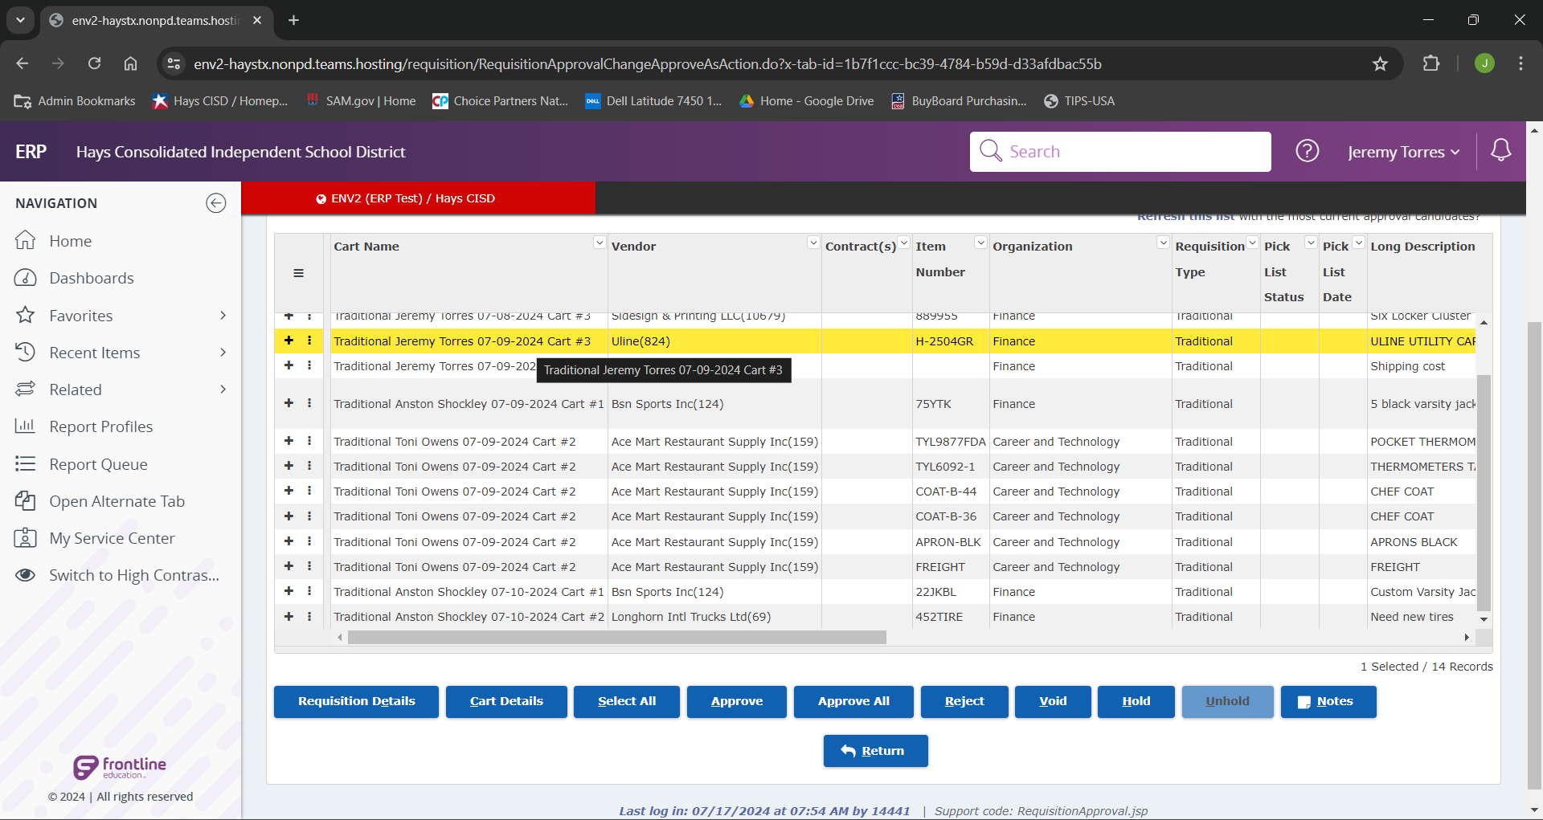
From here we have a few different options depending on what we are wanting to do. If we wanted to see the details for a single line item in the requisition, we can click “Requisition Details” for the selected line. If we wanted to see details for the entire requisition, we could click “Cart Details”. Or lastly, if everything looks good from the “Display Requisitions” screen we could approve from here by simply selecting the lines we want, and clicking “Approve”.

Slide 7
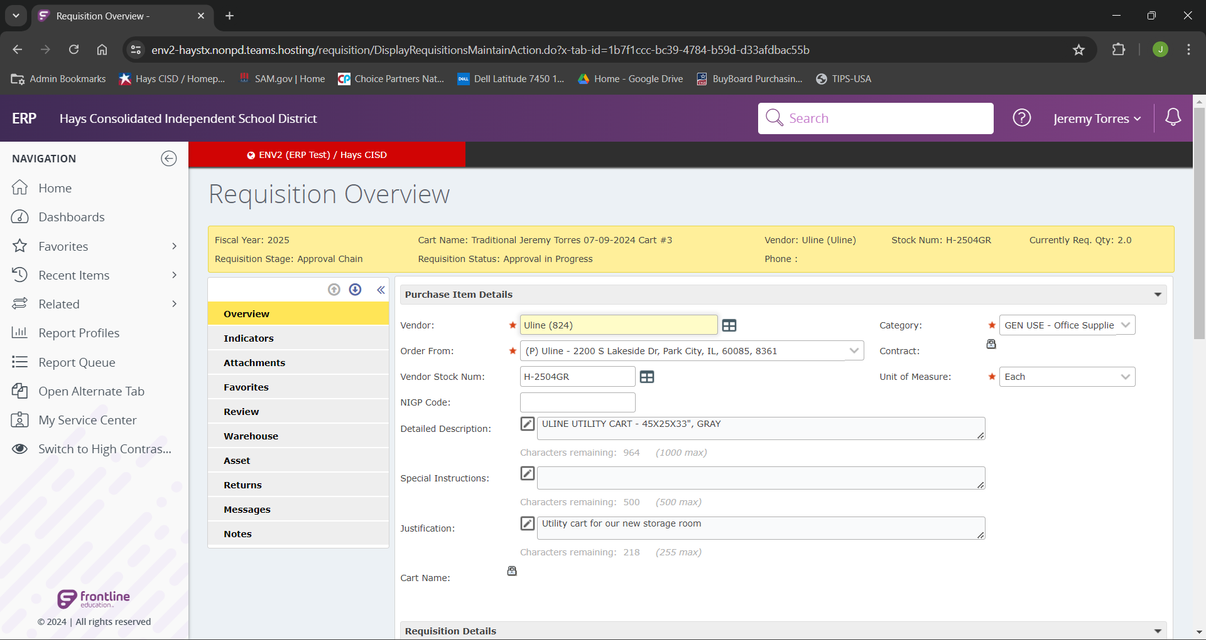
If we selected “Requisition Details”, it will bring us to the “Requisition Overview” page in the “Overview” tab in the right nave bar. From here we can see all the details for the single line item. This will include details such as Vendor, Category, Item Number, Description, Justification, Requestor, Ship to Location, Budget, Coop information, Line Item Cost, etc.

Slide 8
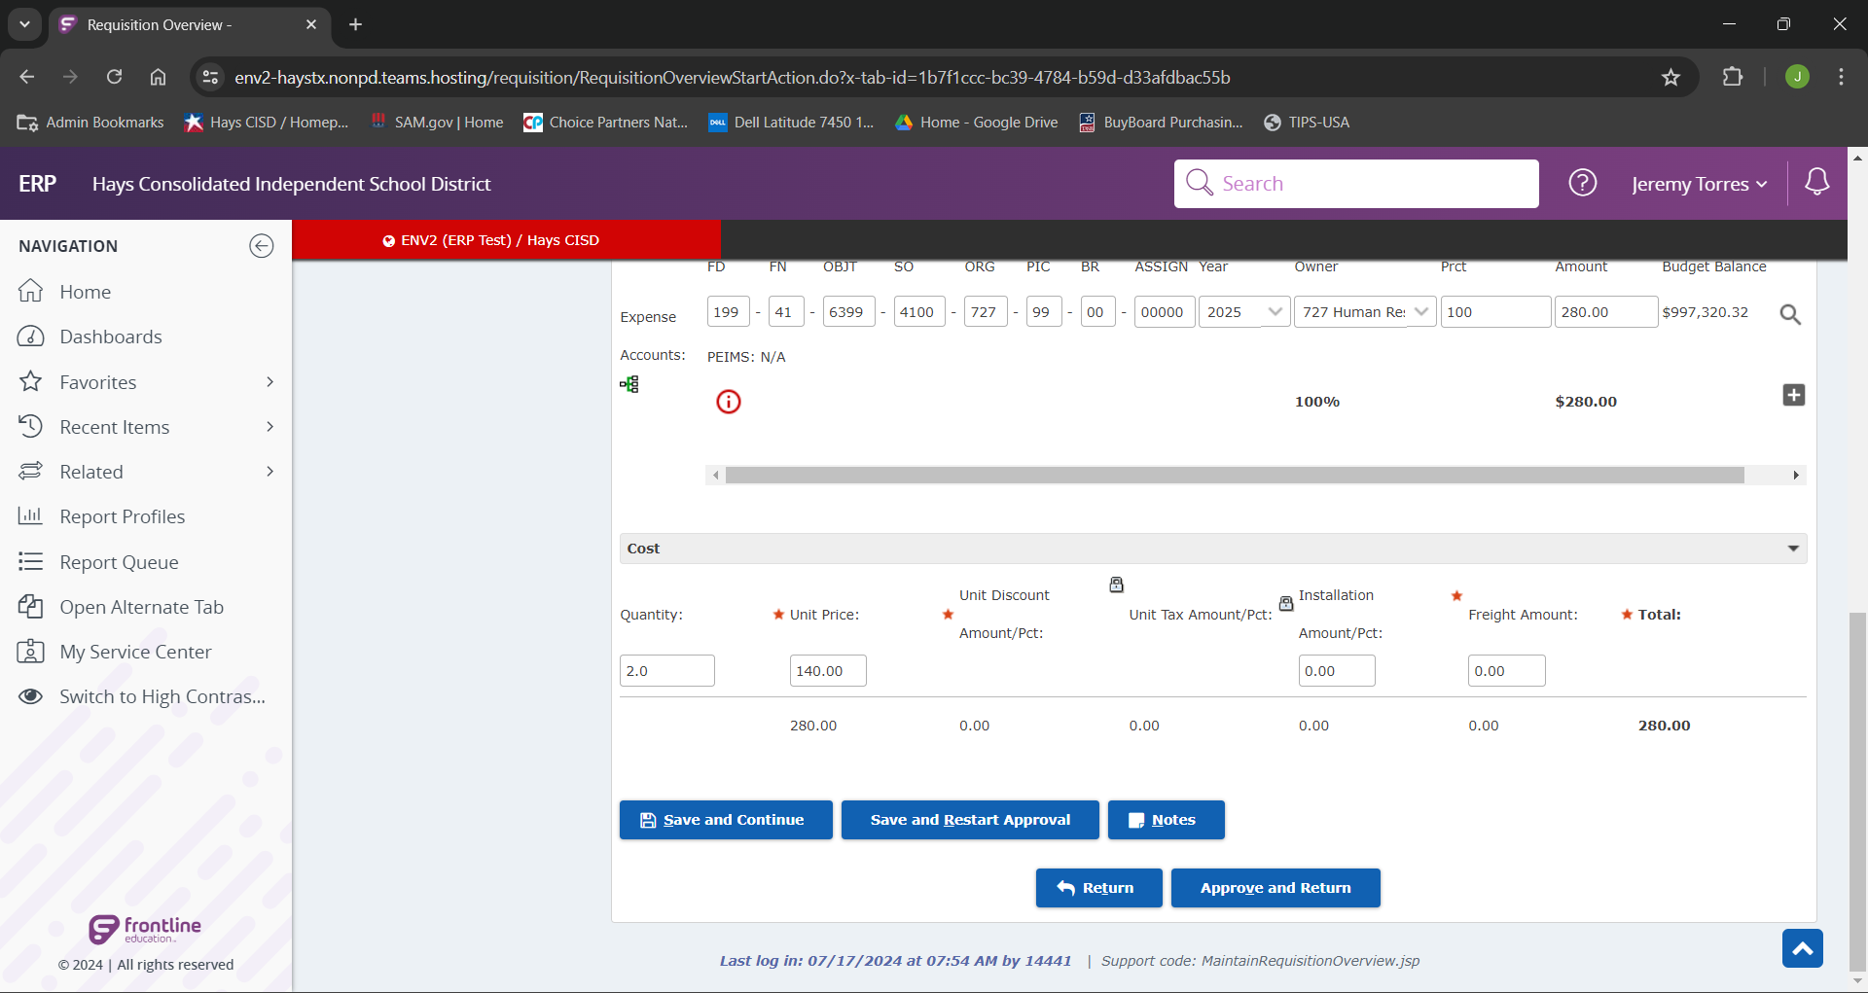
At the bottom of “Requisition Overview” page, once we have reviewed all of our necessary information, we can either return to our main requisition approvals page by clicking “Return” or we can approve the single line of a requisition by clicking “Approve and Return”.

Slide 9
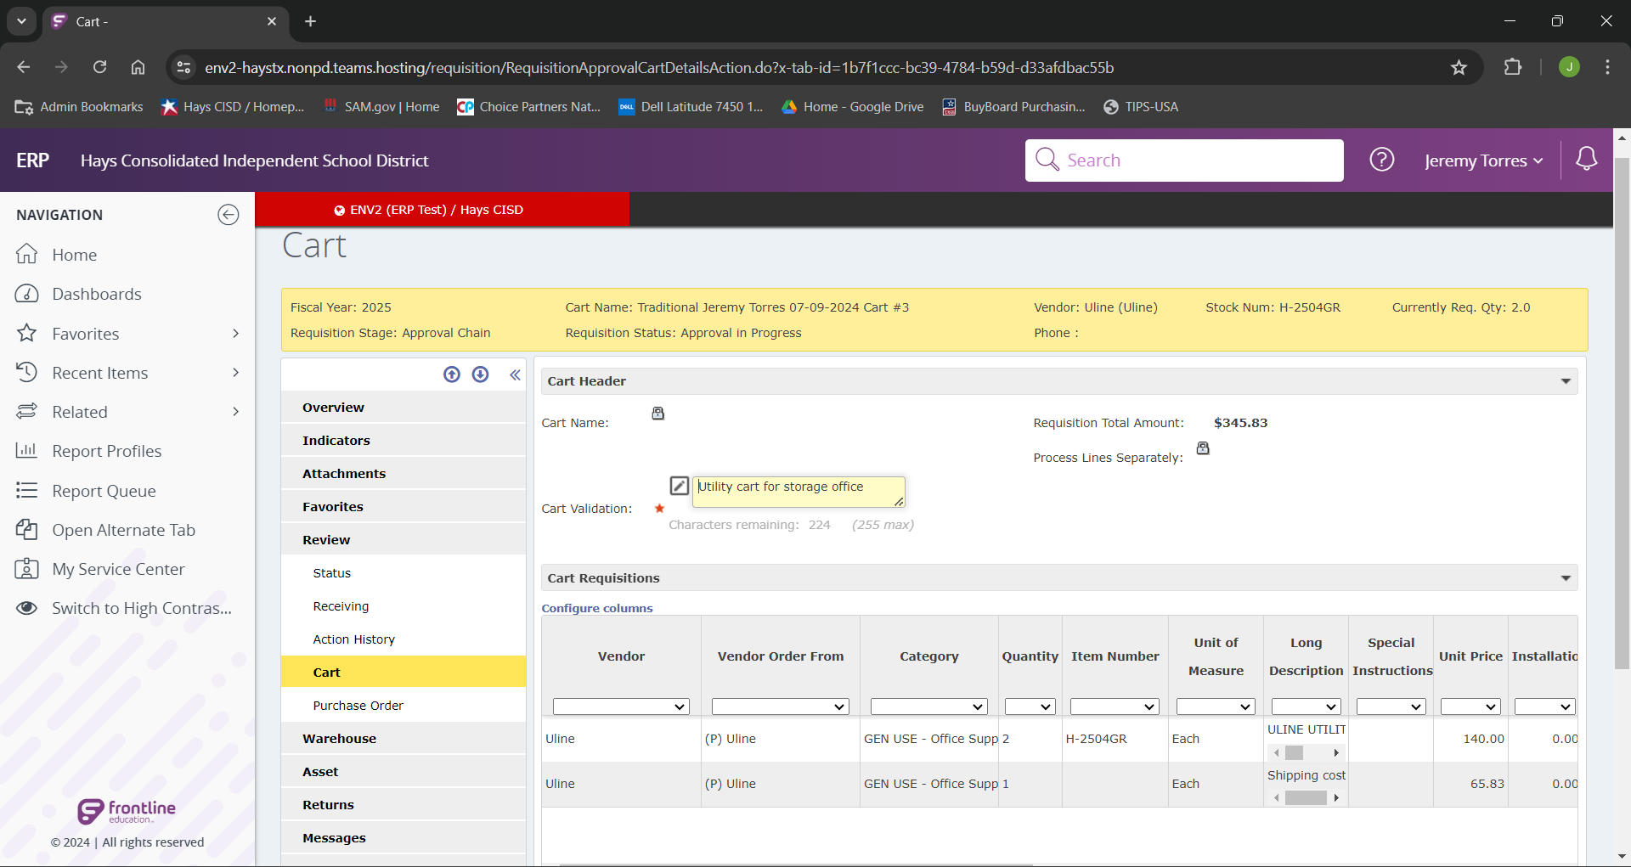
If we selected “Cart Details”, this would bring us to the “Cart” Page. If we were in our previous step of “Requisition Details”, we could also get to cart details by selecting “Review” in the navigation bar and clicking “Cart”
From here we can see all the details for the entire requisition, including “Requisitions Total Amount”

Slide 10
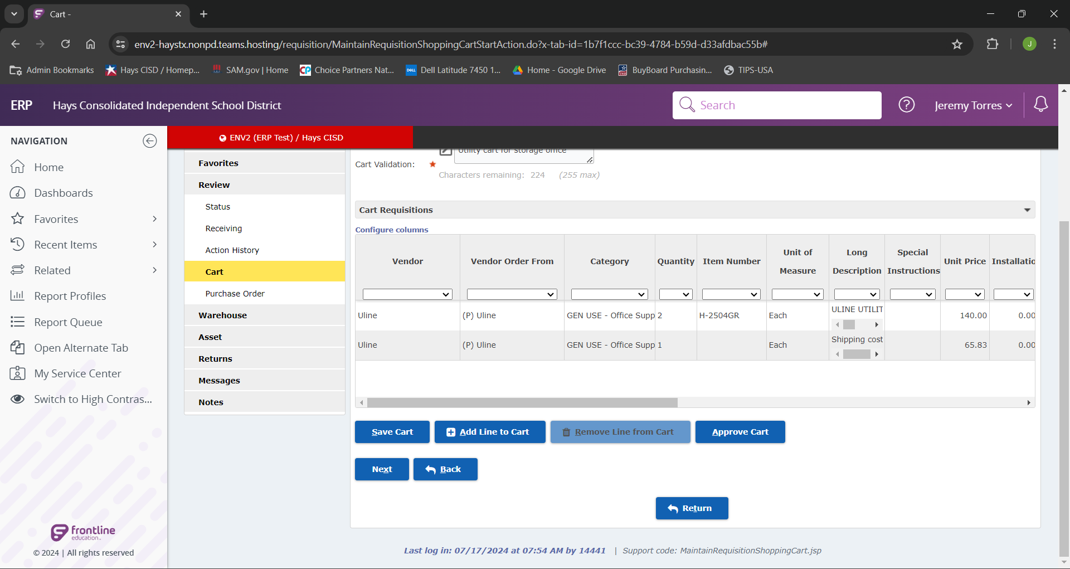
At the bottom of the “Cart” page, if the requisition had multiple line (and all of our necessary information looked good), we could approve the entire thing by selecting “Approve Cart”

Slide 11
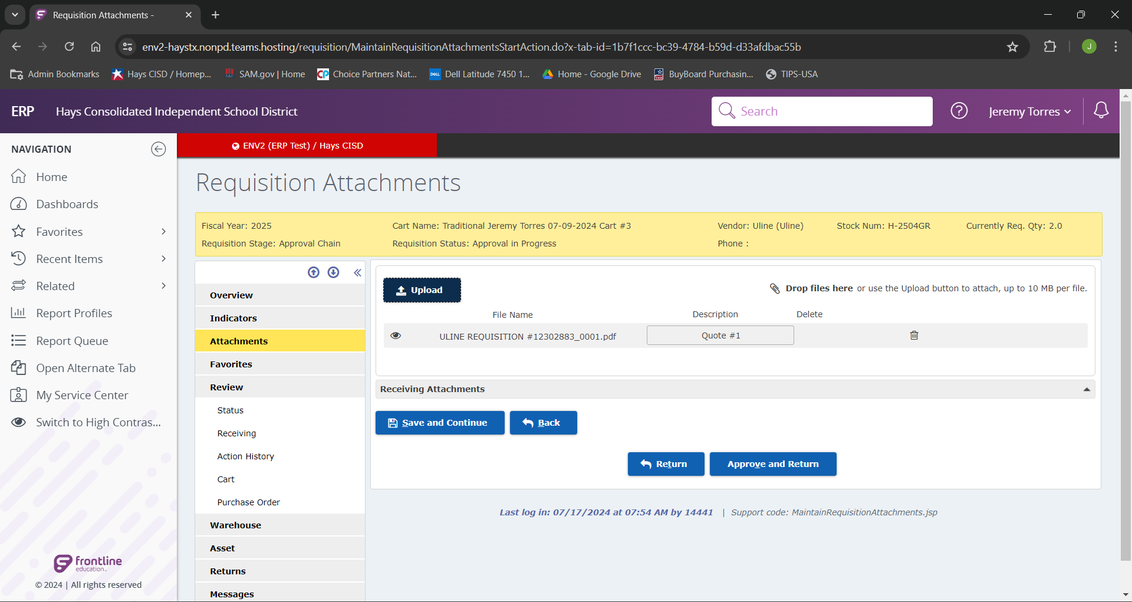
To view any attachments that were added to the requisition, from either the “Requisition Details” or the “Cart Details” we could select the “Attachments” menu item from the navigation bar. This will land us at the “Requisitions Attachments” page, where we can view all the supporting documentation loaded for this requisition.

Slide 12
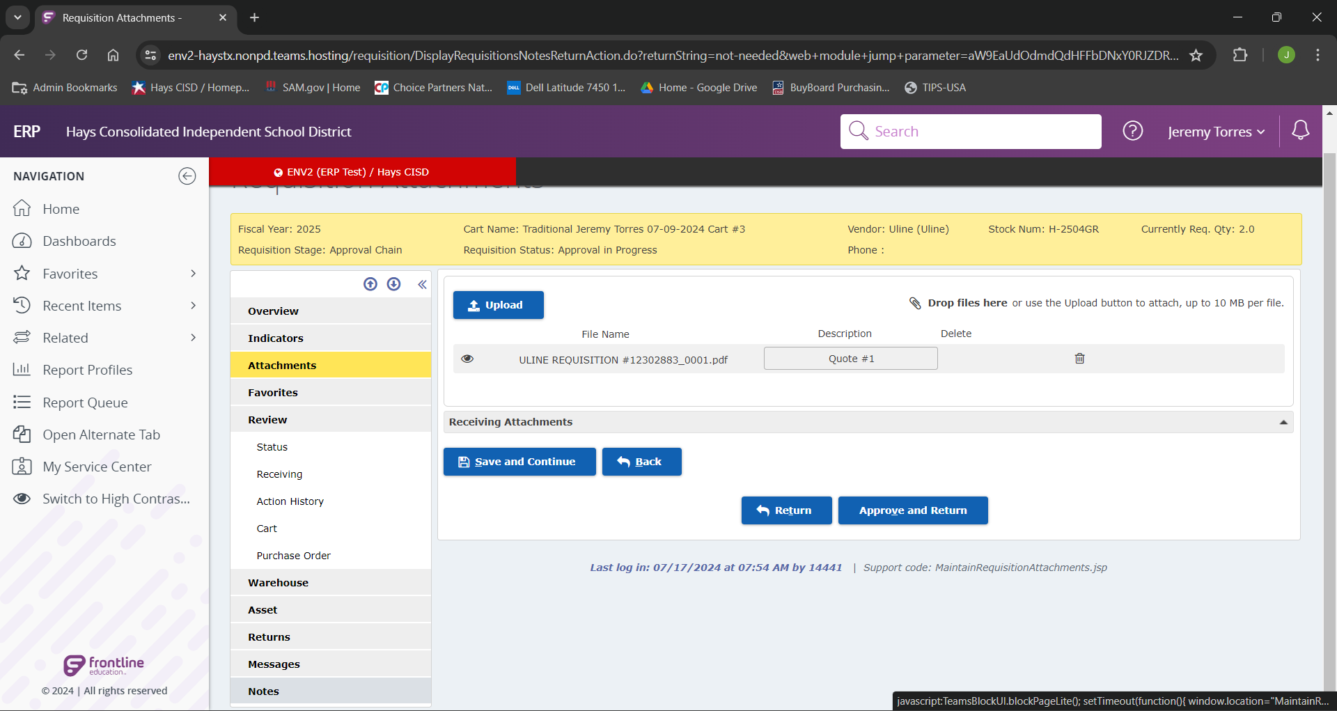
If we wanted to view or add any notes to this requisition we could go to the “Notes” menu item in the navigation bar.

Slide 13
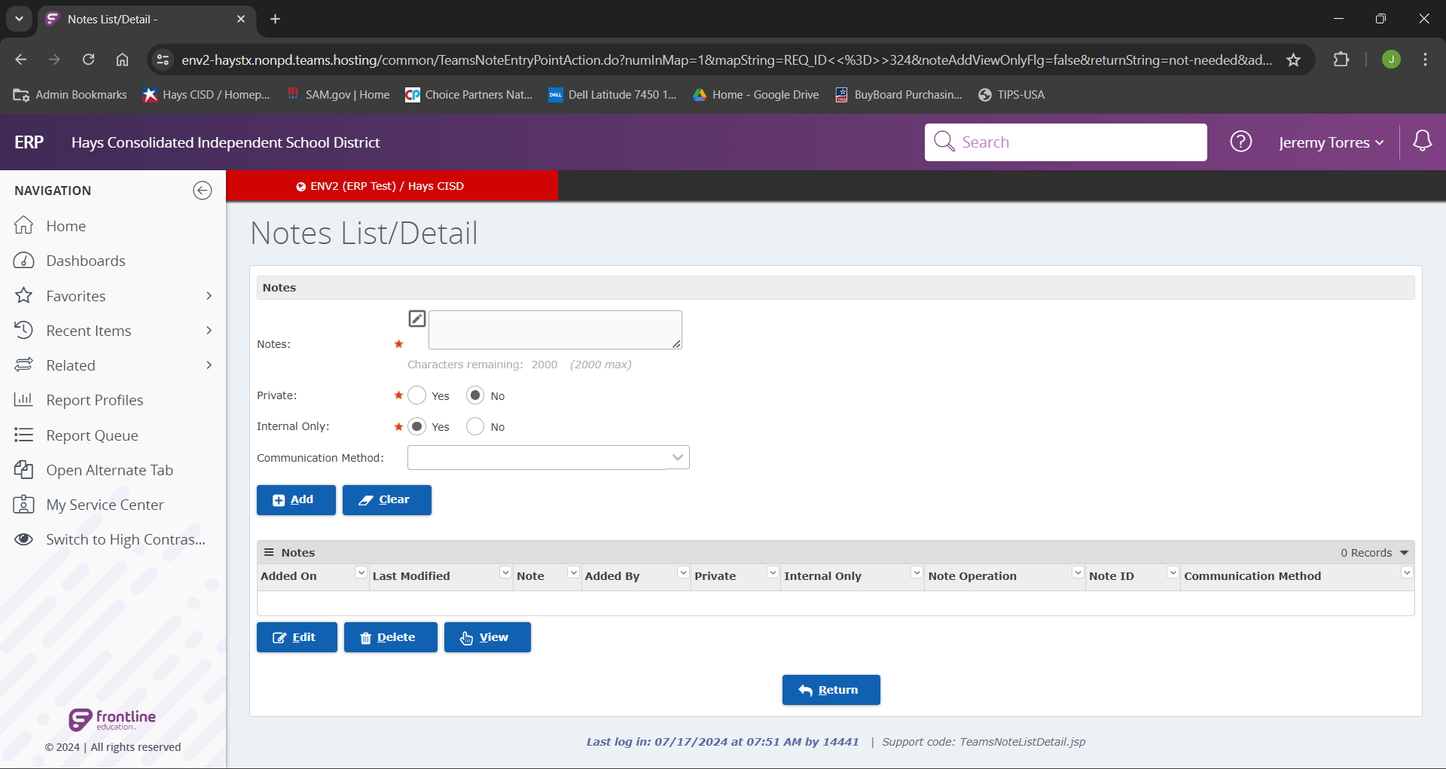
From here we would be able to view all notes already attached, or add our own notes.
Note: When adding a note we want visible on the PO we need to make sure “Internal Only” has the selected option of “No”.

