Slide 1
Searching for Incomplete Cart
Nicole Turner, Director of Purchasing
Anston Shockley, Buyer
Wendy Cordero, Buyer
Jeremy Torres, Buyer
Carlos Gavidia, P-Card Administrator

Slide 2
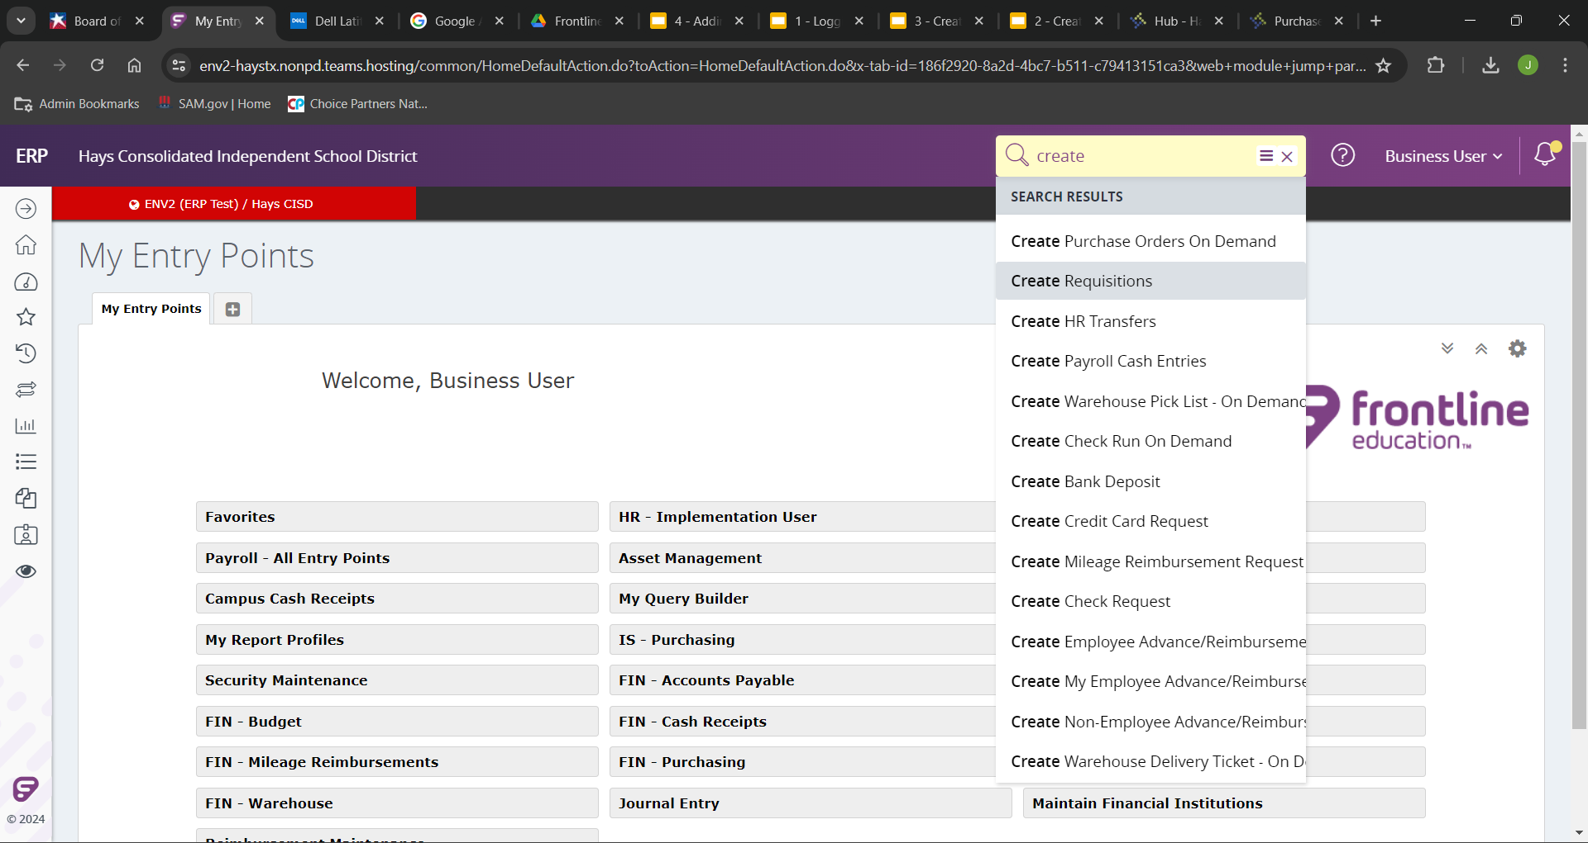
To finish an incomplete requisition, we will begin the same way as creating a requisition.
Begin to search for “Create Requisitions”.

Slide 3
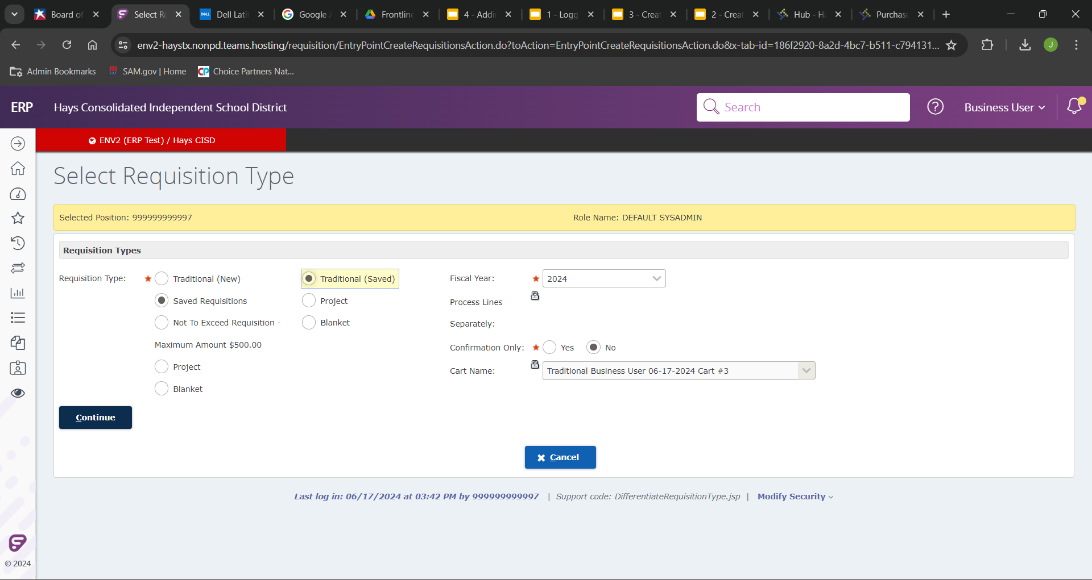
This time we will select “Saved Requisitions”, and since the requisition I save as an incomplete was a traditional, we will choose “Traditional (Saved)”.
Any saved carts will now generate in the “Cart Name” drop down.

Slide 4
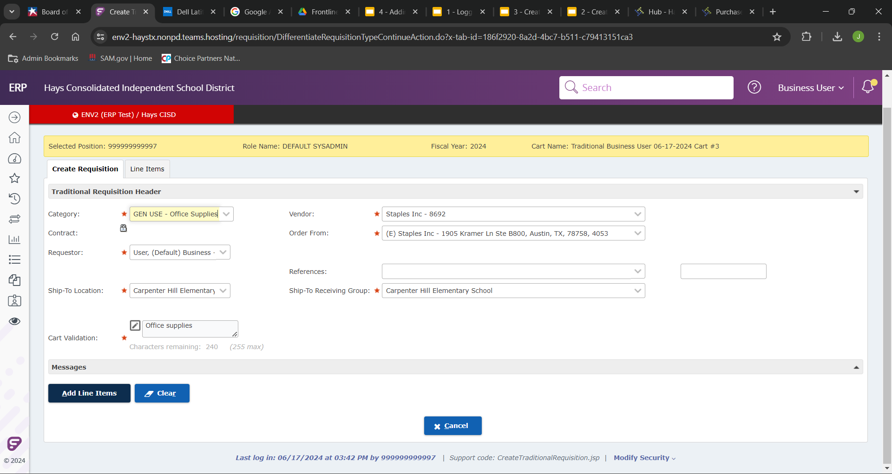
In the “available” list, select your desired entry point and click the “add” button. You can select all of your desired entry point and add them in at this point.

Slide 5
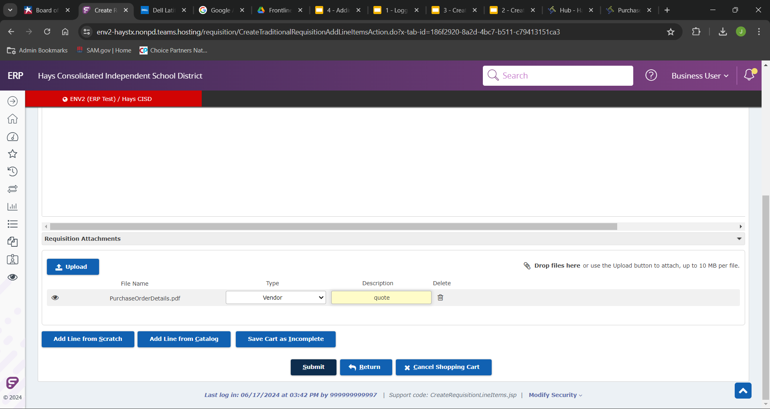
Once you have added your entry points in the “existing” field you can arrange their order by using the arrow buttons on the far right.

Slide 6
If you have any further questions please reach out to any of the purchasing team listed on the cover, or email the entire team at purchasingdept@hayscisd.net

