Slide 1
Creating Simple Traditional Requisition
Nicole Turner, Director of Purchasing
Anston Shockley, Buyer
Wendy Cordero, Buyer
Jeremy Torres, Buyer
Carlos Gavidia, P-Card Administrator

Slide 2
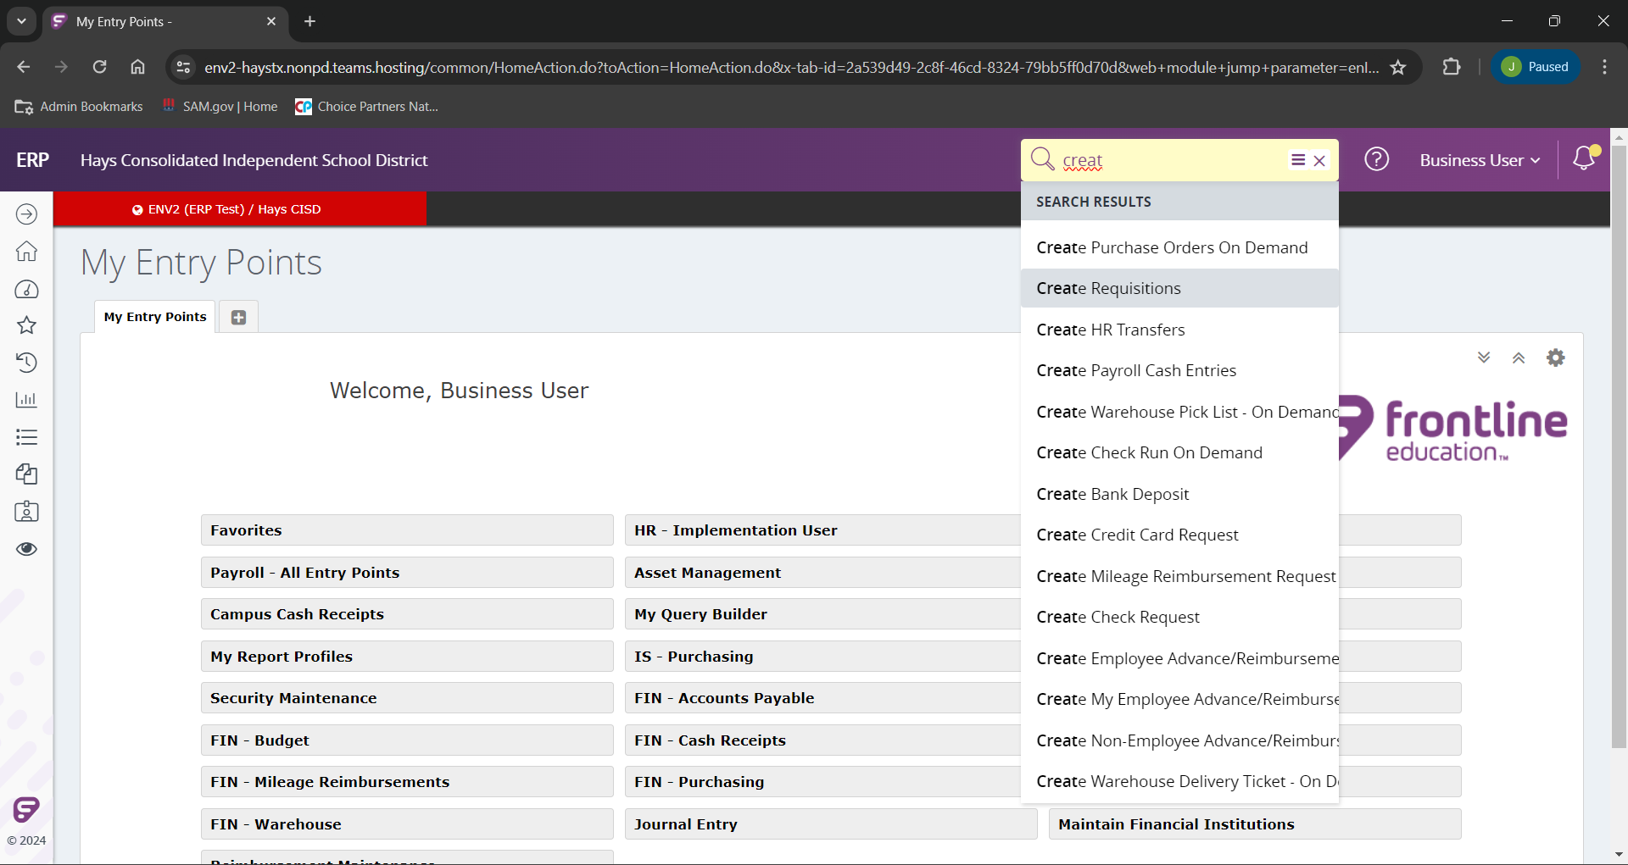
After you have logged into Frontline, to create your requisition we will begin typing the “Create Requisitions” in the search bar as indicated.
As you type in the search field the related inquiries will appear.
Select the “Create Requisitions”.
In a later training we will show you how to find this selection more quickly.

Slide 3
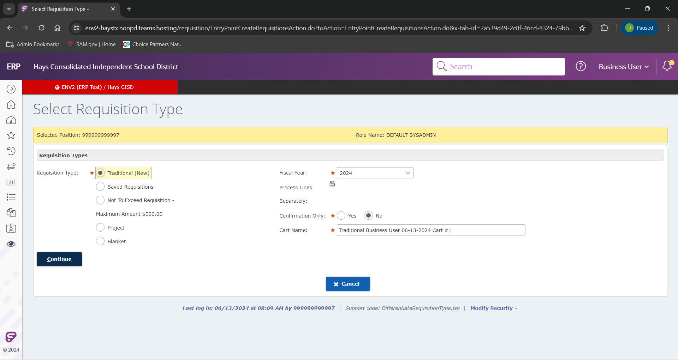
When you land on the “Create Resolution” page you will be prompted to select your type requisition we are going to create. For this example, we are going to select “Traditional (New)”.
We will need to be sure you have the correct “Fiscal Year” selected as well.
The “Cart Name” will auto-populate a cart name with “Traditional (Your Name) (Current Date) (Sequence Number)”.

Slide 4
Click Continue to the requisition creation.

Slide 5
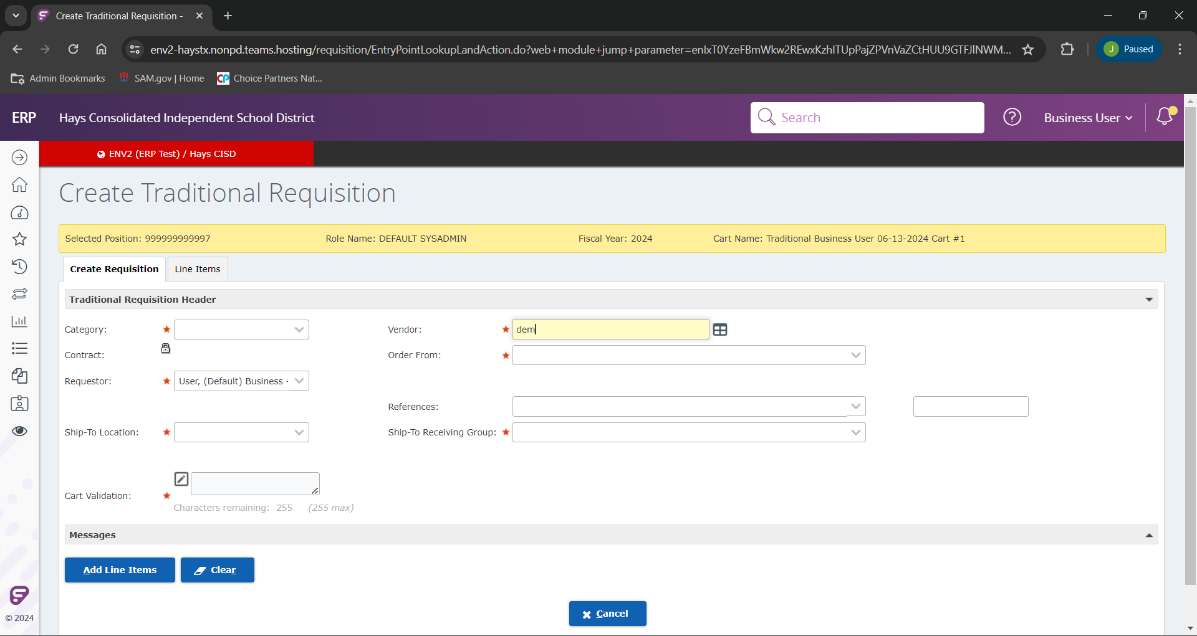
Once on the “Create Traditional Requisition” screen. Our first prompt we will use is the “Vendor”. If you know your vendor name you can begin to typing their name.
If you type in their exact name, it will populate as you click out of that field. If you only know a portion, you can type that portion and either click out of that field, of click the “Lookup Vendor” icon.

Slide 6
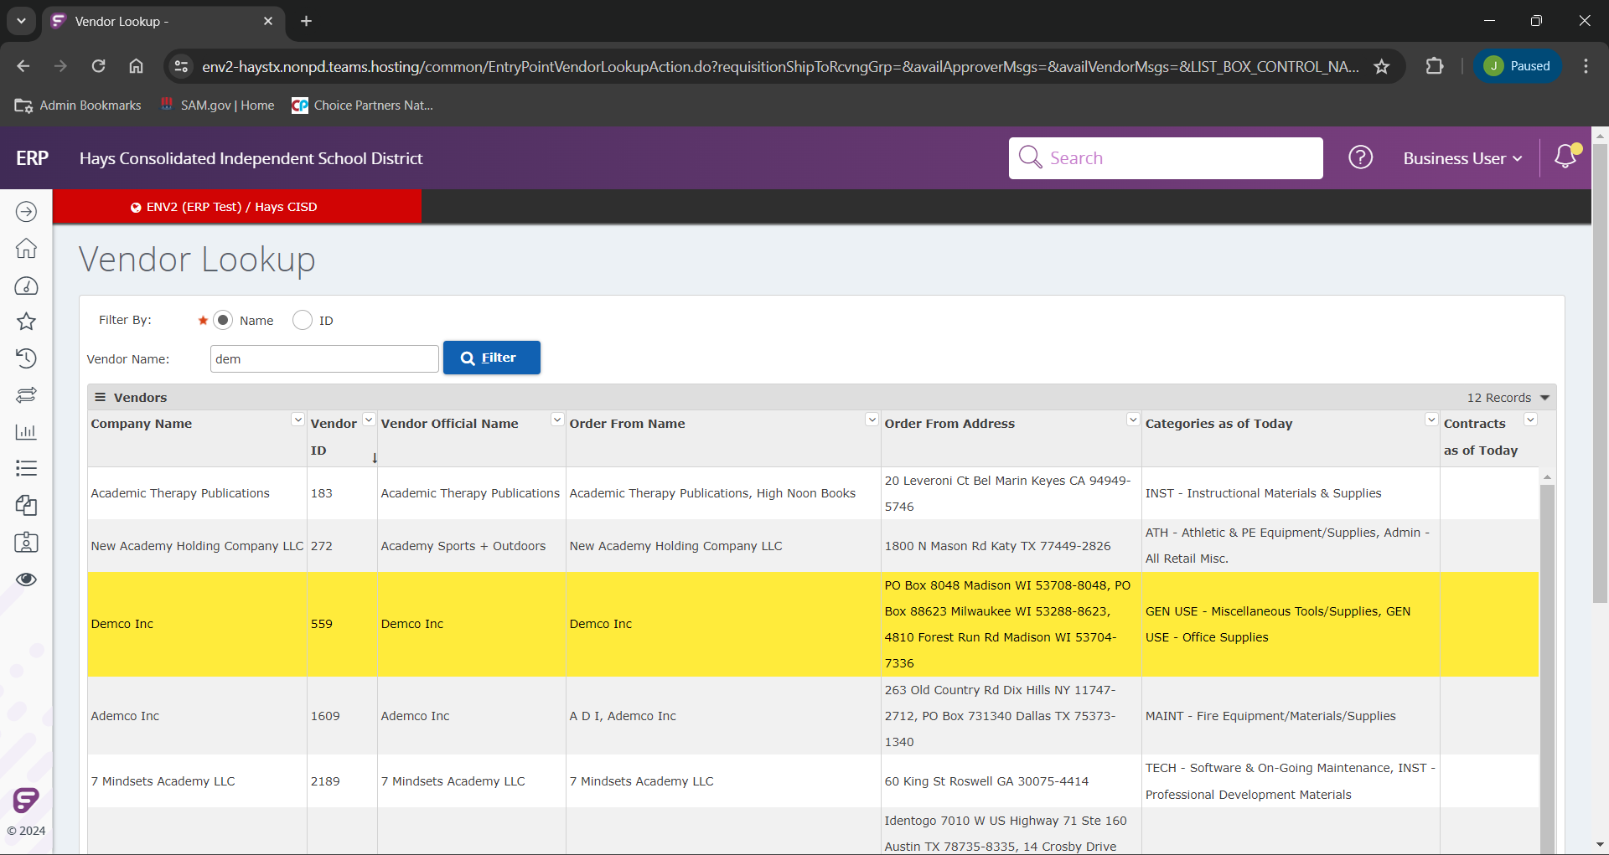
If you clicked out of the “Vendor” field or clicked the “Lookup Vendor” option. We will land on this “Vendor Lookup” page. From here we will select our correct vendor from the search list (In this example we will be using Demco), click the vendor to highlight/ select them.

Slide 7
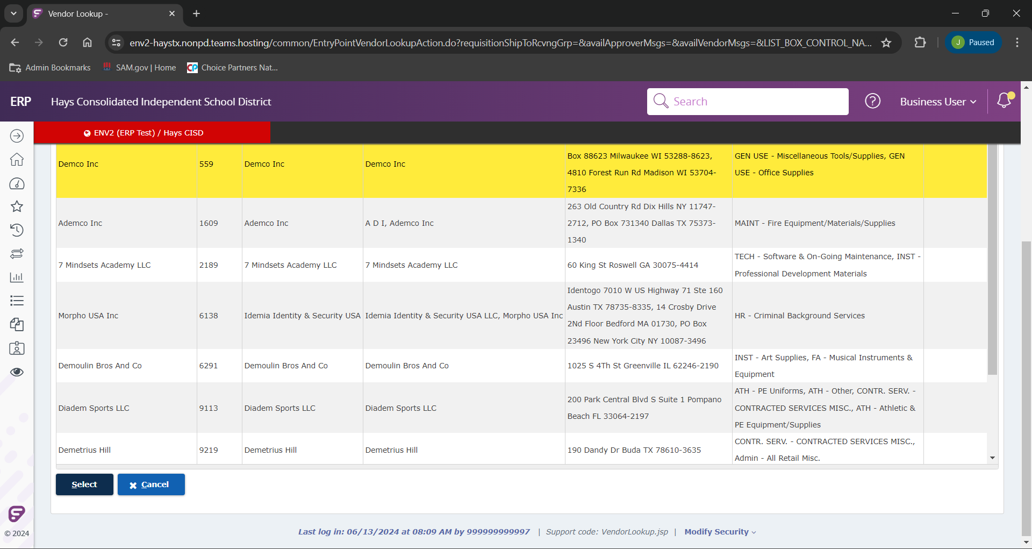
After you have your vendor selected we will click “Select” to move forward.

Slide 8
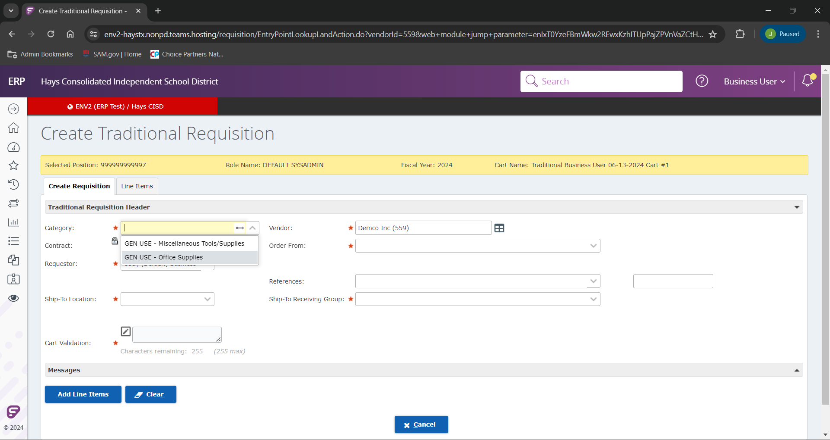
After the vendor is selected, we will chose the correct category in our “Category” field. For this example we are selecting “GEN USE – Office Supplies”.
Please note. As we work through this new ERP together, if there is a vendor that is being used in a different category reach out to Purchasing.Dept@hayscisd.net and we will work to make the appropriate corrections.

Slide 9
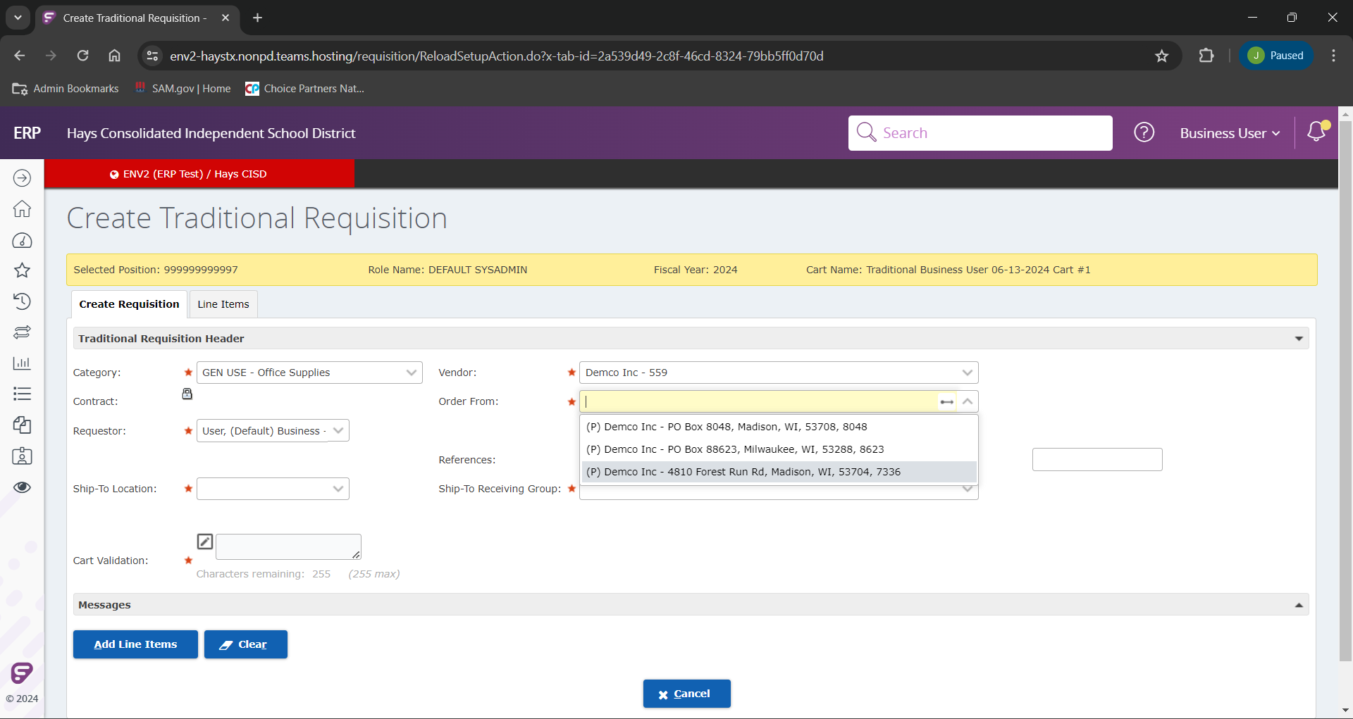
Several vendors will have multiple “Order From” locations. Please be sure to select the one published on your provided quote. In this example we will be using “(P) Demco Inc – 4810 Forest Run Rd, Madison, WI, 53704, 7736”

Slide 10
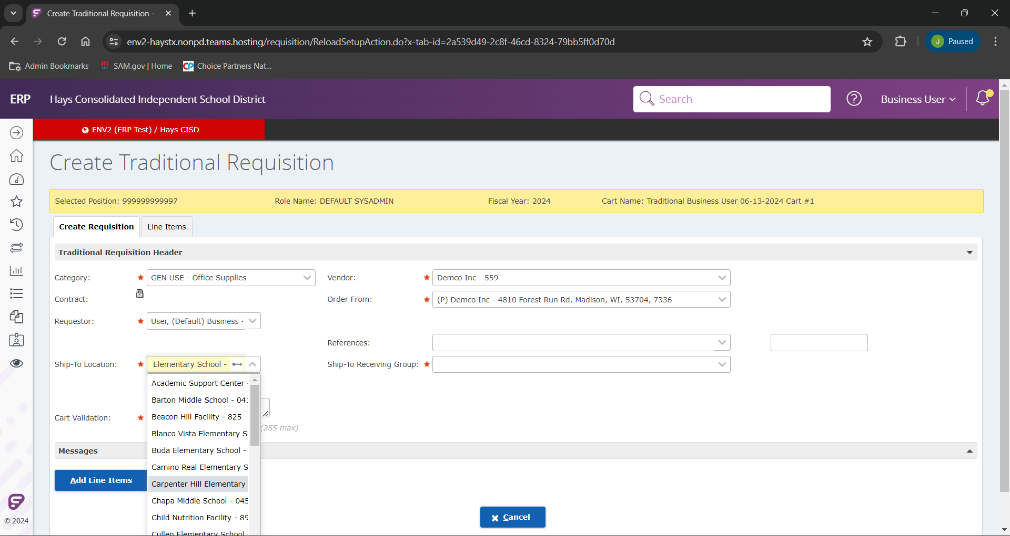
We will next select our “Ship-To Location”. A drop down will show all available options, but you can also begin typing in your location if you choose. In our example here, we will choose Carpenter Hill Elementary.

Slide 11
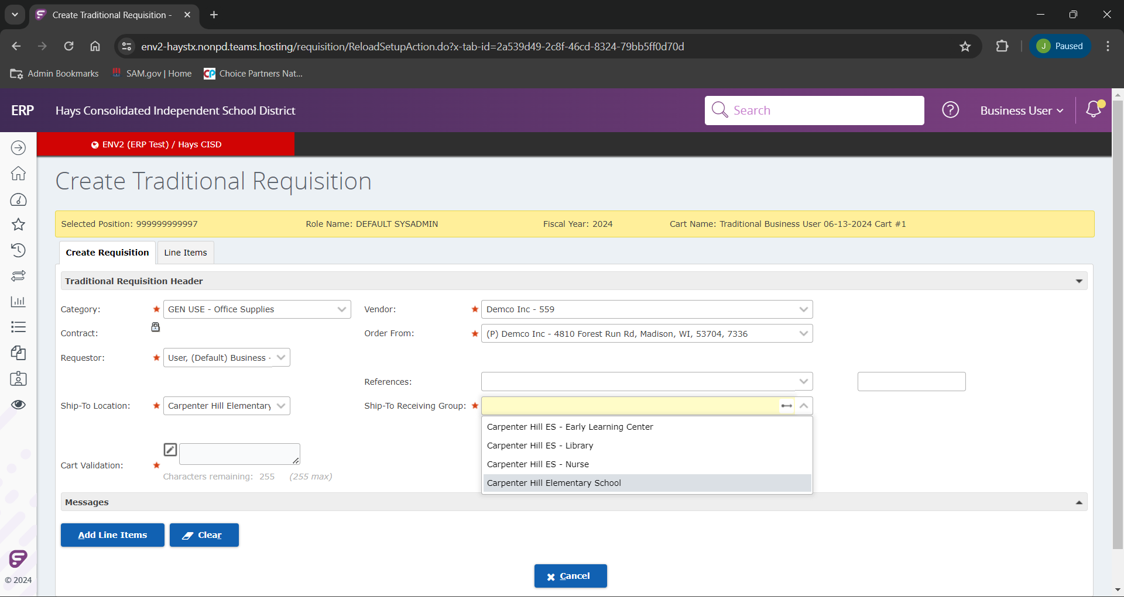
If your location has multiple ship points, you will next the appropriate “Ship-To Receiving Group”. Our example will use “Carpenter Hill Elementary School”.

Slide 12
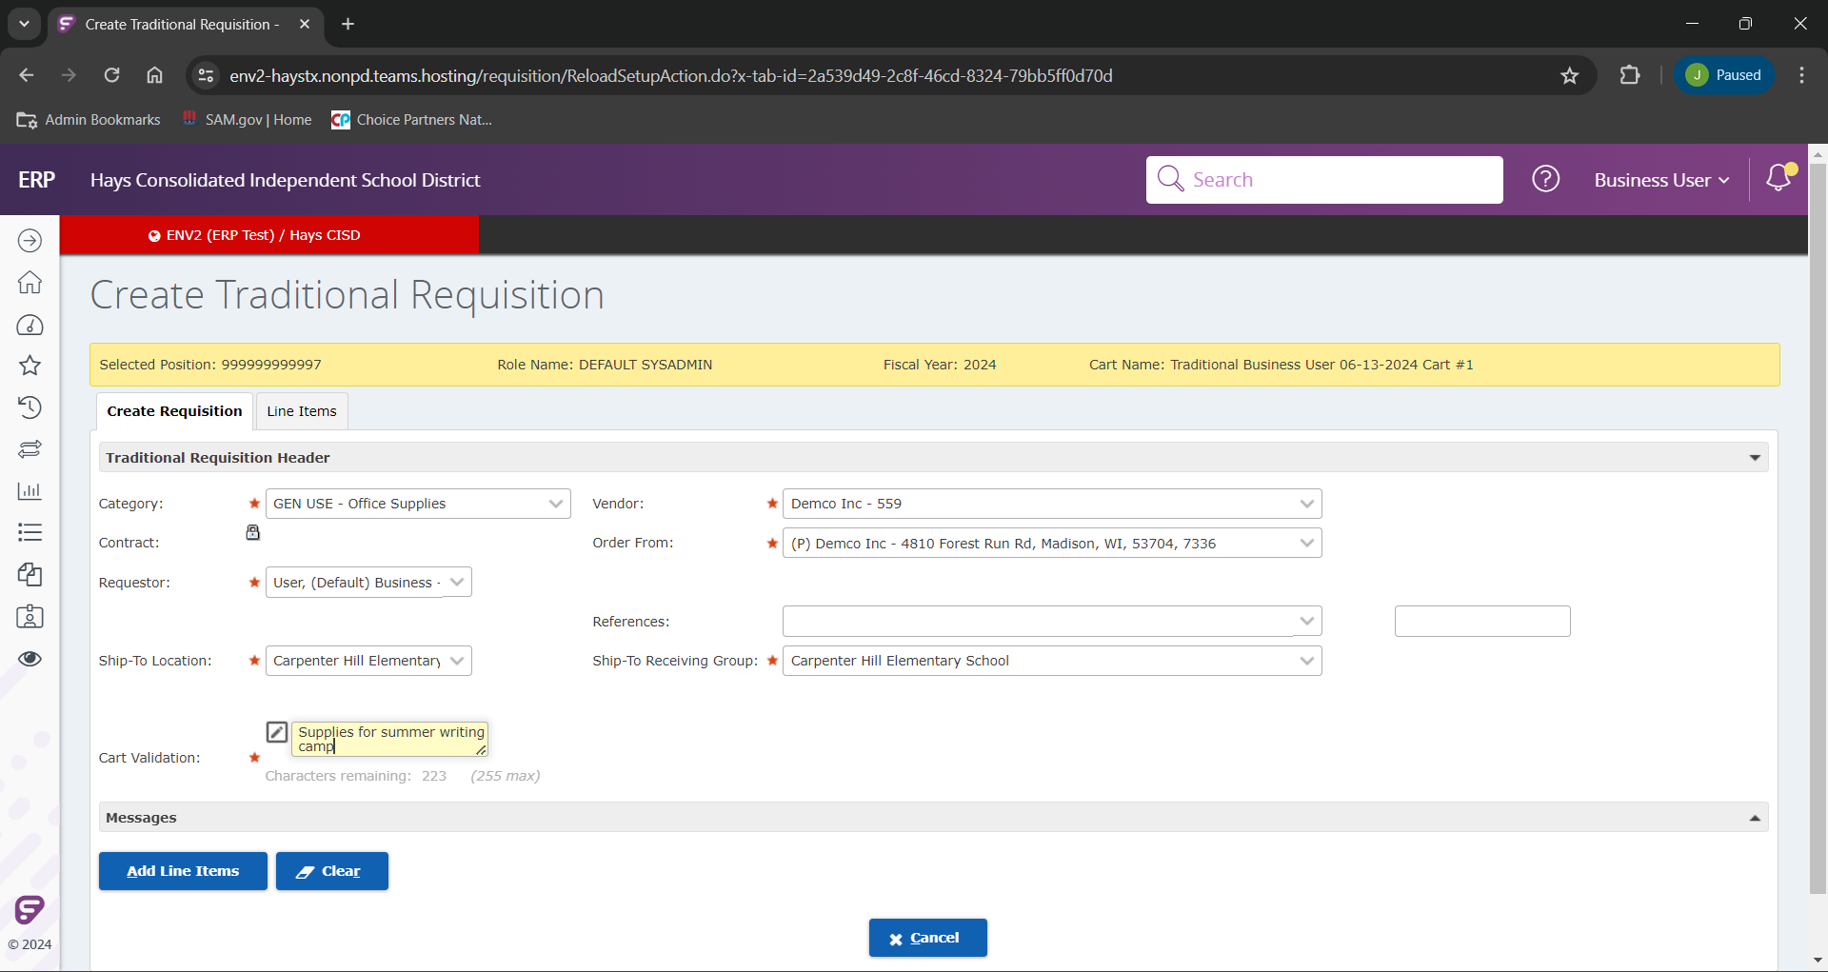
We will next be prompted to enter your “Cart Validation”, which will be the reasoning we are entering your requisition.

Slide 13
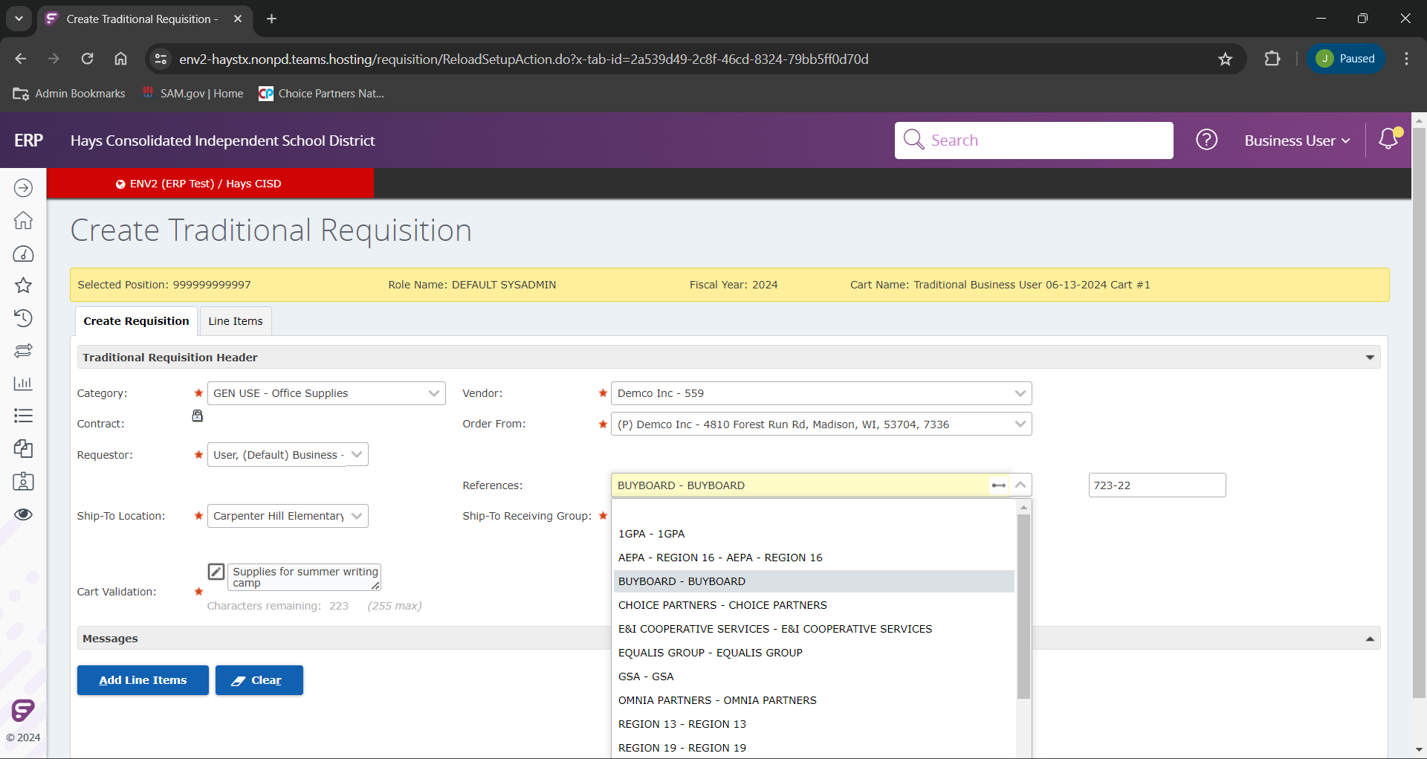
Our last fields we will use will be our two “References” fields.
If your requisition will be using a contact number for procurement, you can click into that field and a drop down will populate with our current contacts. (If you don’t see your contract please inquire with the purchasing team).
Your second field will be the actual contract number.
Our example we will use “BUYBOARD” and number 723-22

Slide 14
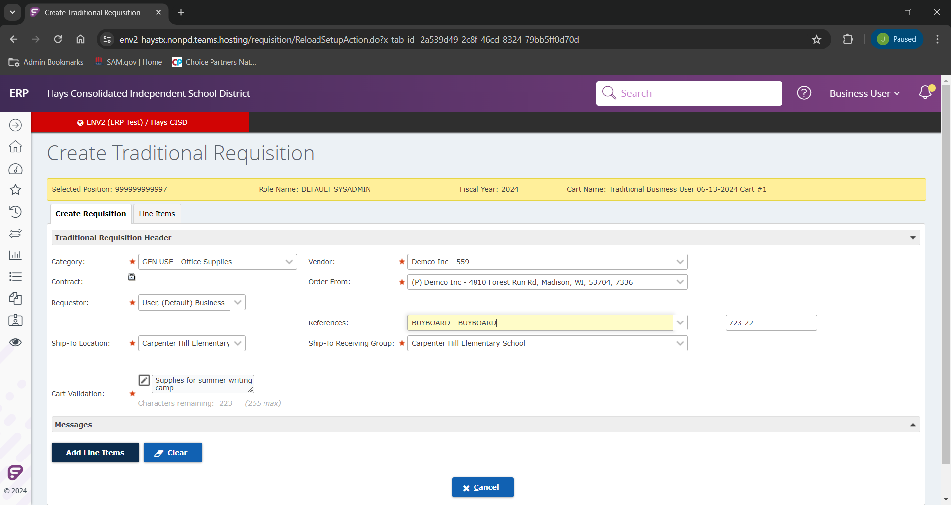
Once we have all of our fields filled out we are now ready to add our line items!
We will click “Add Line Items” to begin.

Slide 15
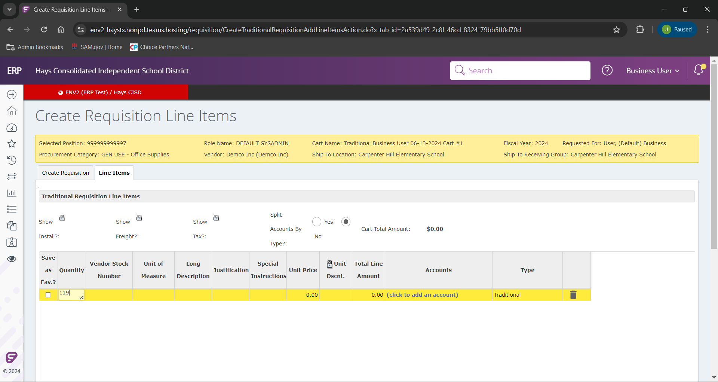
The first field we will work in is “Quantity”. This will be the amount of units we are wanting to purchase.

Slide 16
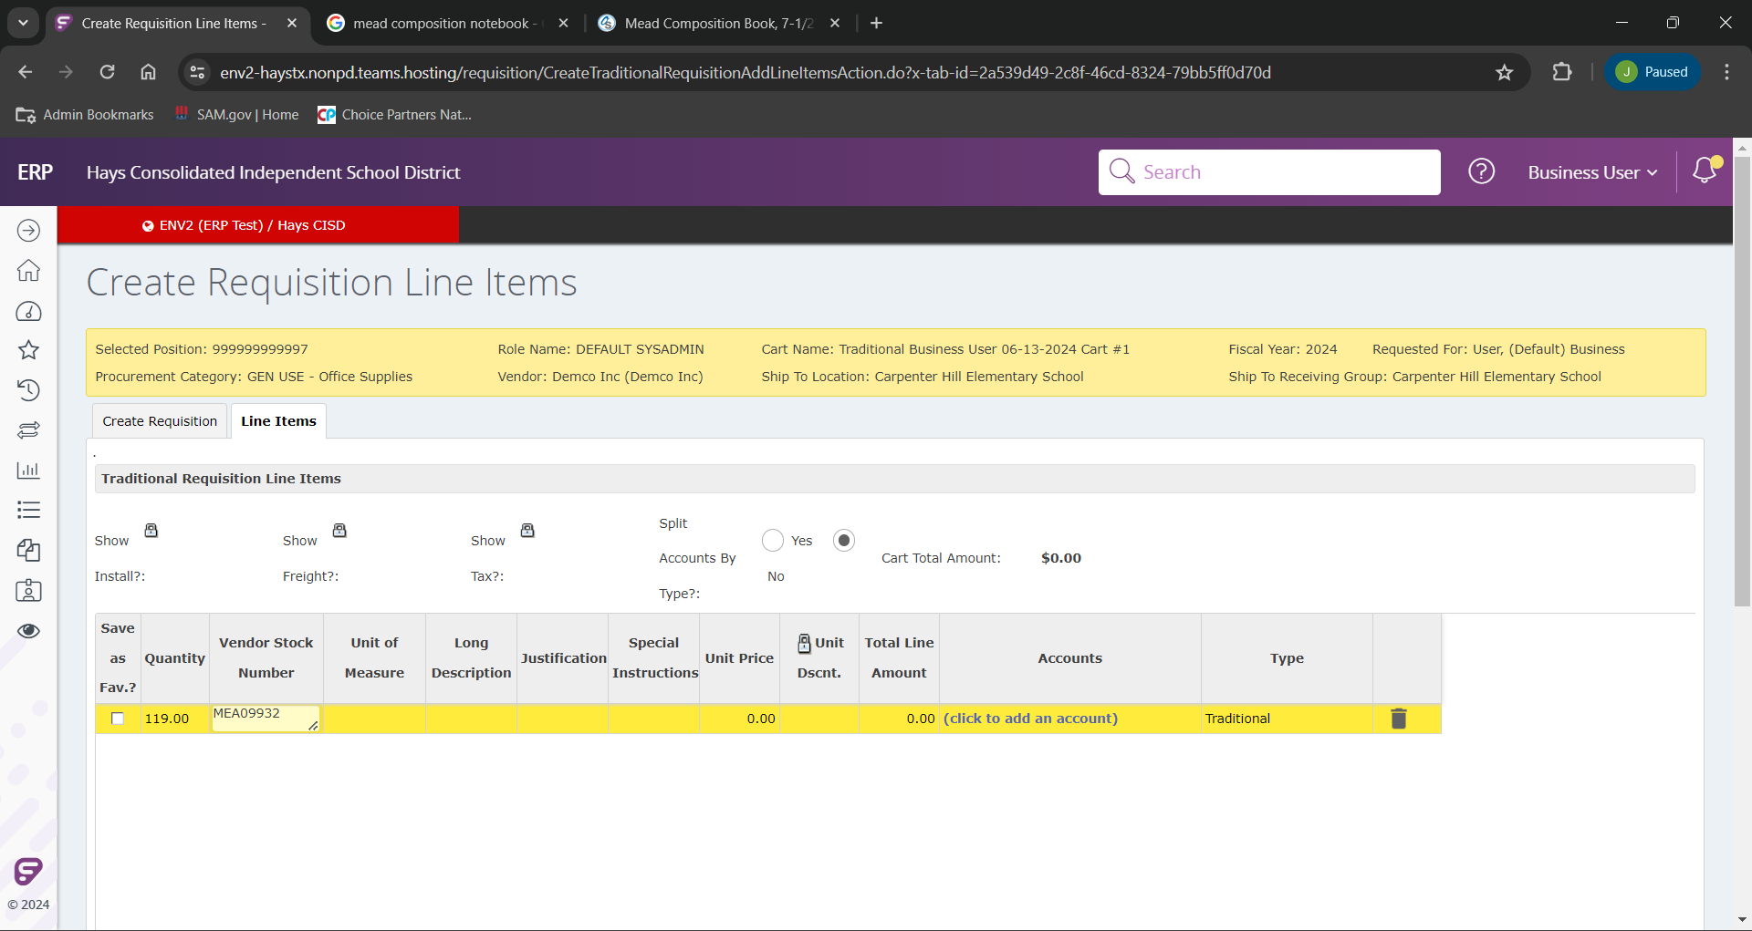
Next we will add the vendor number. This can be found on either the invoice or quote for the requisition.

Slide 17
We will next be prompted to add the “Unit of Measure”. This will be the manner in which we are ordering the goods/ or services.

Slide 18
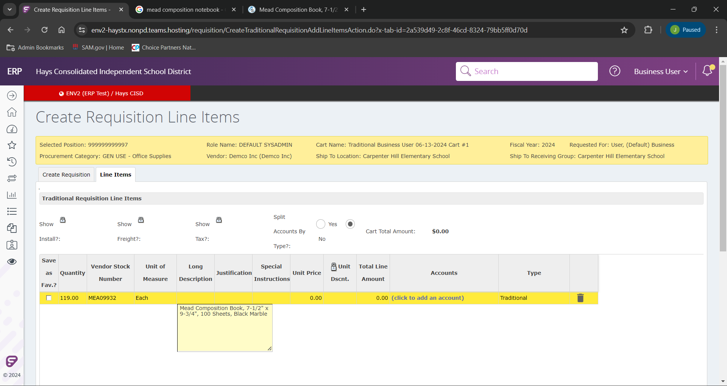
Next we will add the description of the item in the “Long Description” field. Please enter the fullest description you can for this. You can often find the most accurate description on the invoice or quote. (even though this field has no asterisk it will be mandatory)

Slide 19
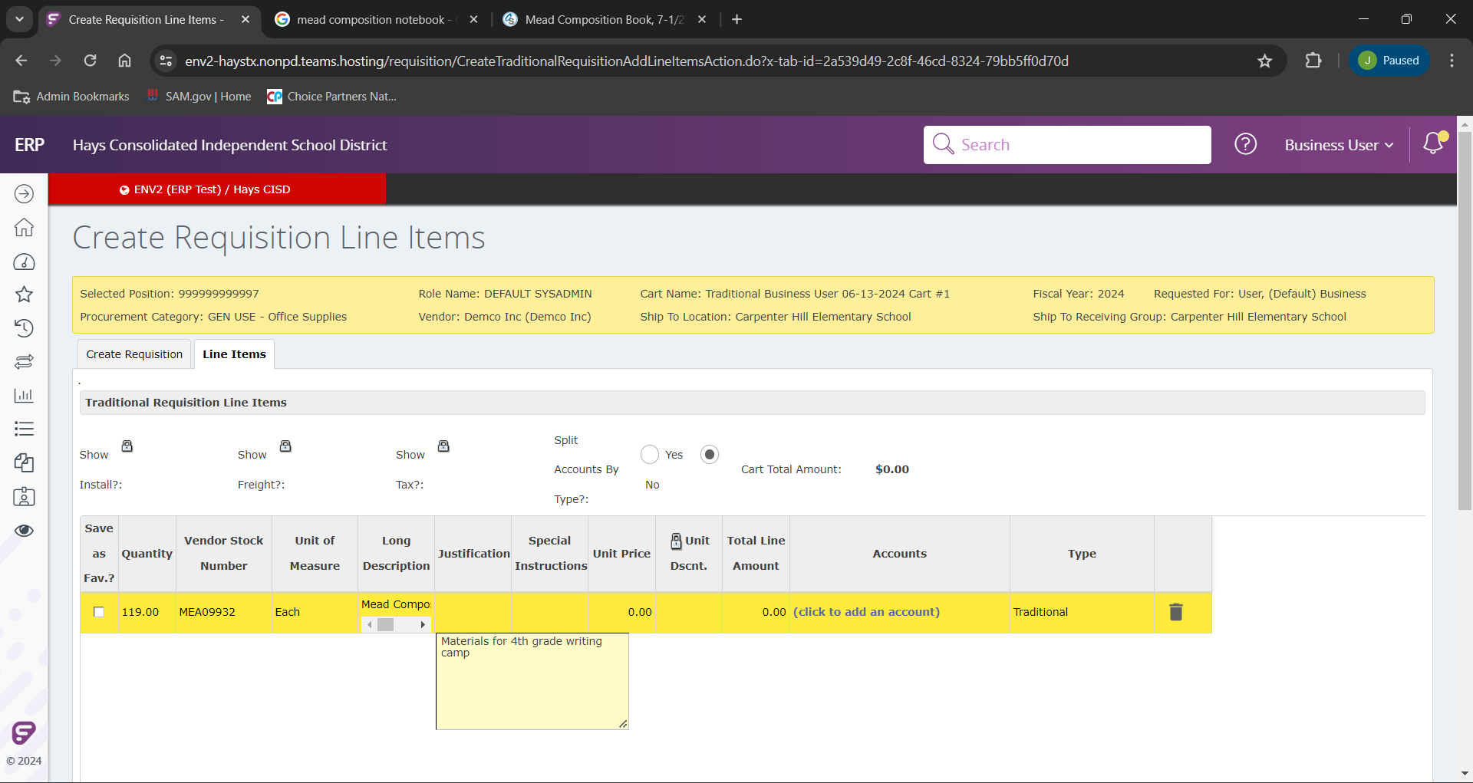
Our next field will be our justification, which will be very similar to our cart validation, our reason for submitting the requisition.

Slide 20
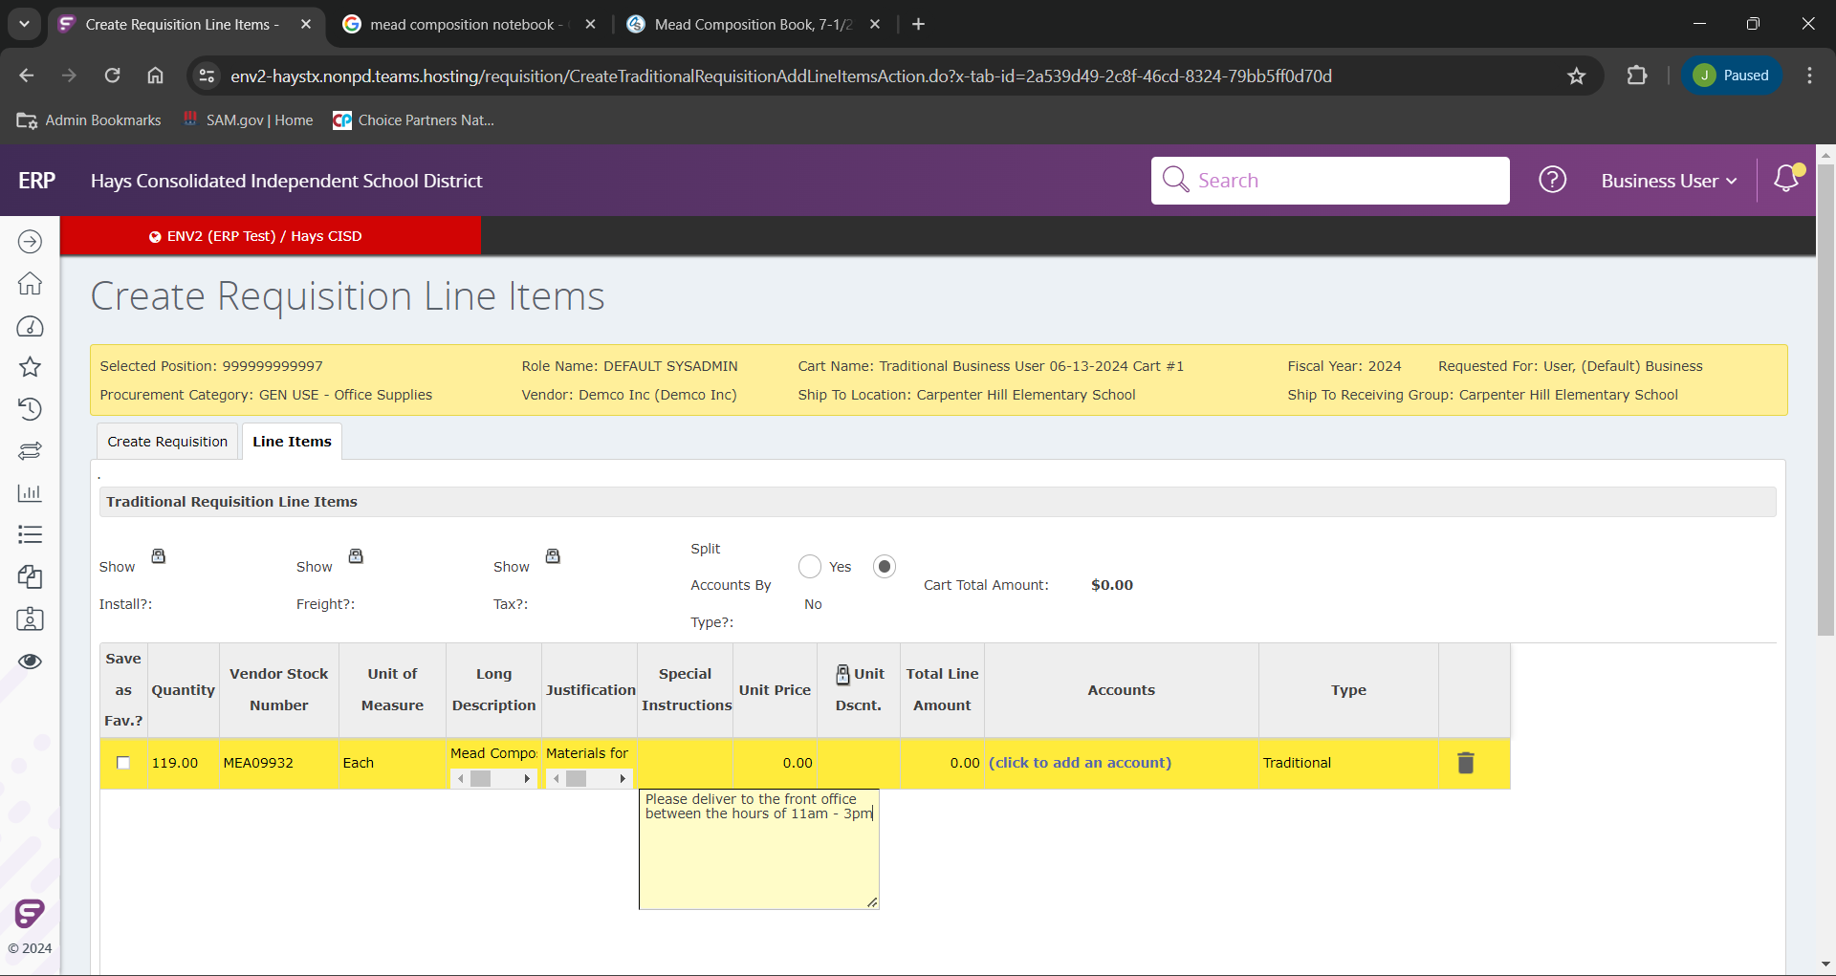
If we have any special instruction, they will be entered here. These can be examples of required delivery hours, delivery days, who or where to deliver to, etc.

Slide 21
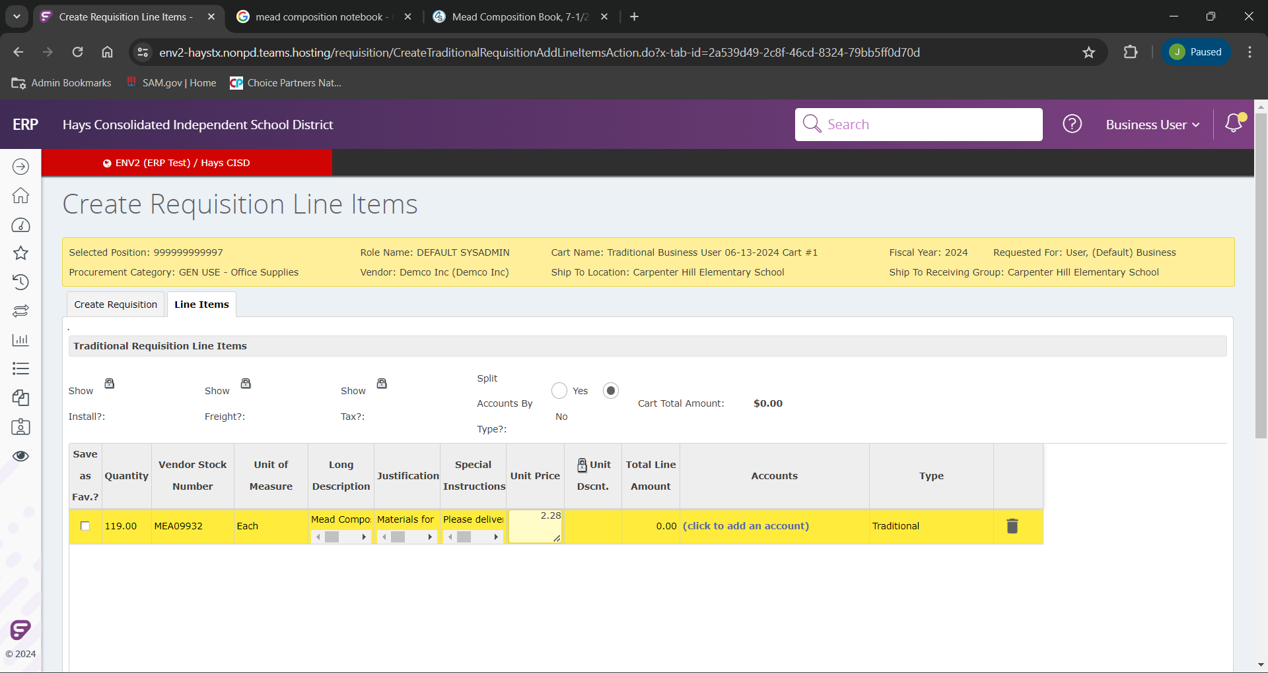
We now will enter the “Unit Price”, which will be the cost per the unit of measure you selected. In this case it will be 2.28 for each journal.

Slide 22
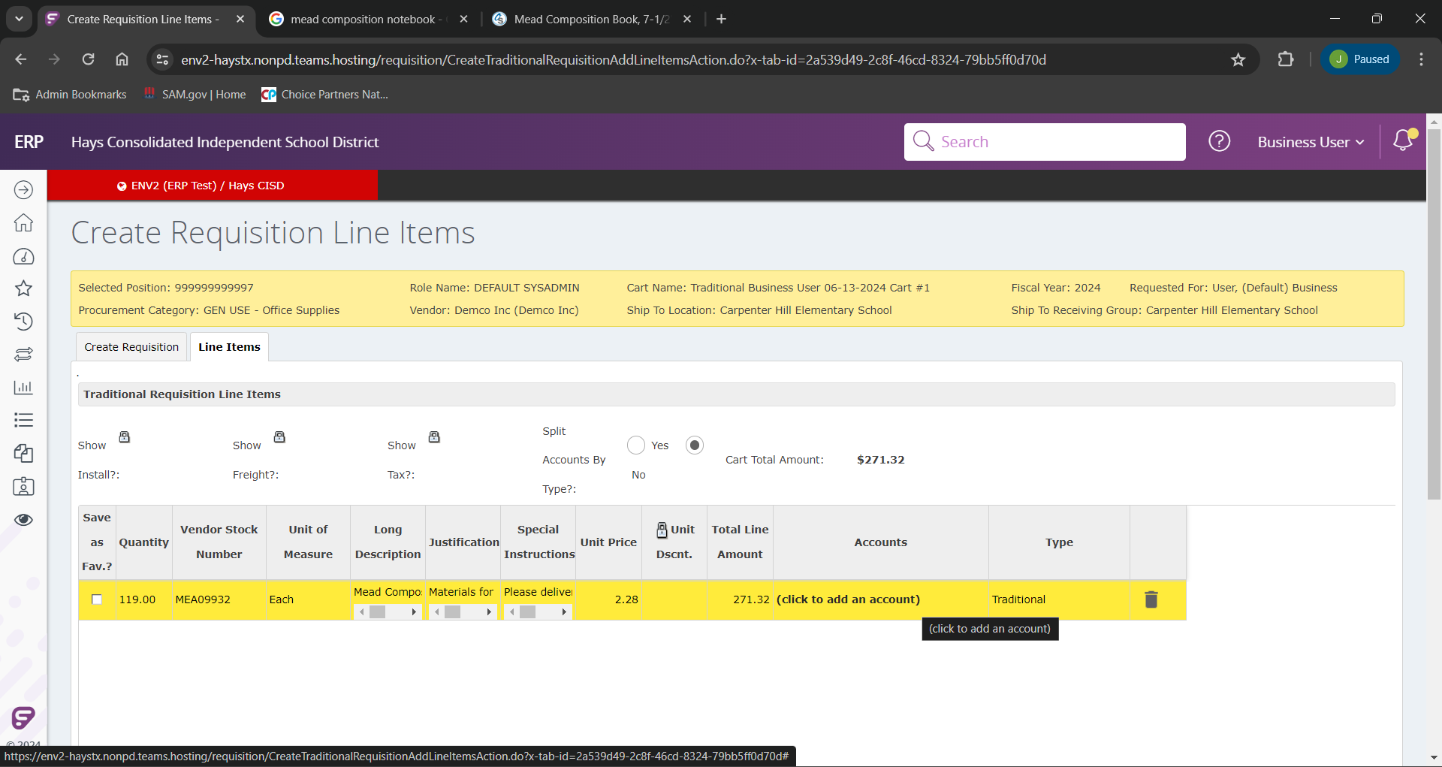
When we have the Unit Price and click out of that field it will populate the “Total Line Amount” field.
In the next field we will add a budget code by clicking the “(click to add an account)” link.

Slide 23
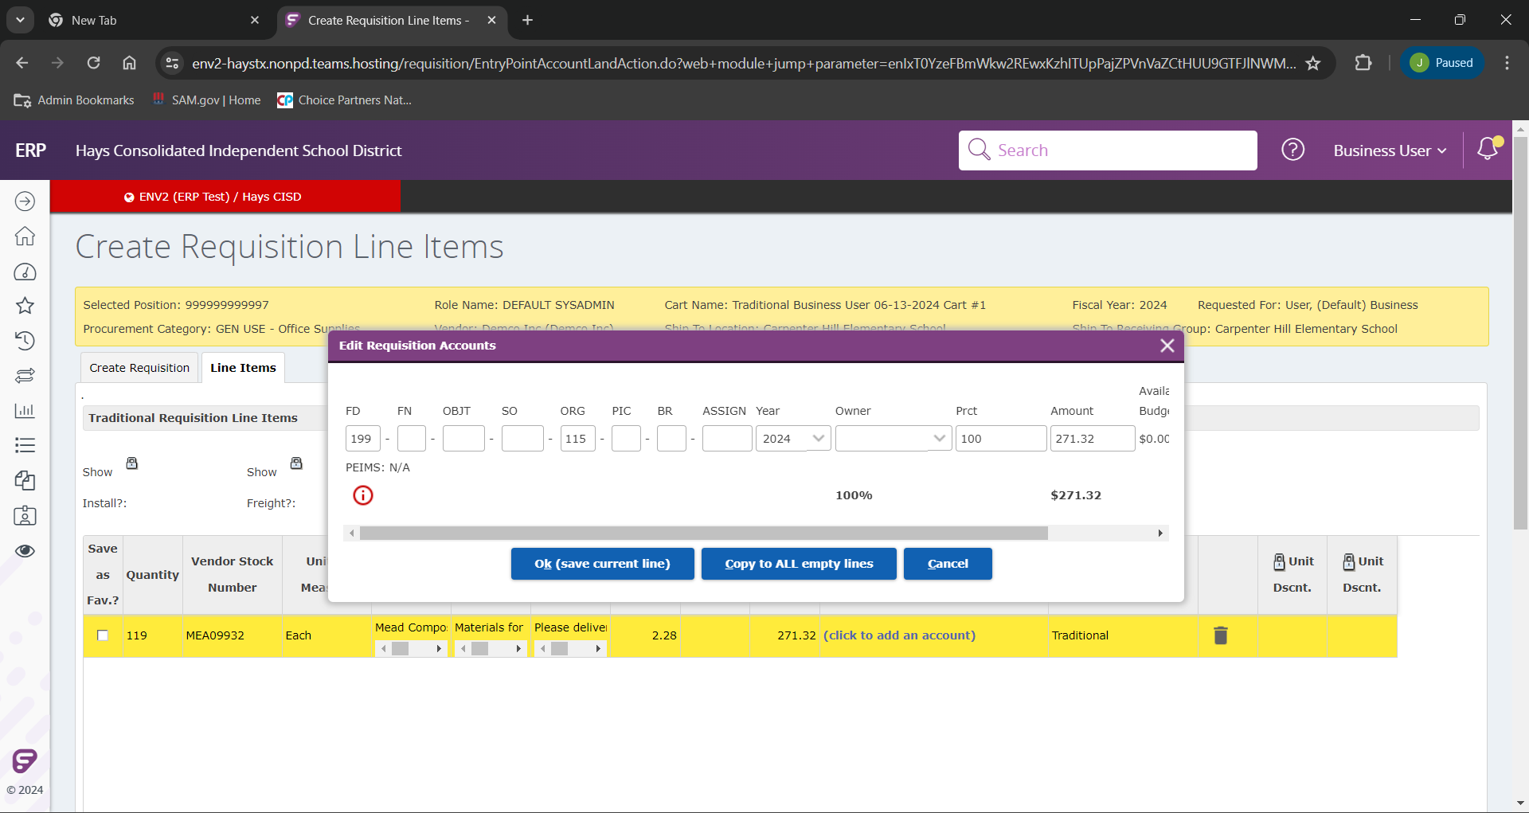
If you know you budget code you can type in manually.
If you would prefer to search it and see the available funds on the budget code, you can begin typing parts you know.

Slide 24
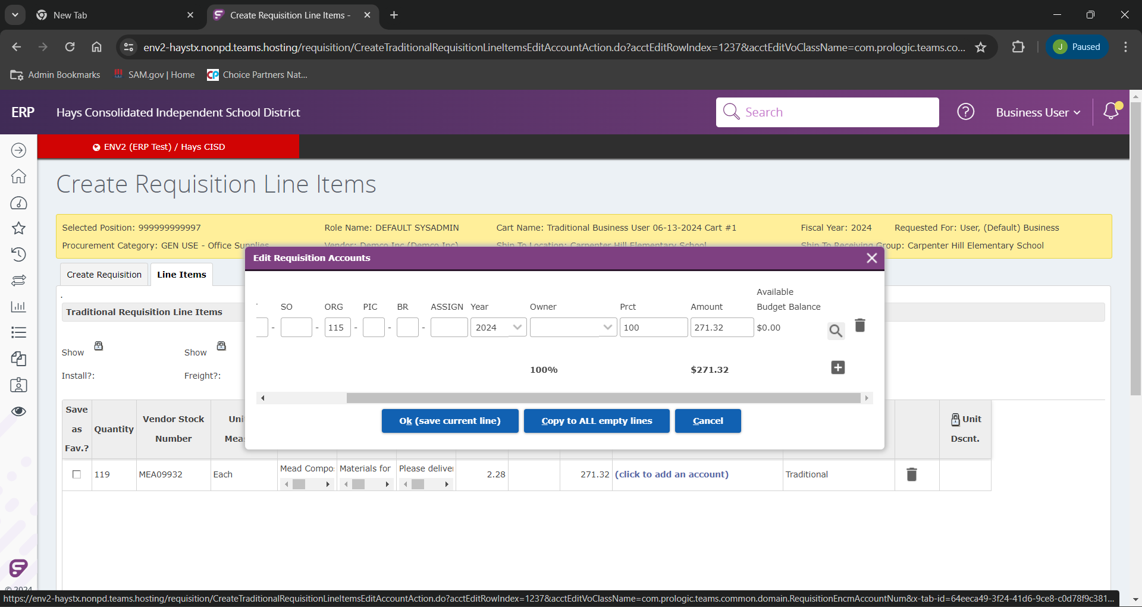
Click the magnifying class to initiate the search.

Slide 25
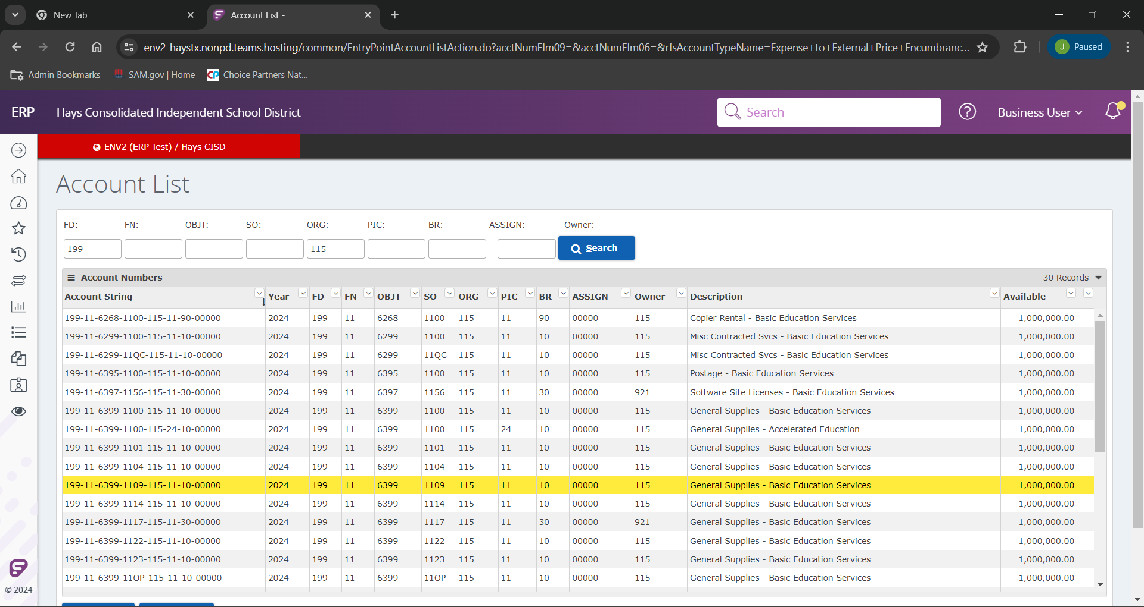
Select the desired budget line (See the last column, "Available”, to see the account balance)

Slide 26
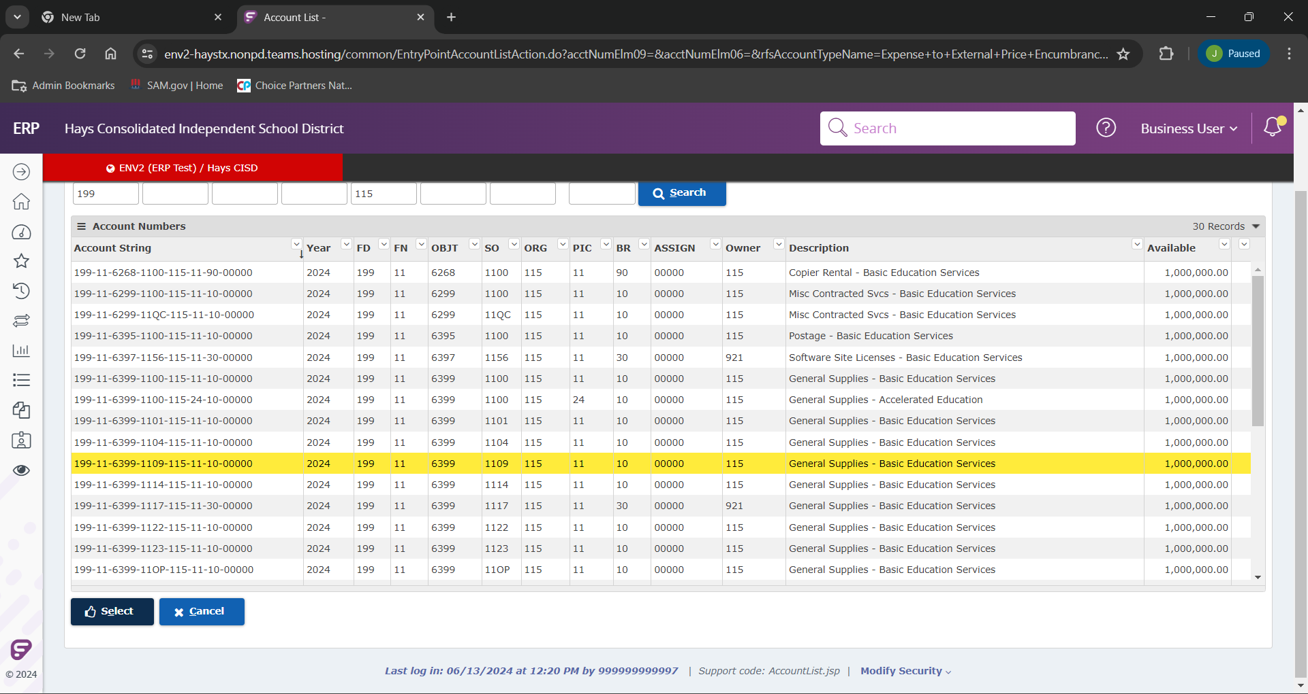
As we have our desired budget selected, we can finalize our selection by clicking “Select”.

Slide 27
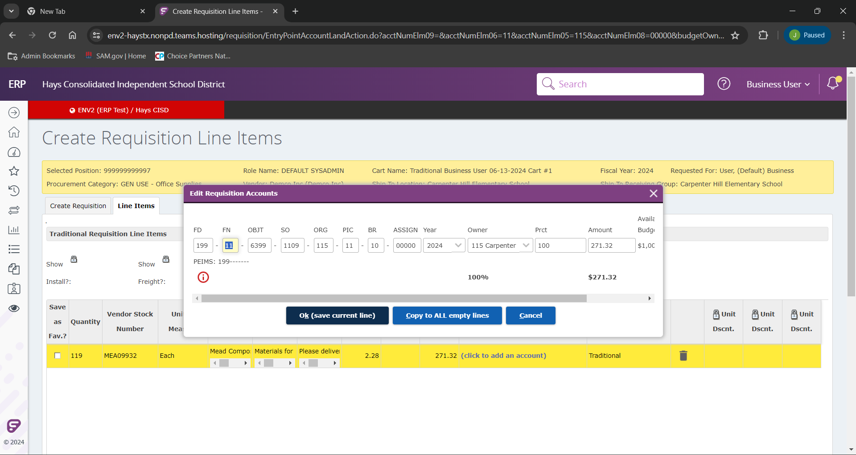
We can now see the budget line has been completed.
As we verify the budget line is correct, click “Ok (save current line)” to add the budget code to the line we are creating.

Slide 28
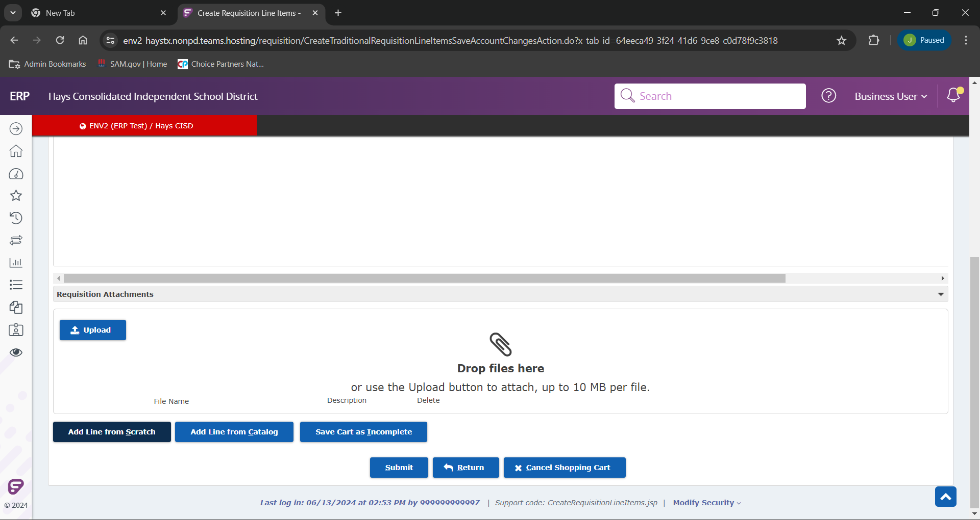
To add an additional line scroll to the bottom of the page and click “Add Line from Scratch”.

Slide 29
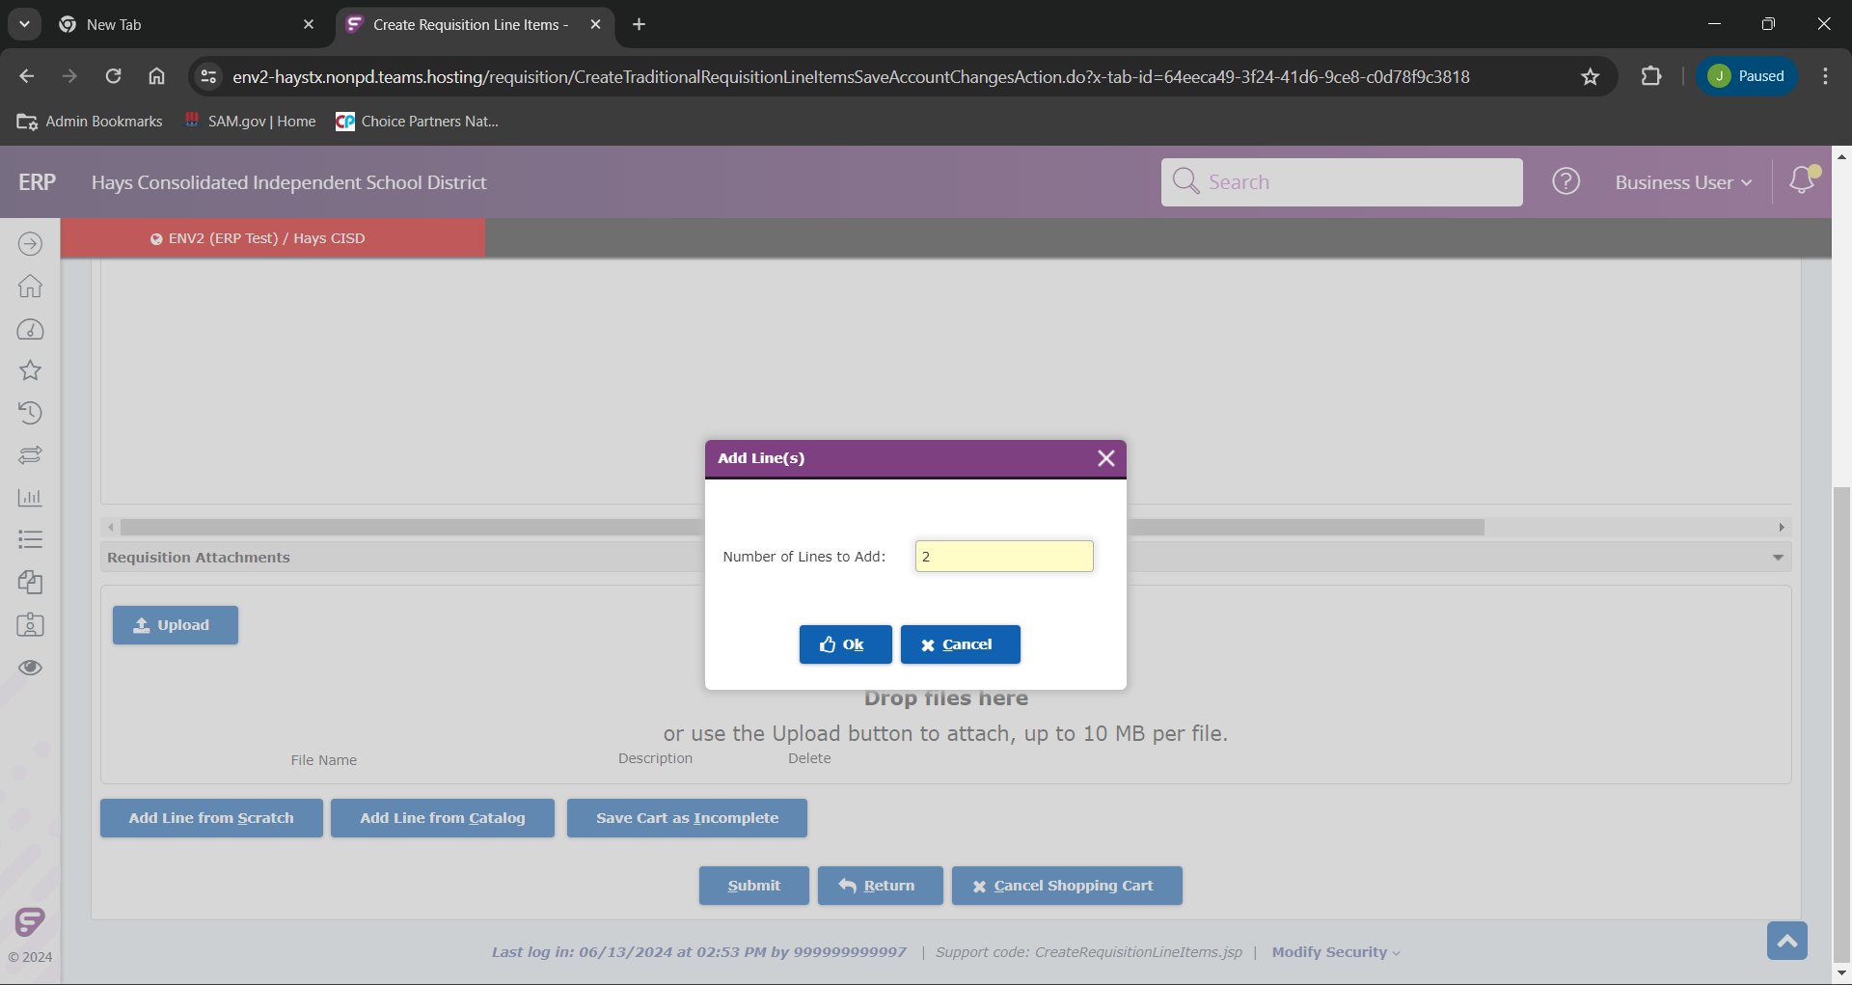
This will prompt us to enter the number of additional lines we want to add, and cook “Ok”.

Slide 30
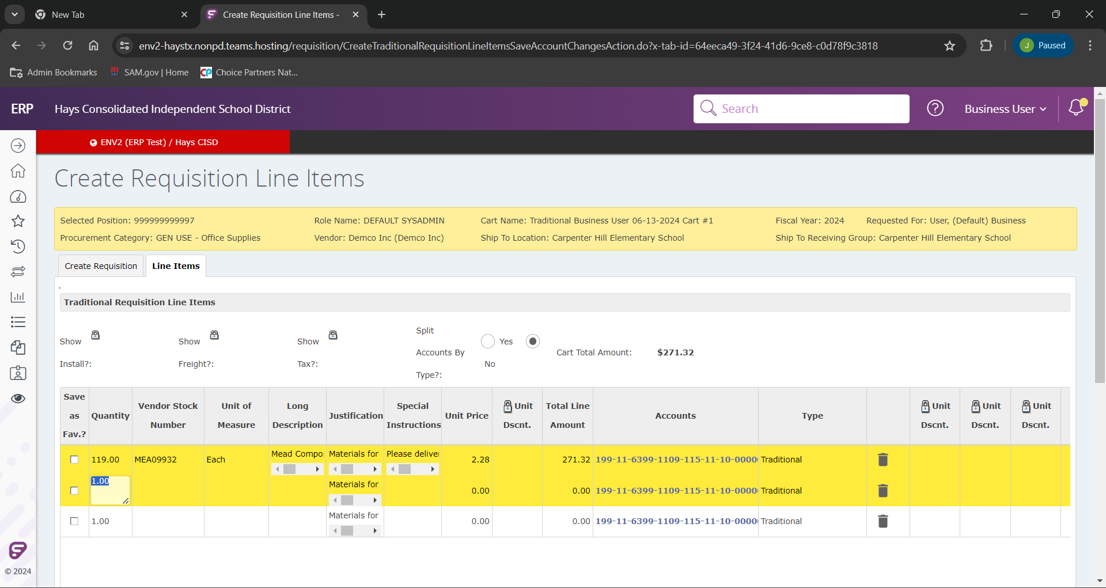
Note: If you entered a justification and budget line on your first line, it will auto-populate in the newly added lines.

Slide 31
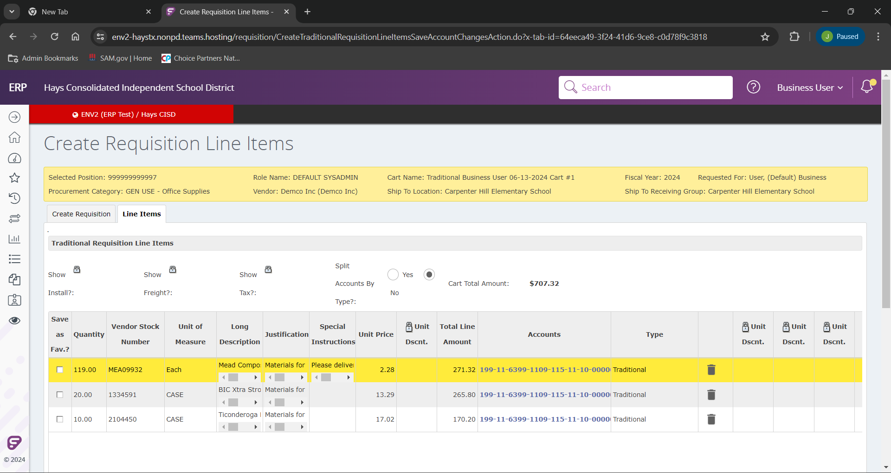
Please fill out the other lines following the prompt provided.

Slide 32
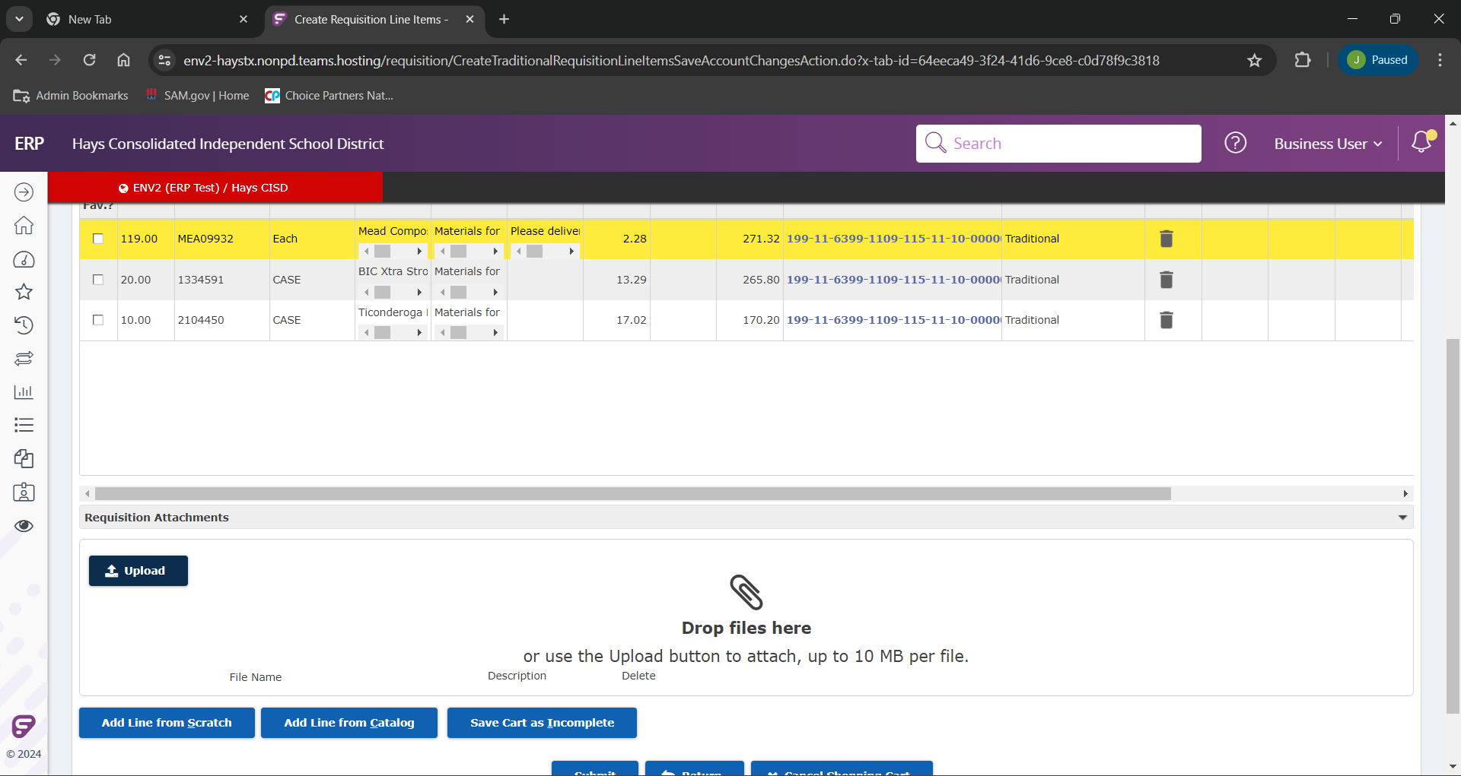
We now upload an our attachment by clicking “Upload”.
This will be a mandatory requirement. The system is set up to auto reject any requisitions without attachments, and they will return to your work queue.

Slide 33
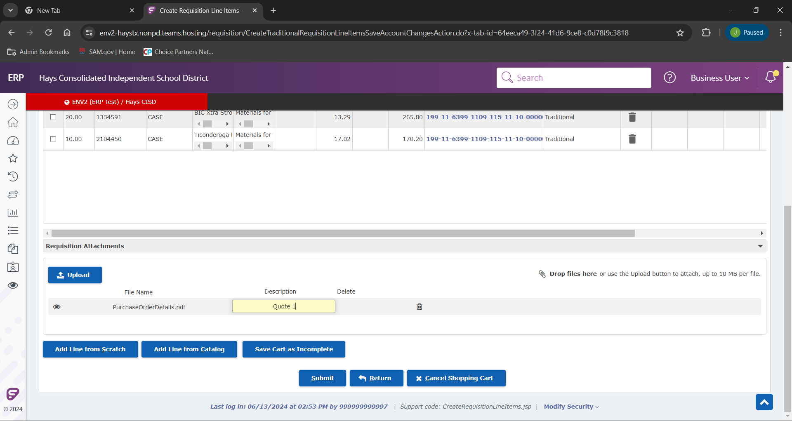
From here, if we need to add items, change budget, add additional supporting documents, or any other changes we can “Save Cart as Incomplete” to save for later corrections. Requisitions cannot be saved until all information is submitted. If you attempt to save with missing information it will give an error message and all work will be lost.
If everything is ready we can “Submit”.

Slide 34
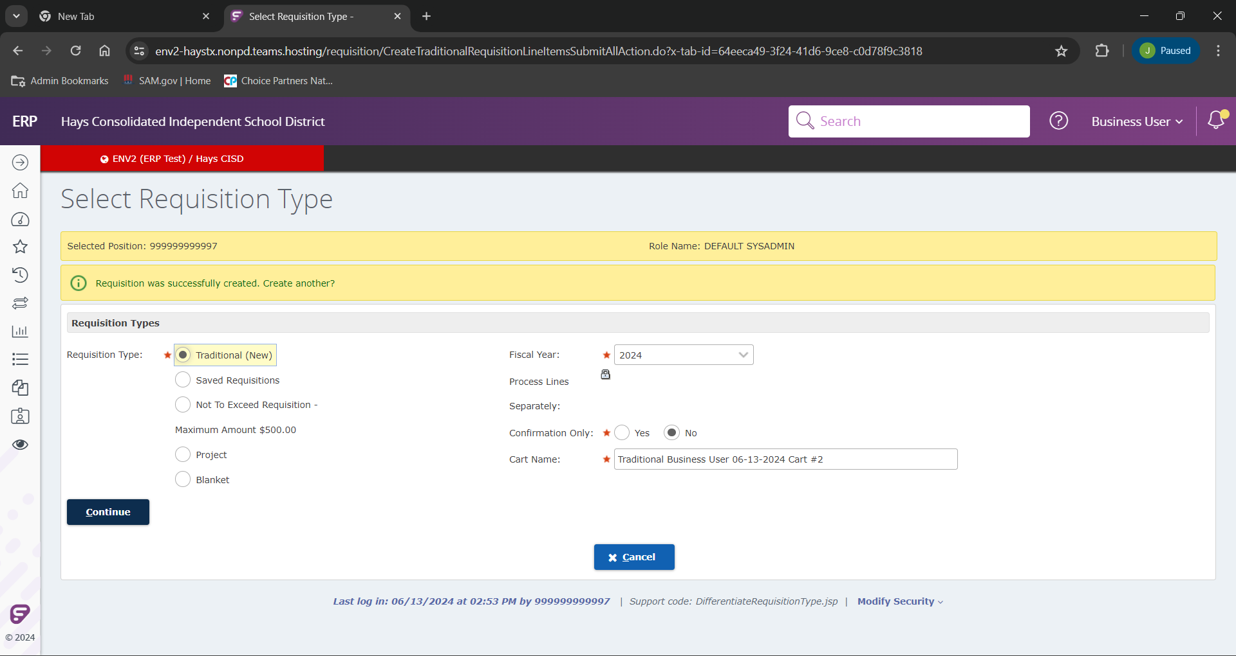
If we did everything correctly, we will see the above message.

Slide 35
If you have any further questions please reach out to any of the purchasing team listed on the cover, or email the entire team at purchasingdept@hayscisd.net

